Slide 1
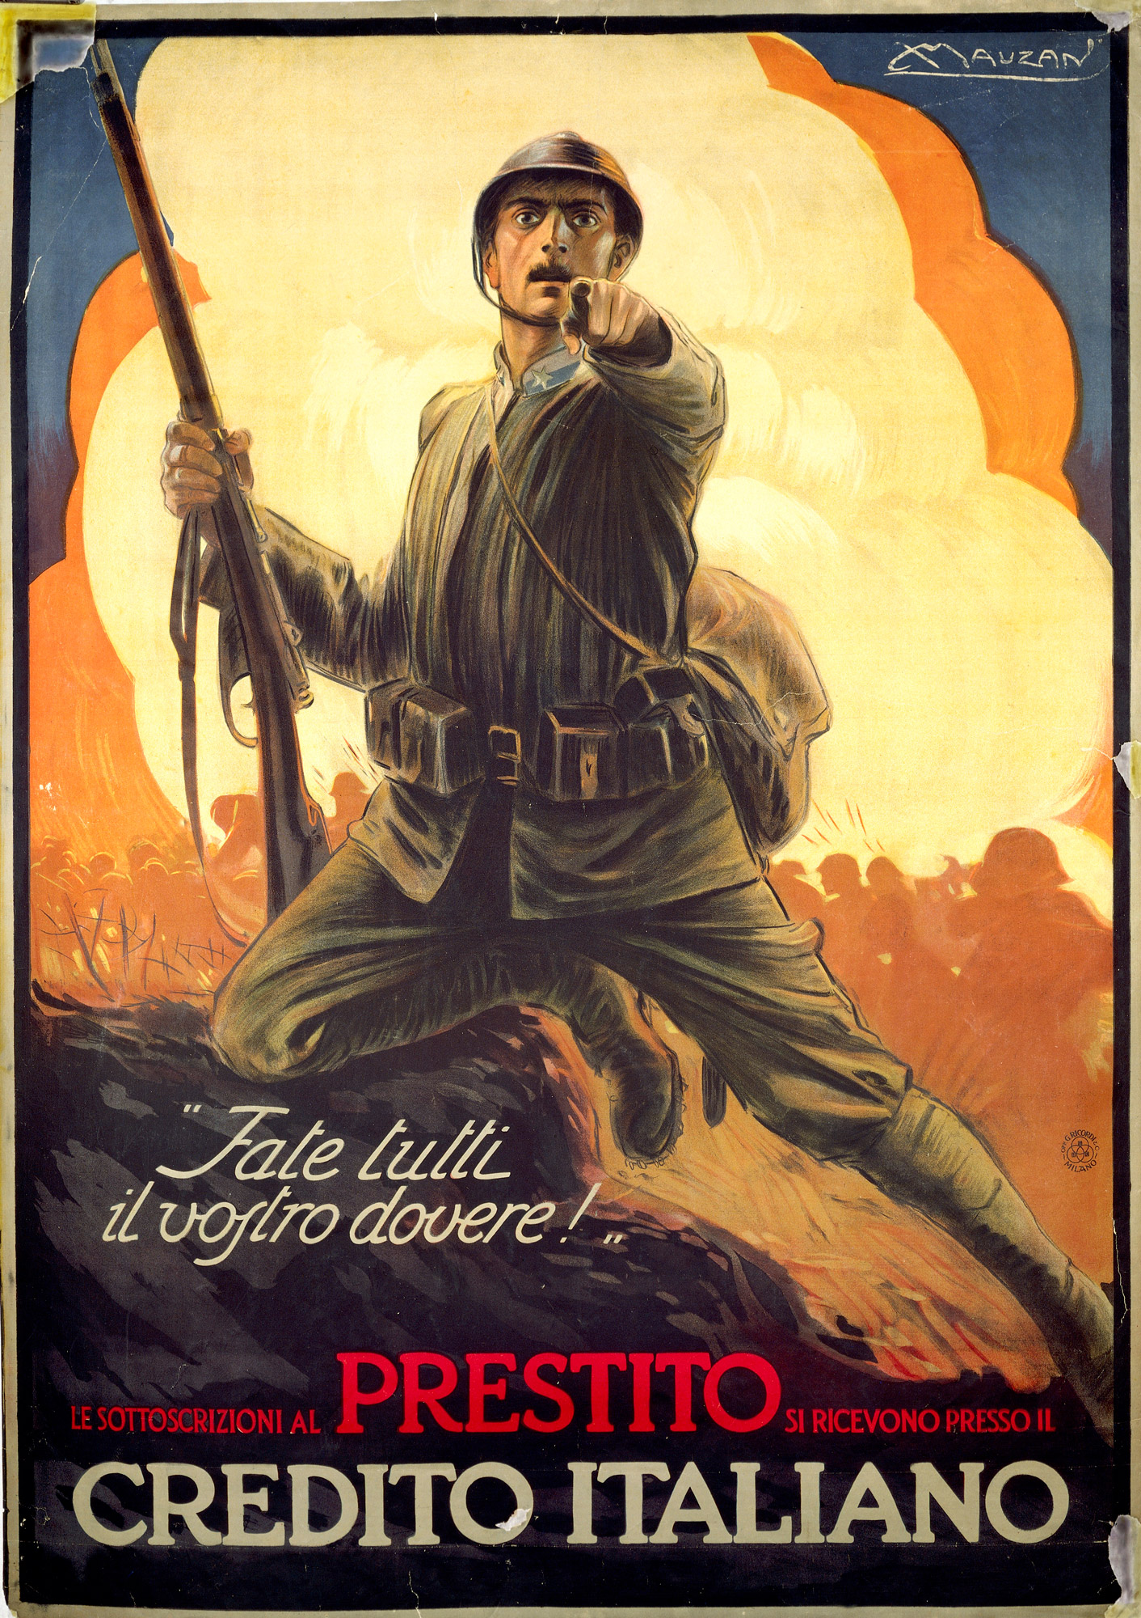
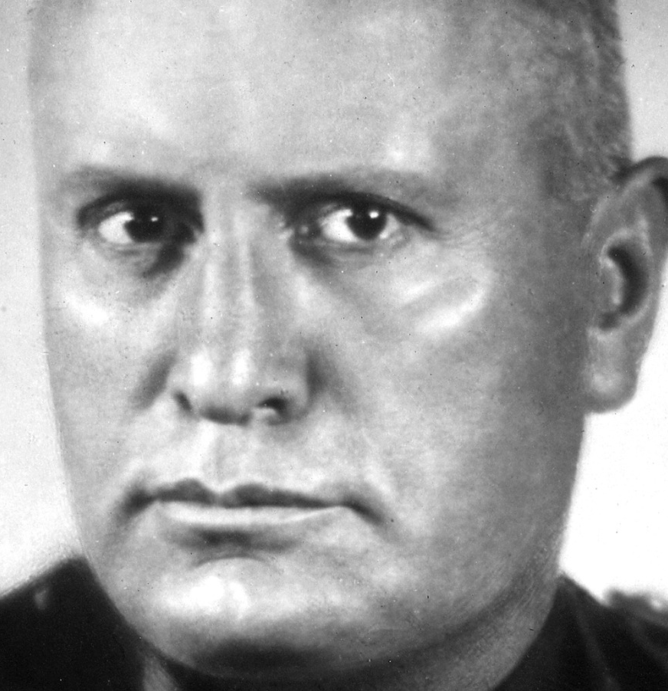
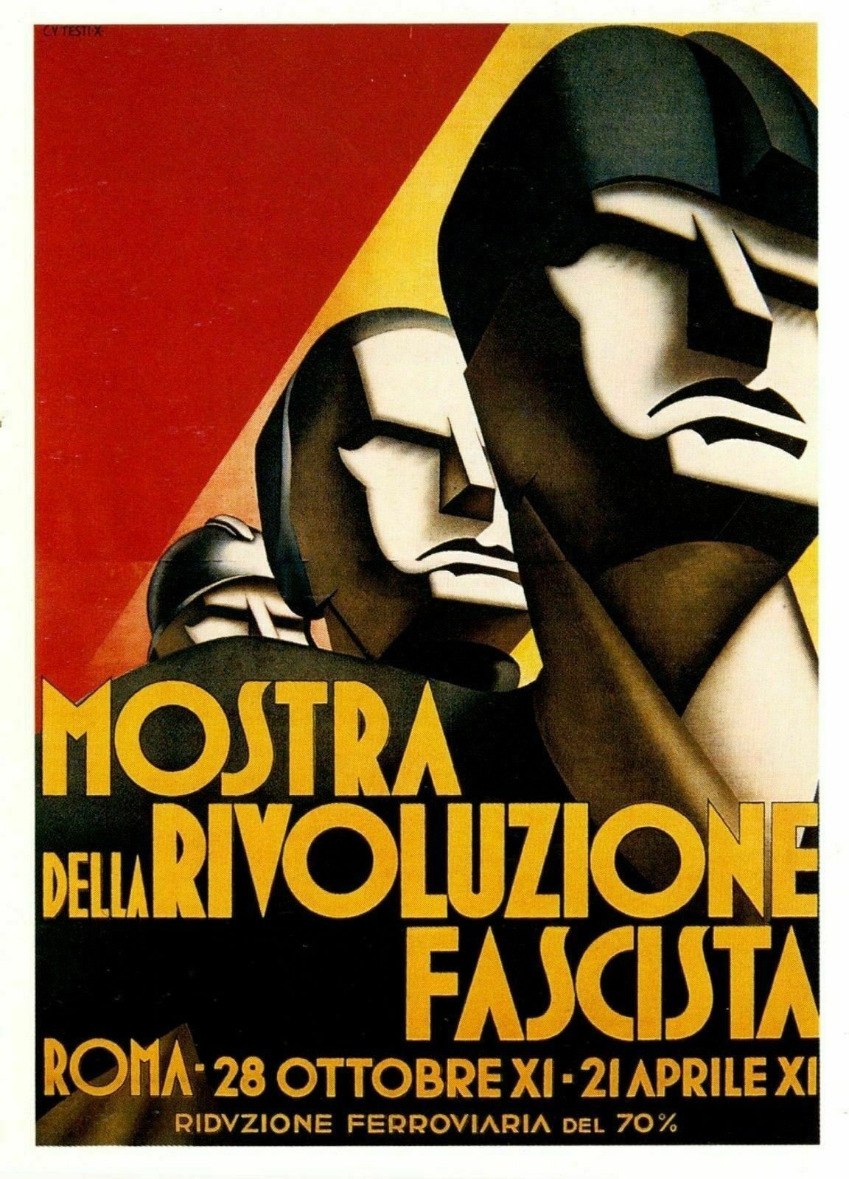

Slide 2
Navigation and action buttons
Click to return to the main menu.
Click this symbol on pages to ensure you follow the correct navigation path of the PowerPoint.
Click this symbol on pages to connect to external videos or websites.
Content locked or in development – available for full site pass holders – access here.
Click this PDF symbol to access the supporting student resources, PowerPoint and worksheets.

Slide 3
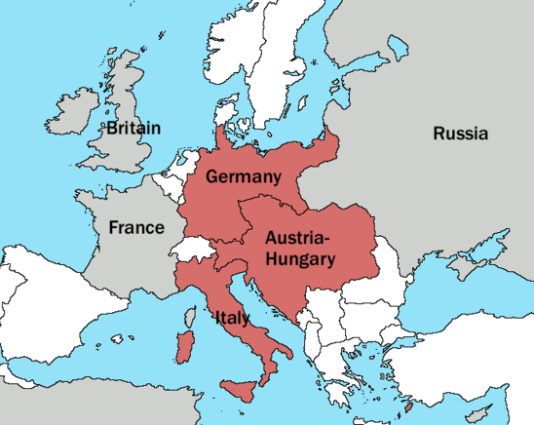
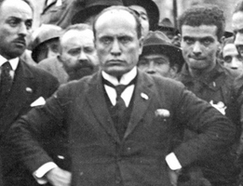
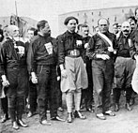
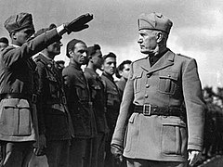
Click on each image to find out more

Slide 4
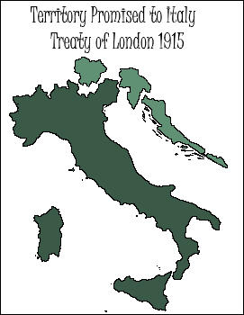
Italy (1861- 1919 )
- Was once the greatest empire in the world - Roman Empire. - Home of Renaissance - ideas, culture, arts. - Only unified in 1861 - Cavour and Garibaldi. - Largely divided after unification – Risorgimento incomplete. - Period c1861 - 1921 = ‘Liberal Italy.’
- Policy of ( Giolitti ) = Trasformismo – unite more central parties + ideologies to ensure extreme parties did not gain power. - Italy signed the Treaty of London, to switch to Entente in 1915. - Italians = significant losses in WW1 – e.g Battle of Caporetto - 1917. - 5 million Italians conscripted to fight in WW1. - Many – RW felt betrayed by the settlements of WW1 – ‘mutilated victory’ - 5 million Italians conscripted to fight in WW1.

Slide 5
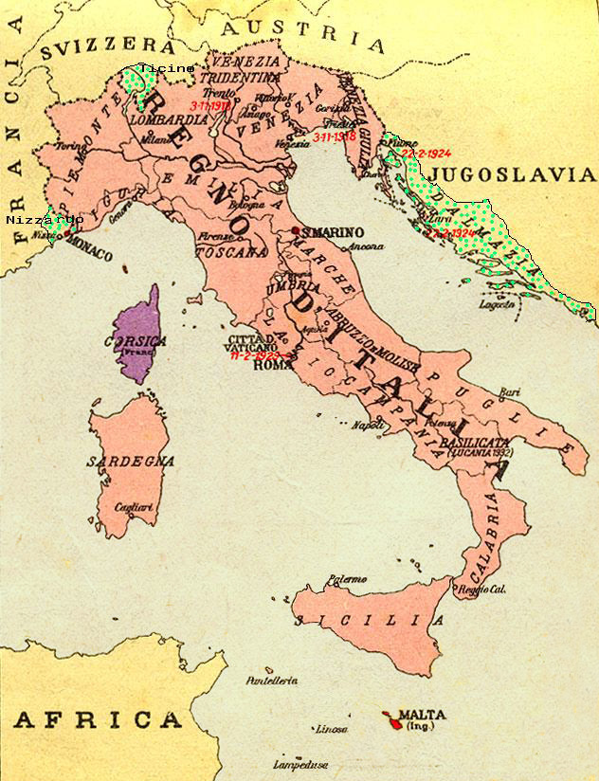

Slide 7
Highlight statements you think link to fascism
List / Write Correct Features
1 - Left Wing | 14 - Right Wing
2 - Flexible ideology | 15 - One party state
3 - Nationalism | 16 - Survival of the fittest
4 - Rich control society | 17 - Class war needed
5 - ‘‘Ideas and logic’’ | 18 - Fixed ideology
6 - Anti - immigrant | 19 - Power by any means
7 - Isolationist nature | 20 - Pro trade unions
8 - Superior race | 21 – Against - pacifist
9 - Embraces violence | 22 - Multi – Party Democracy
10 - Means ‘group’ | 23 – ‘‘action and mood’’
11 - Imperialistic nature | 24 -Rule of strong majority
12 - The State is absolute | 25 - Anti – Marxist
13 - Pro Liberal | 26 - Support of elites
Write a Definition

Slide 8
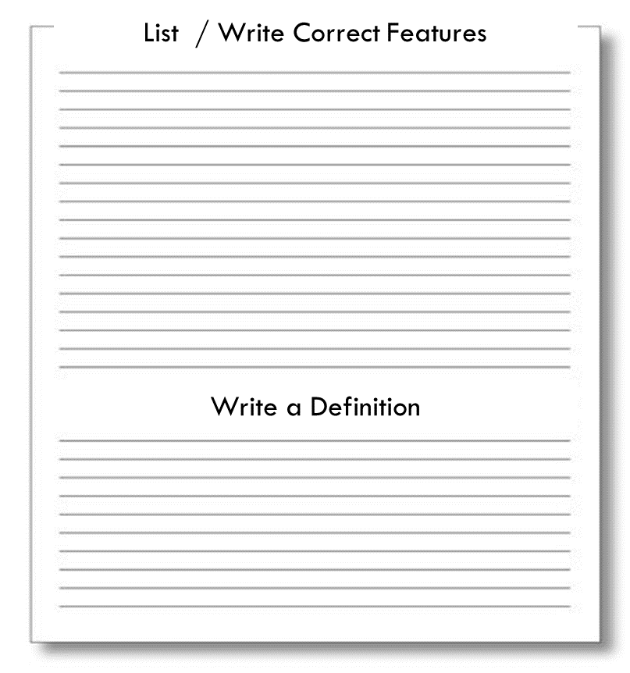
Features of Fascism
Left Wing | Right Wing
Flexible ideology | One party state
Nationalism | Survival of the fittest
Rich control society | Class war needed
‘Ideas and logic’ | Fixed ideology
Anti – immigrant | Power by any means
Isolationist nature | Pro trade unions
Superior Race | For pacifism
Embraces violence | Multi – party democracy
Means ‘group’ | ‘action and mood’
Imperialistic nature | Rule of strong majority
The State is absolute | Anti – Marxist
Pro - Liberal | Support of elites

Slide 9
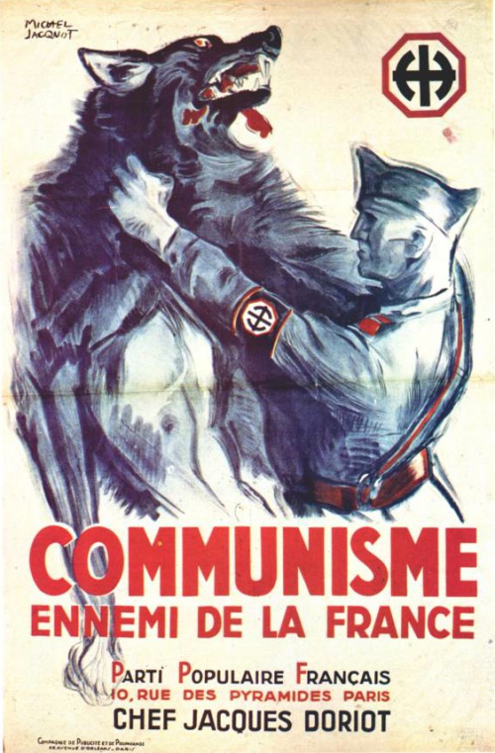
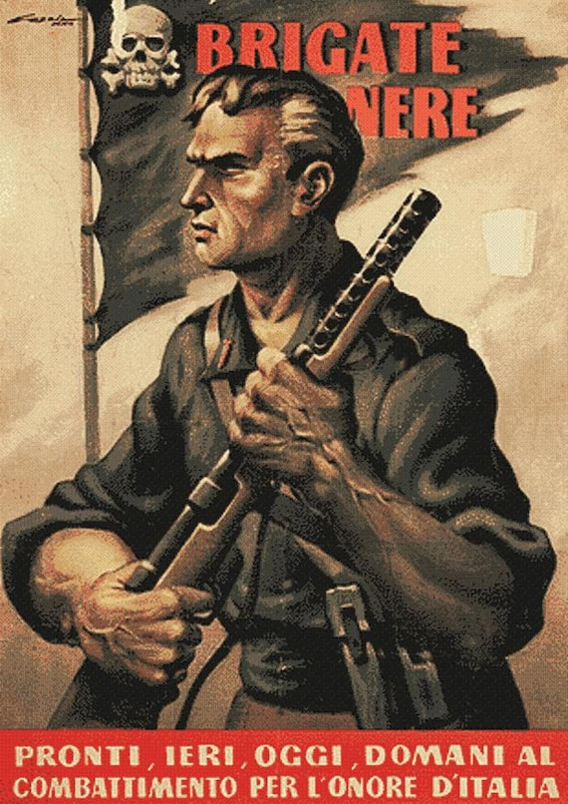
The Doctrine of Fascism - 1932 Giovanni Gentile + Benito Mussolini.
‘Fascism is the precise negation of that doctrine which formed the basis of the so – called Marxian Socialism. After Socialism, Fascism attacks the whole complex of democratic ideologies. Fascism denies that the majority, through the mere fact of being a majority, can rule human societies. It denies that this majority can govern by means of periodical consultation. Fascism is definitely and absolutely opposed to the doctrines of liberalism, both in the political and economic sphere.’
Fascism is Pro - For
Fascism is Anti - Against

Slide 10
An ‘incubation period’ developed since the late 19th century until the First World War. Anti - liberal ( weak government ) Anti - capitalism
Anti - big business ( industrial ) capitalists Anti - socialist / trade union ( organised labour ) movements. The viewpoint was that the above allowed the wealthy to manipulate politics. This harmed the ‘small man’ and the greater nation. Led to a form of ‘reactionary ultra- nationalism’ and calls for a return to imperialism, and yearning for Italy’s glorious past. Main group – Italian Nationalist Association pre WW1. Growth in support from conservatives, upper / middle classes, shopkeepers and farmers - afraid of growth of socialism.

Slide 11
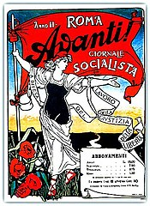
In 1911, Benito Mussolini was a member of the Socialist Party. He was arrested for attempting to provoke an insurrection against the liberal government – for its war in Libya. Anti – War Anti – Catholic Church Anti – Liberal Government Pro – Violence to overthrow the government 1912 – Mussolini became editor of Socialist newspaper Avanti in Milan. A well red newspaper ☹ . Syndicalism = Marxists socialist idea / theory to unionise workers and gain control of means of production + government via general strikes. Note – Mussolini not considered a Marxist.

Slide 12
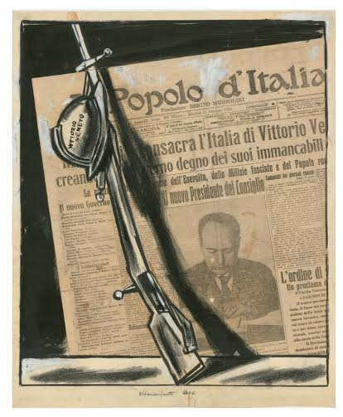
During the First World War, Mussolini would make a ‘dramatic, political U-turn.’ The Socialist Party stood in opposition to the war, however, Mussolini was influenced by members of syndicalists and republicans groups who were in favour if Italian entry. Mussolini shifted from his anti-war stance and to more extreme nationalism. BM = Involved with the setting up of Fascio Rivoluzionario d Azione Internazionalista – Revolutionary Group of International Action. 1914 – he was fired from Avanti and set up his own paper – Il Popolo D’ Italia or The People of Italy. His paper received backing from some wealthy Italian companies ( capitalists ) such as Fiat who would gain from lucrative war contracts. Mussolini was expelled from the Socialist Party in 1914.

Slide 13
Click on slide to move statements
Mussolini fought in WW1
Mussolini volunteered to fight in WW1
He won a medal and became a general
Mussolini was injured in a training exercise
He wrote his ‘Manifesto for a Nation’
He wrote that a dictator should take over
He was kicked out the PSI - Socialist Party
True | False

Slide 14
In 1919 Mussolini and other founding members set up the Fascists of the First Hour – ( Fascio di Combattimento ) in Milan. 70 other fasci groups were soon established across northern and central Italy. An ‘incoherent mix’ of left and right wing policies - to appeal to broad spectrum. ( Throwing spaghetti against a wall ) National Syndicalism = republican, socialist and anti – clerical (church) Technocratic Fascism = embracing modernisation + industrialisation ( Futurists )
Rural Fascism = anti – urban, industrialisation and anti – modern. Conservative Fascism = pro tradition, monarchy and Catholic Church National Fascism = authoritarian and imperialistic – irredentism.

Slide 15
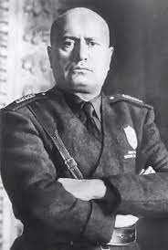
‘We allow ourselves the luxury of being aristocrats and democrats; conservatives and progressives, reactionaries and revolutionaries, legalitarians ( equality for all ) and illegalitarians according to the circumstances of the time.’ Benito Mussolini – commenting on fascist ideology in 1919.

Slide 16
Following poor performance in 1919 ( regional ) elections – Mussolini began to shed the more radical aspects of their programme and reduce its ‘enemy list’ … a more focused programme. ‘Our programme is simple, we wish to govern Italy. They ask us for programmes but there are already too many. The crisis of the Liberal State has proved it … we must have a state that will simply say …’The State does not represent a party but the nation as a whole, it includes all, is over all, protects all.’ A state which does not fall under the power of the Socialists.’ Benito Mussolini – speech, 1922. Two enemies? Promoting fear of?

Slide 17
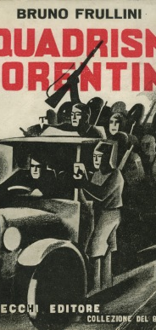
Following election in May 1921 - Mussolini and 34 fascists deputies from right wing of the movement elected. - Increasing their appeal to and support from conservatives.
- Controlling the ras – ( leaders of action groups called Squadrismo ) In October 1921 Mussolini set up the PNF – Fascist Nationalist Party. This has a clearer right – wing programme and appealed to capitalists backers. This was at the back end of the Bienno Rosso – Two Red Years – further frightened conservatives and made the PNF more appealing. PNF – also pushing for fascist violence ( using Squadrismo ) against enemy within. PNF – appeal to Catholic Church ( oppose divorce and support for peasants)

Slide 19
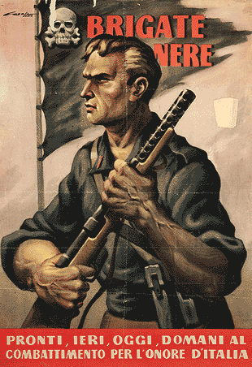
"And, however much violence may be deplored, it is evident that we, in order to make our ideas understood, must beat refractory ( stubborn ) skulls with resounding blows … we are violent because it is necessary to be so. All those acts of violence which figure in the papers must always have that character of the just retort and legitimate reprisal ( retaliation ). because we are the first to recognise that it is sad, after having to fight the enemy within ...and for this reason that which we are causing today is a revolution to break up the Bolshevik State, while waiting to settle our account with the Liberal Sate which remains." Mussolini speech extract to the fascists of Bologna, April 1921.

Slide 20
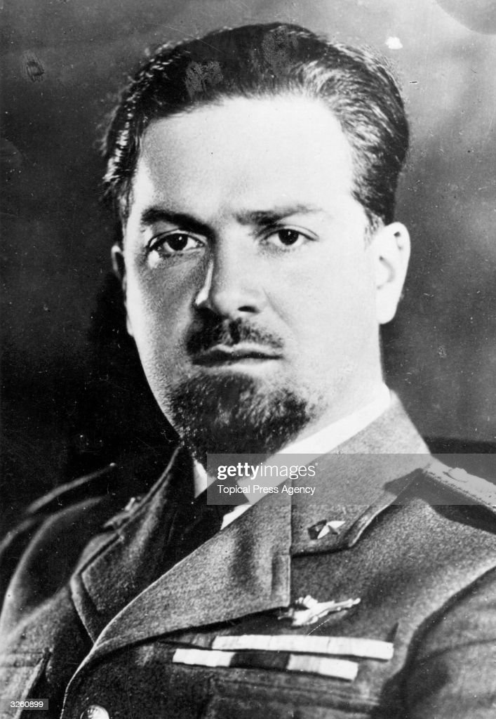

Slide 21
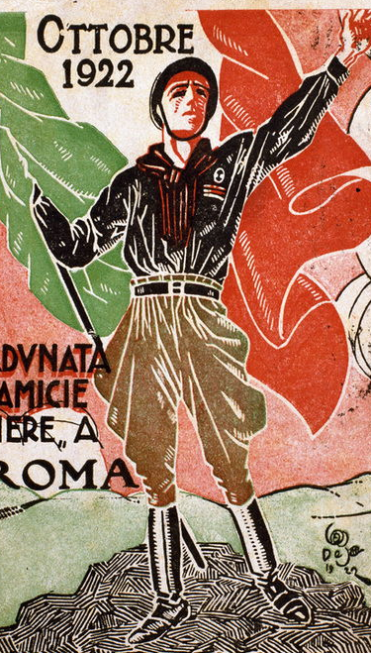
Italy in WW1
Fiume
March on Rome

Slide 22
Why
What
Impact
1920 - Giolitti returns as PM due to failure of current government.
Weakens Italian Liberal government. Increases support for fascism.
Black shirts, salutes and theatre of the fiasco inspired Mussolini.
Irredentism. Fiume a free state / port near Trieste.
To protest Fiume not having been given to Italy after WW1.
D’Annunzio a nationalist hero. Overshadows Mussolini in ST.
LT – Fiume would be annexed by Mussolini in 1924.
Nationalist Poet D'Annunzio + 2000 troops occupy Fiume.
Battleship ‘Andrea Doria’ bombed D’Annunzio’s palace – he fled .
Click on slide to move statements
Fiume - 20 mins Great War

Slide 23
‘Support for this escapade ( fiasco) was obtained from many patriots who had no intention of honouring Orlando’s signature at Versailles. And D’Annunzio spoke for such people when in November (1919 ) he stated ‘’the Yugoslavs are excited by a savage spirit of domination and we cannot avoid perpetual quarrel with them’’ …. D’Annunzio’s ‘’Regency of Camaro’’ lasted over a year. Although it was a pretty ridiculous affair, its example was a dress rehearsal for fascism. The black shirts of the arditi were to be seen in Fiume as people shouted the future fascist ‘’A noi ( to us ) …eja,eja,alala.’’ = war cry. All this would later be copied by Mussolini without acknowledgment.’ British Historian, Denis Mack Smith. Modern Italy – A political history ( 1997)

Slide 24
Why
What
Impact
Complete / develop chart option / add from previous source?

Slide 25
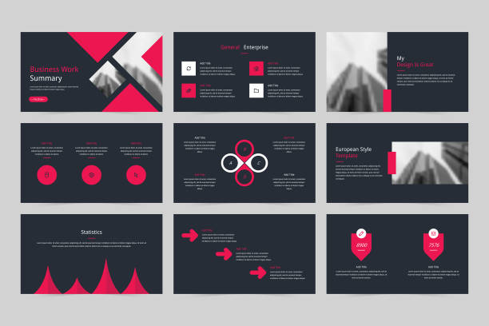
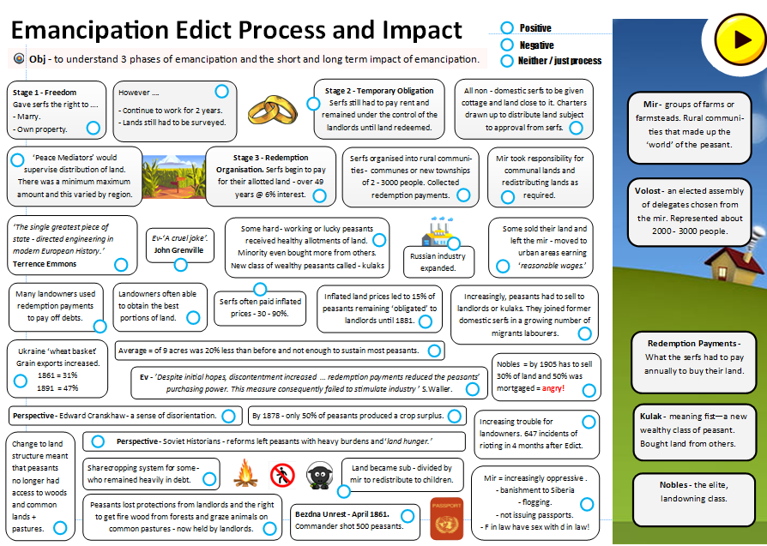
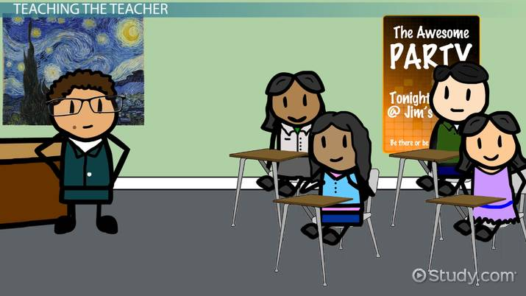
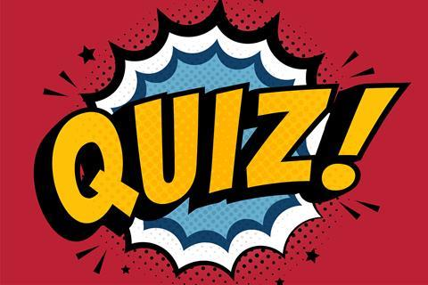
Choose one of the methods - right - to cover, teach, present or deliver. The … why + what happened + impact of Mussolini's March on Rome. Make it shareable. Taught Presented Hyperlinked ( hand written not easily shareable )
Presentation
Activity / Handout
Teach
Best
Resource
Digital Flashcards
Video
Website
Summary Notes

Slide 26
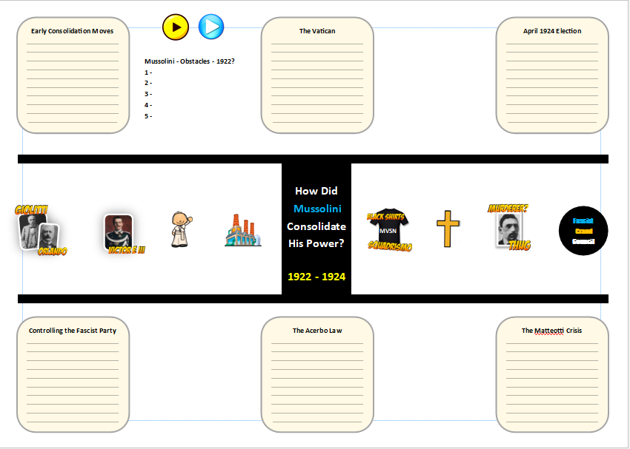
Starter – consider 5 things that stood in Mussolini way once he became prime minister in 1922. Task – complete a summary in the light yellow spaces. Add – notes to the images showing the role these people, groups etc played during this time. Ex PM – King – Pope Pius XI – Industrialists – MVSN – Popalari – Amerigo Dumini – Fascist Grand Council.

Slide 27
Establishment of Mussolini's Dictatorship 1925 – 29 January 3rd, 1925 - Speech to the Council of Deputies. Mussolini denies having set up the Ceka and condemns the actions of Dumini and his gangs. But, he accepts responsibility as leader of the PNF. Would not resign and rule by force if necessary. ‘’Italians want peace and quiet, and to get to work … I shall give all these, if possible in live, but if necessary by force.’’ What might the Mussolini be implying here? February 1925 - Farincacci and Squadristi purge – ( Mussolini ill at this time ) A new wave of squadristi violence led by Roberto Farniacci the ‘notorious ras of Cremona’. Attacks on socialists, communists as well as more extreme and questionable member of the Popolari amd PNF. What might the significance of this be? July to December 1925 - Control of the Press. New laws introduced that allowed for anti – fascists newspapers to be closed. Other newspaper only allowed to print articles with approval from government. Journalists required to be registered by fascists. August 1925 - Control of Local Government – The Podesta. In 93 Italian provinces mayors and other council officials were replaced by podesta – all member of the PNF and mostly from the landowning and military elites. Note that militant fascists were excluded. Significance / reasons for excluding militants ?

Slide 28
December 1925 - Control of Central Government = Head of Government Mussolini gives himself – new title = ‘head of government’. Removed power of Chamber of Deputies and assumed power directly over ministers. 1926 - 1929 – Control of Central Government - Il Duce. Gave himself power to issues decrees without approval from government. King must get approval from Mussolini on any appointments. Insists on being called Il Duce. By 1929 hold 8 ministerial posts himself - in reality were run by civil servants. What might the significance / reasons for him assuming these titles without actively running them be? October 1926 – One Party State Following a failed assassination attempt Mussolini banned all other parties aside from the PNF. All non fascists deputies were expelled from the Chamber – trade unions also banned. 1927 to 1928 – Forming a Police State – OVRA = Secret Police. Laws made political offences punishable by death. OVRA – Organisation for Vigilance + Repression of Anti – Fascism. May 1928 – Rigged Elections Only men aged over 21 who belonged to fascists syndicates ( groups / organisations ) allowed to vote. Fascists Grand Council drew up a list of acceptable candidates in conjunction with confederation of employers. Polling stations in weak areas removed – fascists officials monitored those who voted ‘no’. By 1929 – Mussolini established as dictator of Italy. Chamber of Deputies = 100% fascist. Power of king significantly weakened – why not remove him totally?

