Slide 1
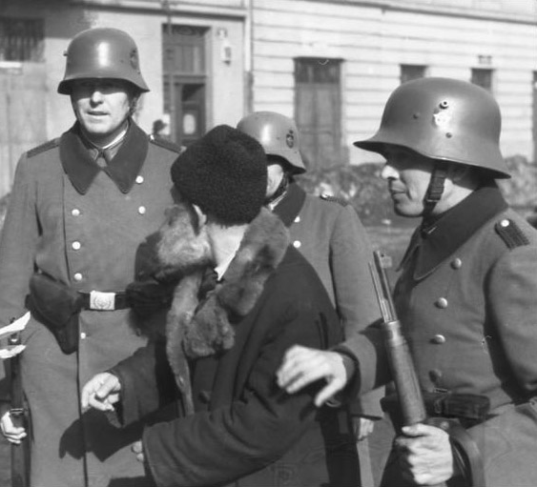

Slide 2
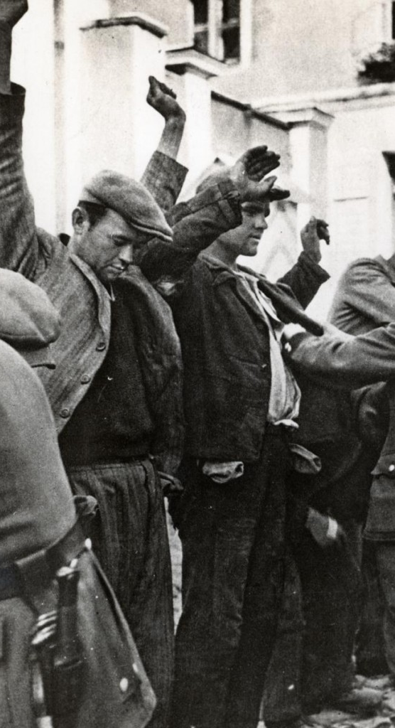
Key Question
Arrest
Trial
Punishment

Slide 3
Why Were The Nazis Able To Deal With Opponents So Effectively?
The short answer is through FEAR through the creation an authoritarian, POLICE STATE. To develop the answer think … ATP - Arrest - Trial - Punishment

Slide 4
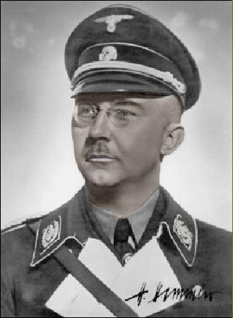
Arrest - The SS
The SS was created in 1925. It was led by Heinrich Himmler. The SS were the fanatic, loyal Nazi soldiers. They would be used to intimidate, beat up and arrest any opposition. The SS was split into 3 areas…
1: The SS was Hitler’s private army 2: Waffen SS fought with the regular army
3: Death’s Head Units ran concentration camps
ORPO ( Ordnungspolizei )
The ORPO was the standard police force and was also controlled by Himmler.

Slide 5
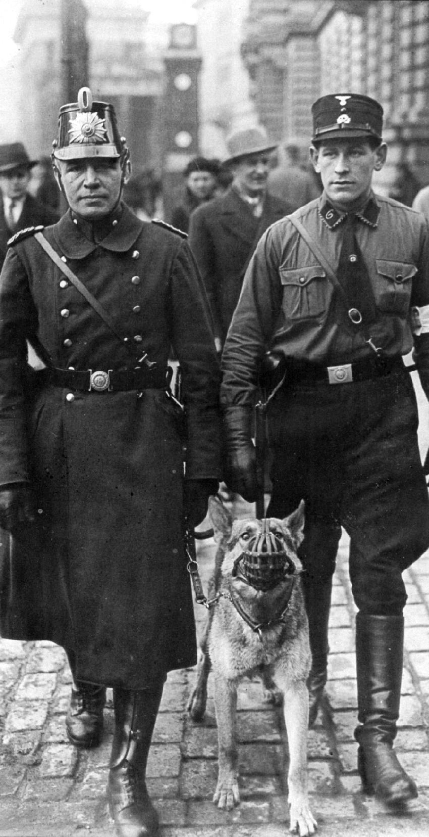
Arrest - Gestapo
The Gestapo were the Nazi Secret Police and were also led by Himmler. They tapped telephones and spied on people. They had informers who would tell on anyone who spoke against the Nazis. People were scared that their friends or neighbours might be Gestapo informers. This fear and paranoia was a very effective way to ensure that grumbling about Hitler and the Nazis was kept to behind closed doors!

Slide 6
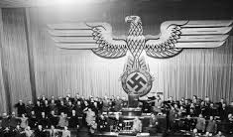
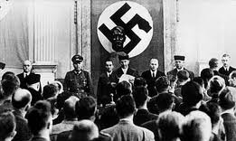
Trial
Once a person was arrested by the SS or Gestapo they were taken to court. The police, courts and judges had been taken over by the Nazis. Judges had to swear an oath of loyalty to Hitler. Those who refused were dismissed or worse. Therefore it very easy for the Nazis to put imprison even without any real evidence against them. As a result of the Enabling Law, Hitler was able to make any laws he wanted. He used this as a way to find excuses to imprison or kill off opponents. He even created a law that forbade the telling of anti-Nazi jokes.
Number of crimes punishable by death … 1933 = 3
1943 = 46

Slide 7
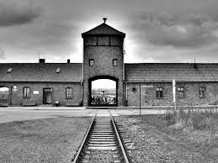
Punishment – Concentration Camps
Special camps were built to house the Nazi opponents or anyone who was not useful to the new German Reich. Most German people did not know for sure what happened in the camps but saw that most people taken there did not return. The fear of the unknown was a very powerful deterrent! Political opponents would be tortured for information and forced to do hard labour. Prisoners often they died of exhaustion, starvation or were executed. Later these became death camps used to kill people in gas chambers. One of the most infamous camps was Auschwitz in Poland

