Slide 1
Note: this presentation is most effective when music and slides are left to play automatically using the rehearsed timings option.

Slide 2
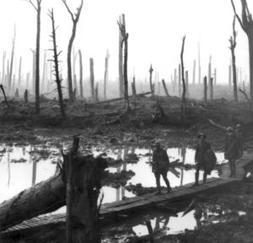

Slide 3
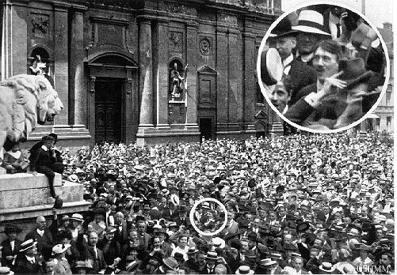
Home by Christmas..? Most people thought the war would be over very quickly and they would be home in just few months. However, they were wrong. Can you see a familiar face in this excited crowd in Vienna ?

Slide 4
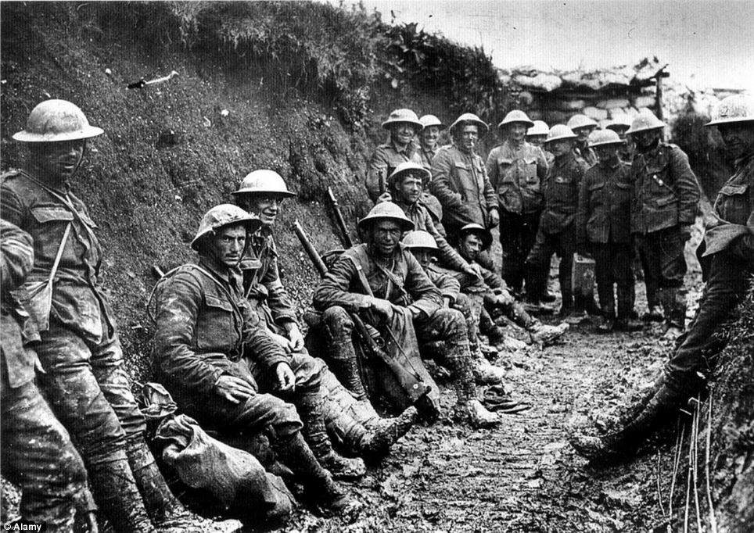

Slide 5
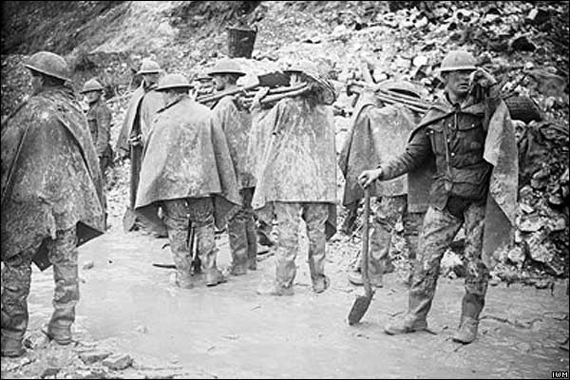
The spade as important as the gun.

Slide 6
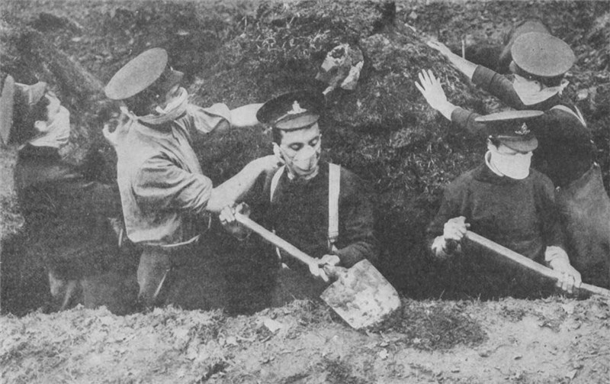

Slide 7
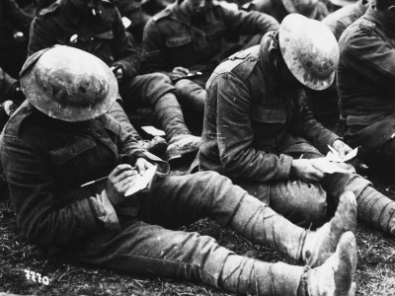

Slide 8
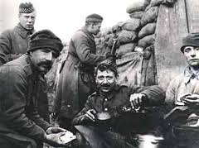

Slide 9
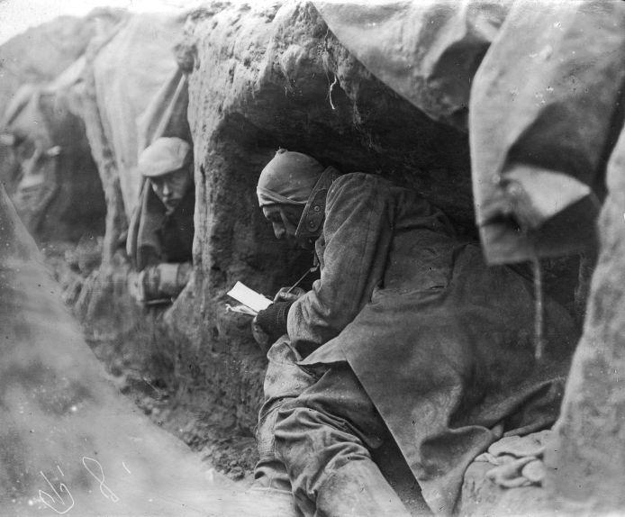

Slide 10
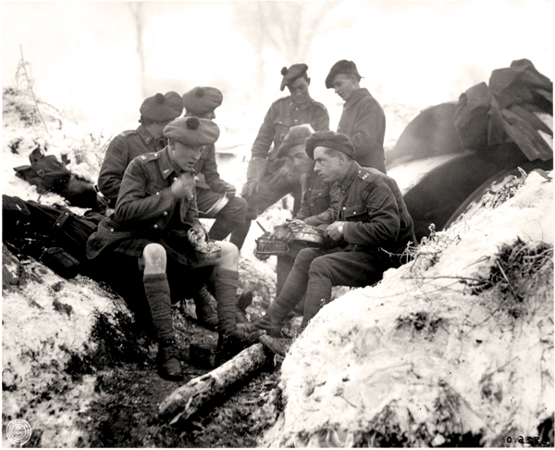

Slide 11
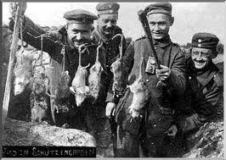

Slide 12
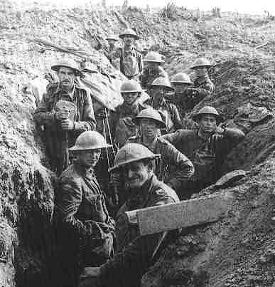

Slide 13
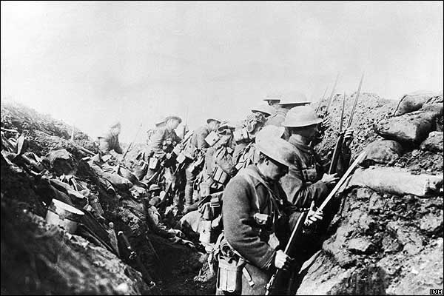
Fixing bayonets (knives) to rifles and getting ready to go ‘over the top’.
Many of these men will be dead in a few minutes.

Slide 14
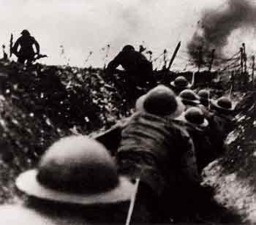
‘Over The Top’ . . . to face the machine guns.

Slide 15
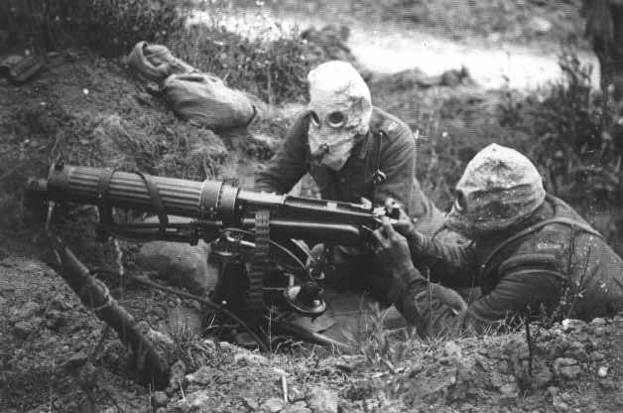

Slide 16
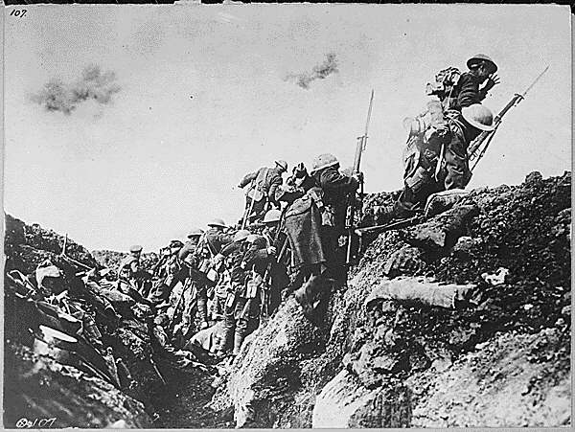
Soldiers who did not go ‘over the top’ would be shot by their own commanders.

Slide 17
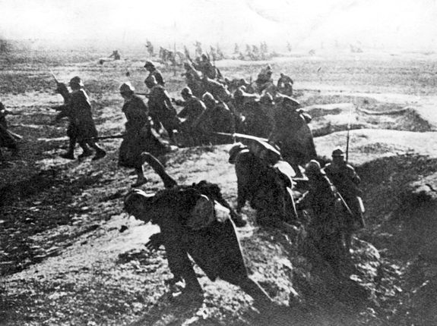
French soldiers go over the top.

Slide 18
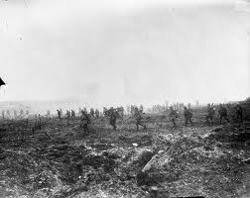

Slide 19
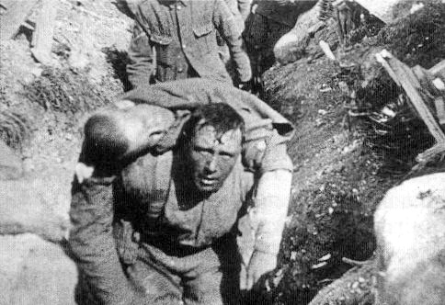

Slide 21
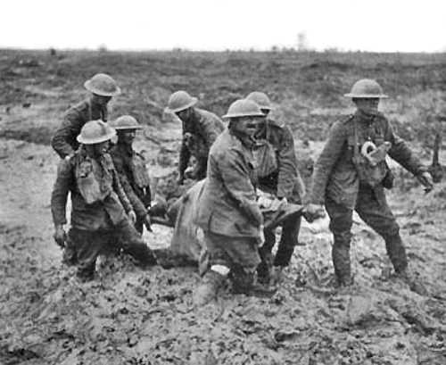

Slide 22
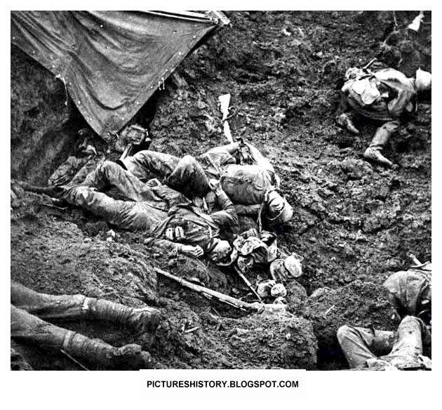

Slide 23
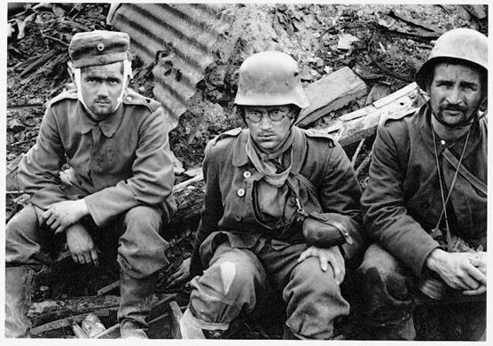

Slide 24
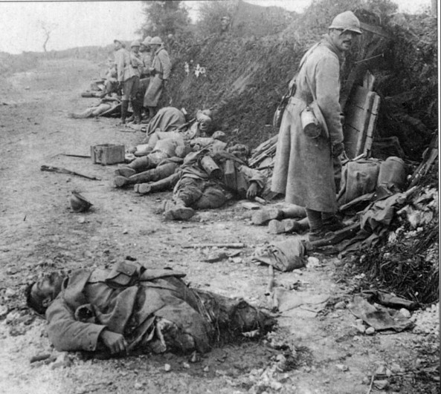

Slide 25
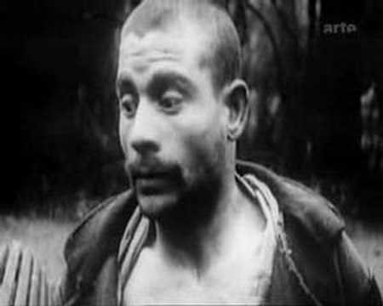
The terrible sights and experiences of war damaged
minds.
This was called Shell Shock.

Slide 26
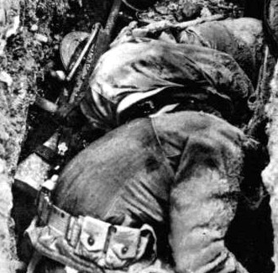

Slide 27
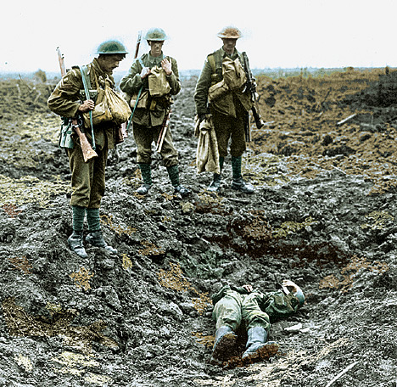

Slide 28
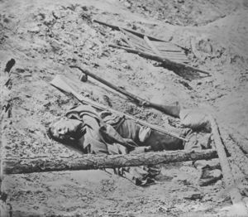

Slide 29
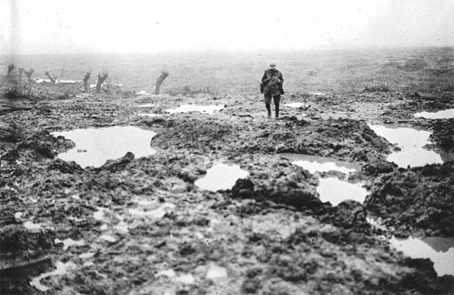
The last man in ‘No Man’s Land’

Slide 30
One Soldier’s Story
This German soldier fought in the very first battle of the war in 1914. He was awarded a medal for his bravery.
Even though he had been inured many times he fought in the war for 4 years
He was still alive on the last day of the war on November 11th, 1918.
When it was clear Germany would lose the war a ceasefire was agreed. The war would end at 11 am on the 11th of November.
Army generals were given this news at 6 am that morning. Amazingly some generals continued to attack until the last minute.
This man was killed at 10:39. Having survived 4 years of fighting he died needlessly with just 21 minutes of the war remaining. He was still wearing his medal.

Slide 31
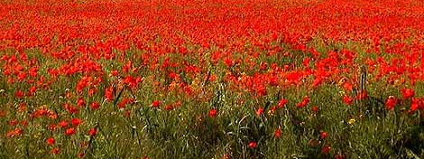
After the war ended one flower grew on the fields where so many died.
The poppy is worn by people on Remembrance Day. Buying a poppy helps the soldiers and their families affected by the war.

Slide 32
Thank you for watching This is a free to share resource
www.icHistory.com

