Slide 1
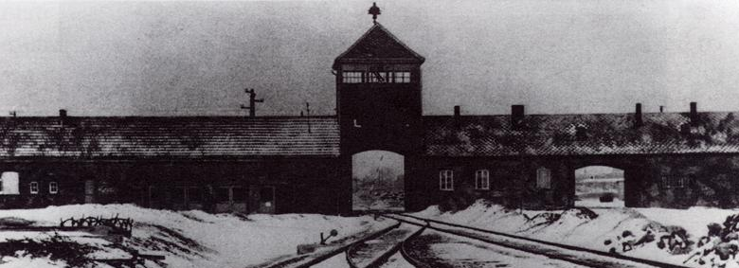
The Holocaust

Slide 2
Why ?
Process
Survivors
Doc + Film

Slide 3
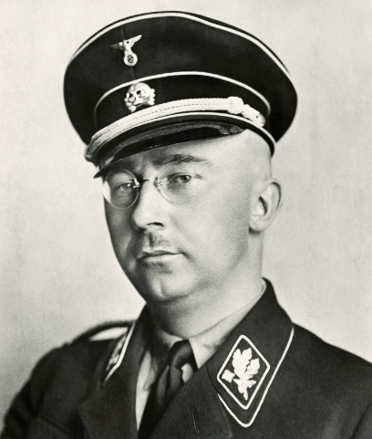
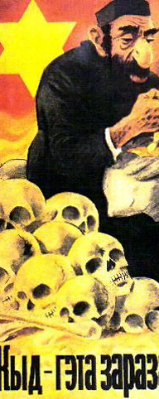
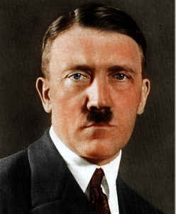
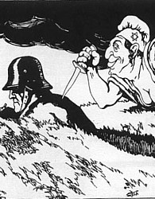
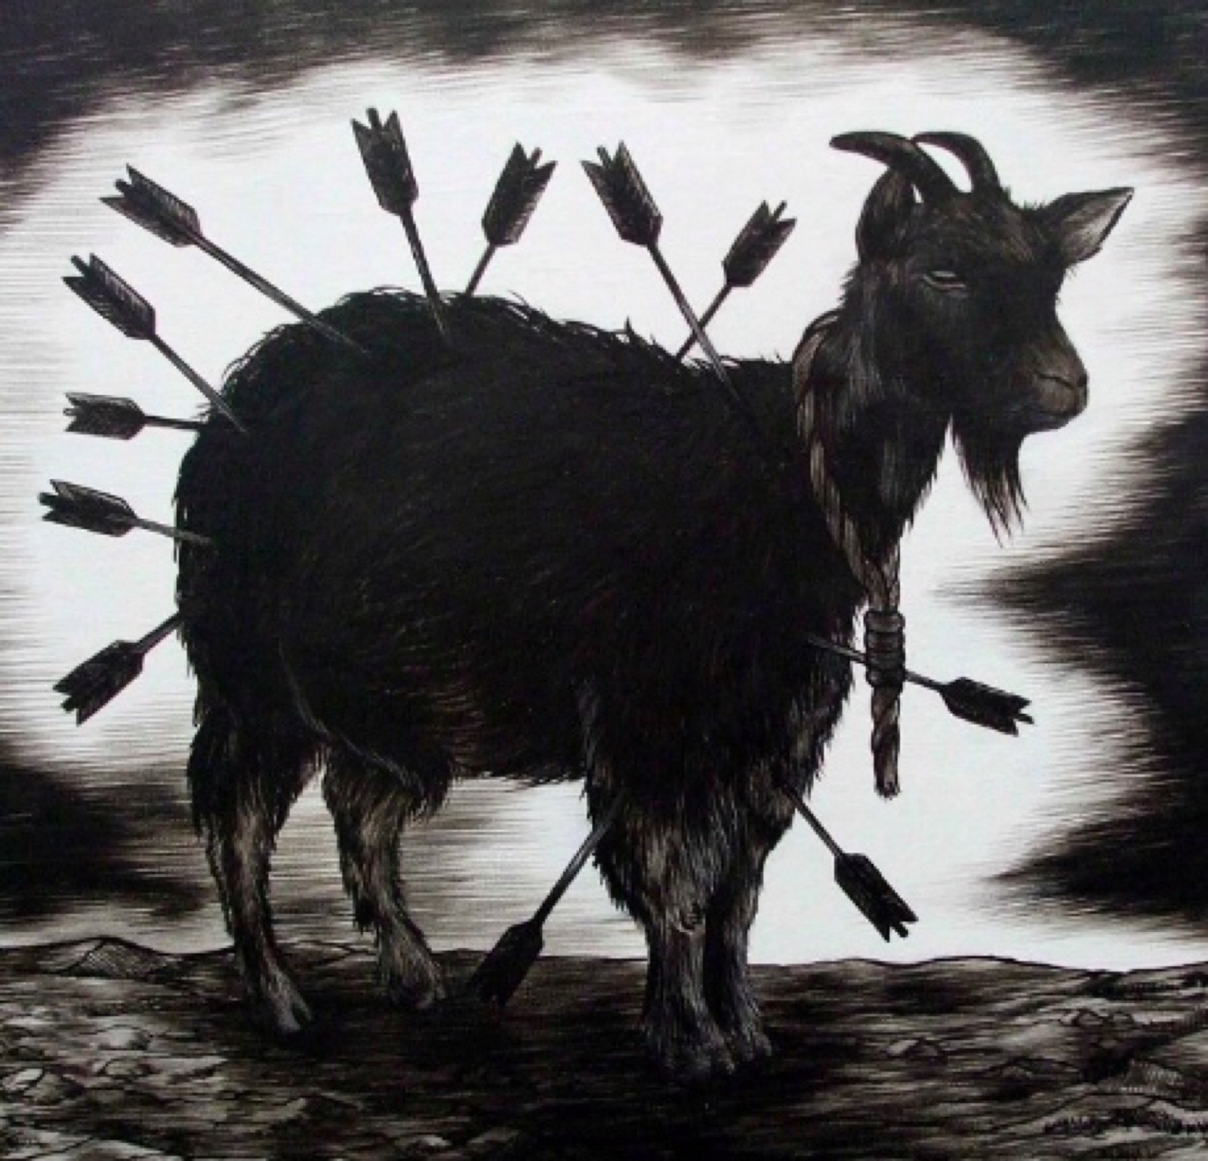
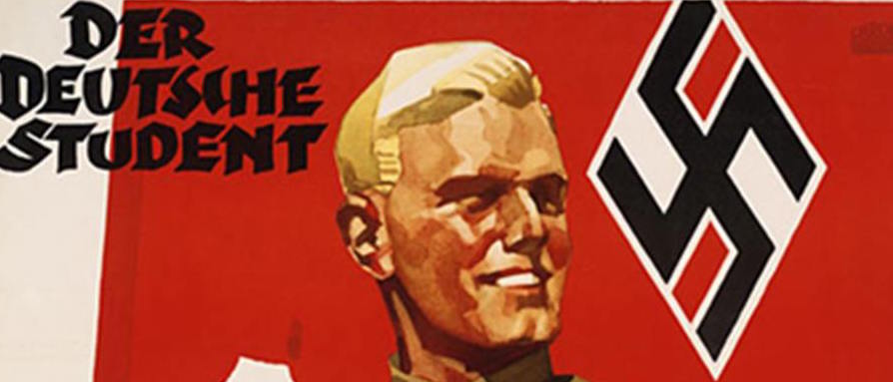
Reasons for the Holocaust
Starter: guess reasons for the Holocaust using images as clues. Click on each image for further information.

Slide 4
Hitler’s Experiences and Beliefs
Hitler’s early life was a hard one. He had an abusive father and his mother died of cancer when he was still a young man. It has been suggested that he blamed her Jewish doctor for her death. He also struggled in school and found life difficult once he left. Soon after he was homeless and sleeping on the streets of Vienna, Austria. Looking around he saw many Jews making a success of their lives. Hitler had hoped to become a famous artist but was rejected from art college. Again, he looked to blame Jews for his rejection due their influence in the arts and culture scene.

Slide 5
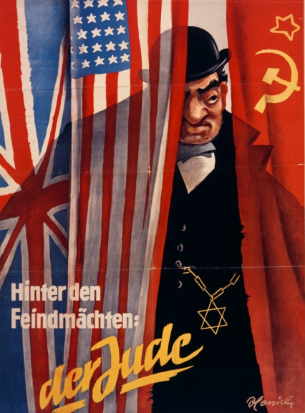
Historical Scapegoating
Throughout history Jewish people have been unfairly blamed for things they were not responsible for. This is called scapegoating.
For example, Jews were wrongly accused of poisoning weather wells and spreading the Black Death in the 14th century.
Jews have been stereotyped over the centuries as being greedy, untrustworthy and evil. Thus during times of hardship they were an easy target for blame.

Slide 6
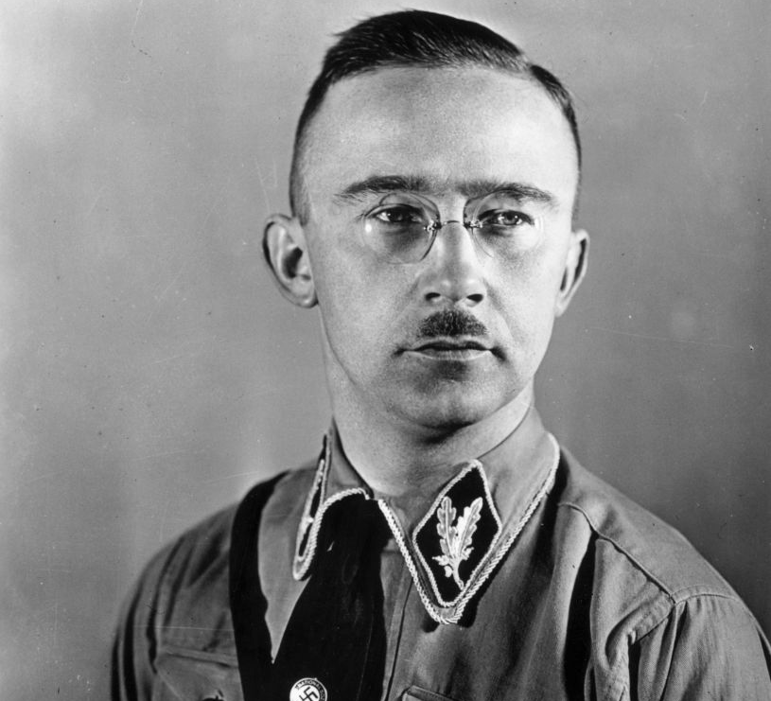
Leading Nazis
The Final Solution – the name given to the decision to rid Nazi controlled Europe of all Jews, was a policy that evolved over time. SS leader Heinrich Himmler was said to be a chief architect of the plan to solve the ‘Jewish question’.
Also, military leaders had expressed that the initial system of shooting Jews was wasting too much time ( and bullets ) as well as being a strain on the German soldiers. Thus, a more effective system of murder was needed.

Slide 7
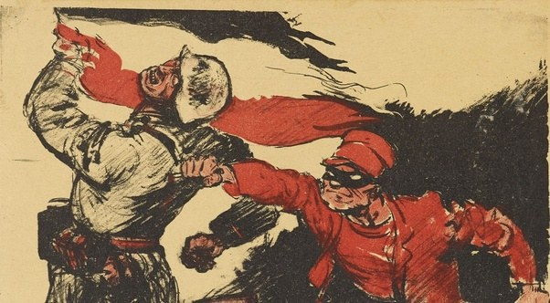
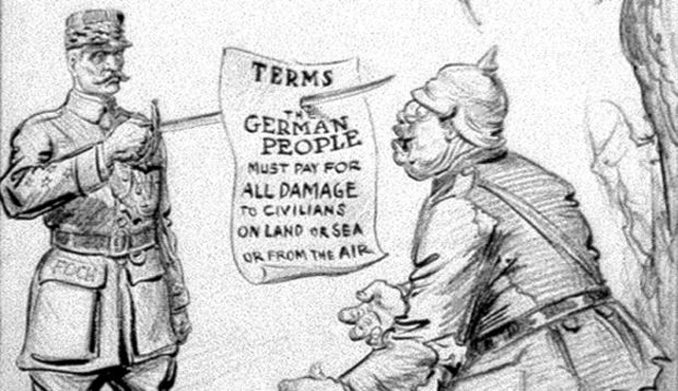
Impact of WW1
Losing the First World War was very humiliating for Germany. Most Germans were shocked by the news that they had surrendered as they had been told that the war was going well. Hitler like many others refused to believe the loss was their own doing and bought into the ‘stab in the back myth’. This was the view that Jews had been behind the decision to end the war and accept the punishment. Furthermore, Germany was forced to sign a harsh and humiliating treaty at Versailles. The economic impact created massive economic, social and political problems in Germany. People were afraid and desperate and ripe for manipulation .

Slide 8
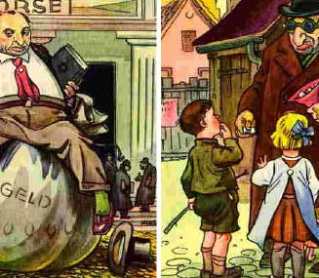
Propaganda
Propaganda – the deliberate method to infect or brainwash the minds of people was an underlying factor behind the Holocaust. All layers of German society were impacted or influenced by it. Hitter himself was heavily exposed to and infested by propaganda during his early life.

Slide 9
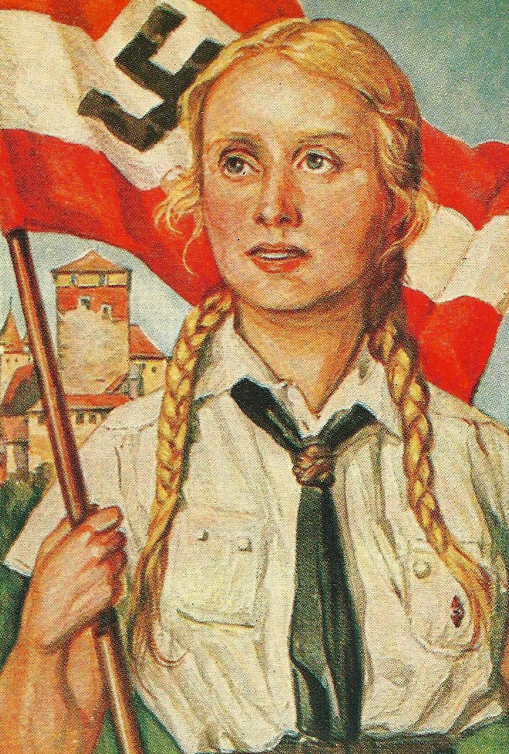
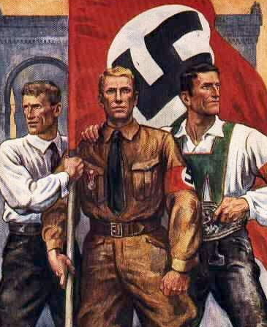
National Community
Hitler and the Nazis wanted to build a national community made up of pure, blonde haired blue eyed Aryans. One method to create a sense of belonging or an ‘us’ mentality was to also have a ‘them’.
Jews made the perfect enemy for people to vent their anger and frustrations at.

Slide 10
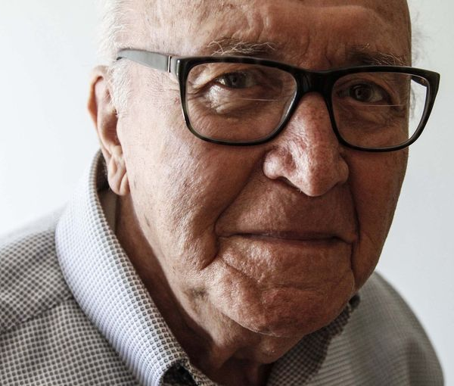
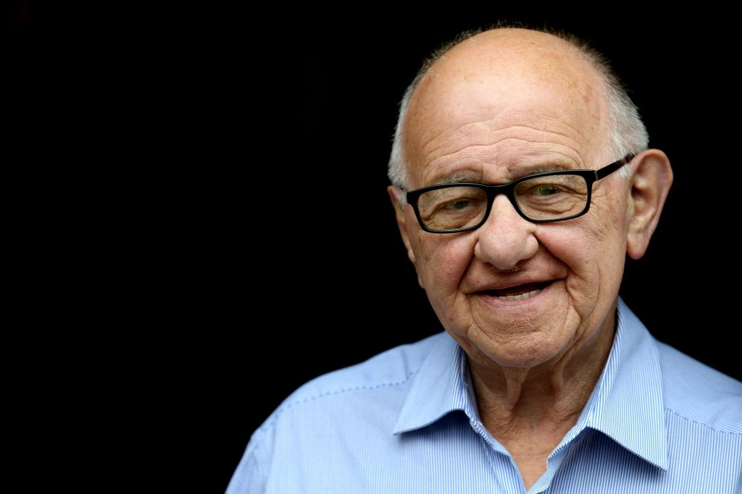
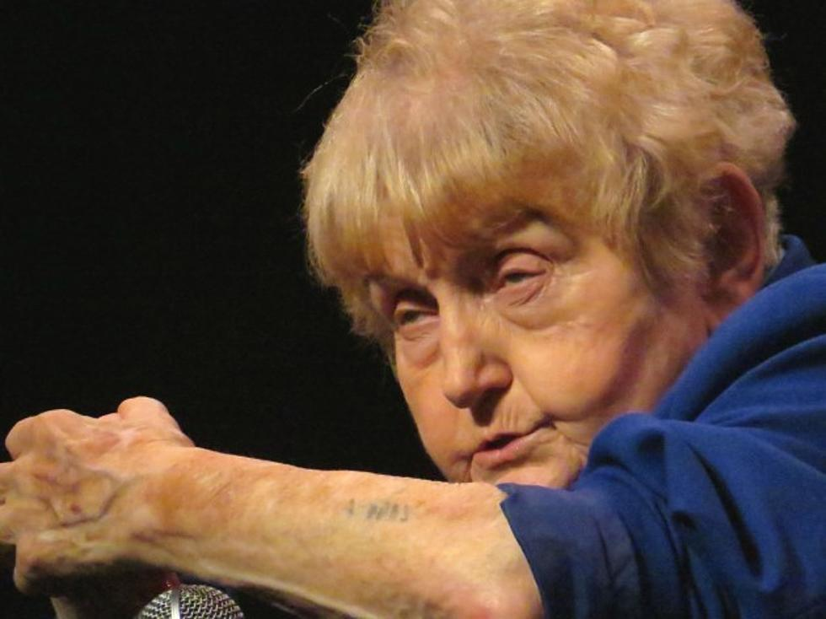
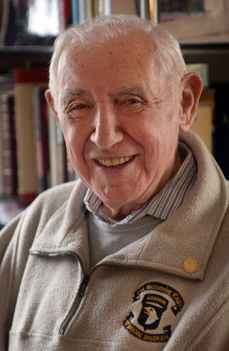
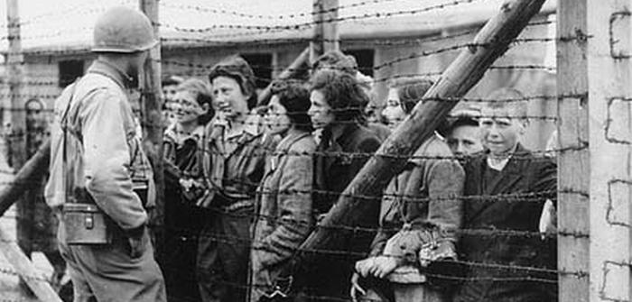
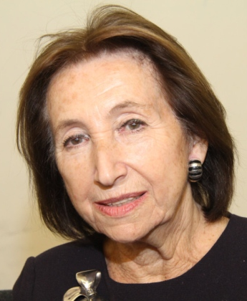
Eva Kor
Zigi Shipper
David Wolnerman
The Liberators
Gerda Klein
David Wisnia
Hannah Lewis

Slide 11
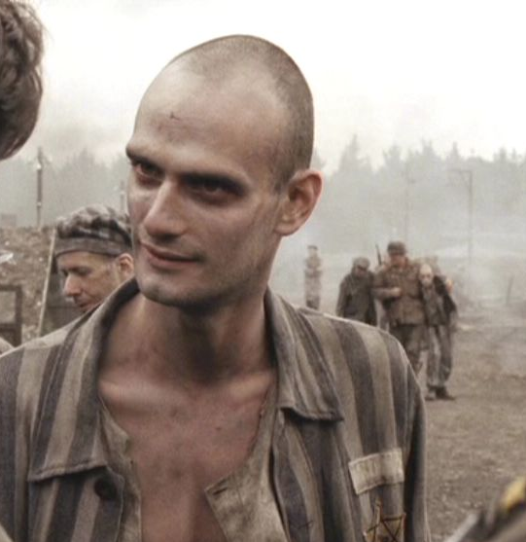
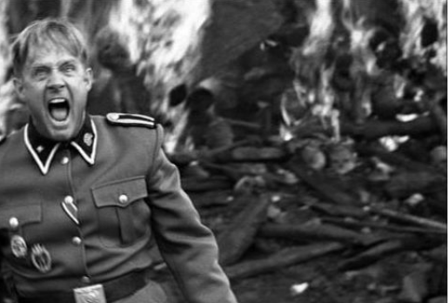
Movie and Media

Slide 12
The holocaust
Please wait for a few moments as this part of the presentation plays automatically using rehearsed timings and with accompanying music.

Slide 13
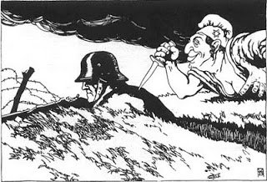
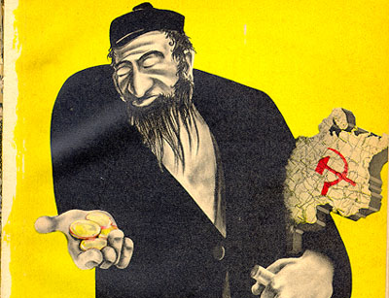
Why Did Hitler Hate Jewish People? Hitler believed the idea that Jews were to blame for Germany’s problems. He blamed them for : 1: His failure to get into art college. 2 : Taking the jobs of ‘real Germans’ when he was unemployed, penniless and homeless. 3:The ‘stab in the back’ myth and the loss of WW1. 4: Being part of the Communist conspiracy to take over Germany.

Slide 14
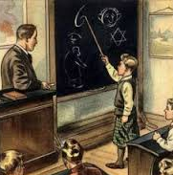
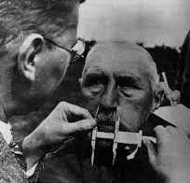
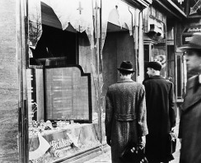
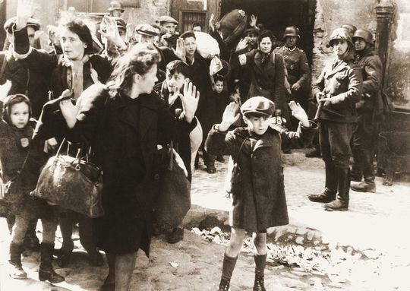
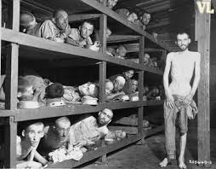
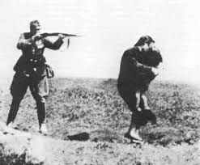
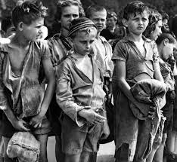
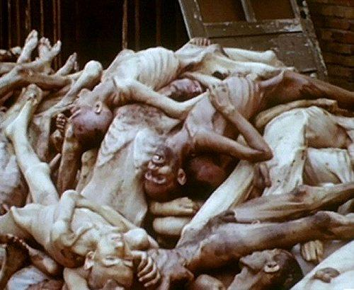
Escalating Persecution The Nazis anti-Semitic ideas were clear in their 25 Point Programme. Once Hitler took power in 1934, he began to act on his plans to eliminate Jews from German society. As the Nazi dictatorship strengthened measures taken against the Jews would get more and more severe. Ultimately they would solve the ‘Jewish problem’ with the
‘Final Solution’

Slide 15
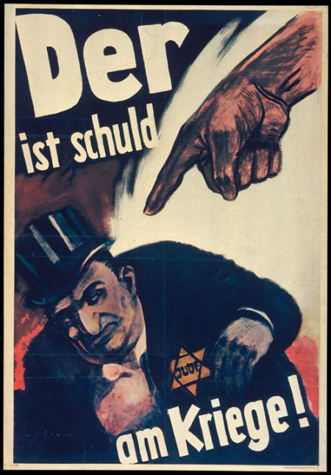
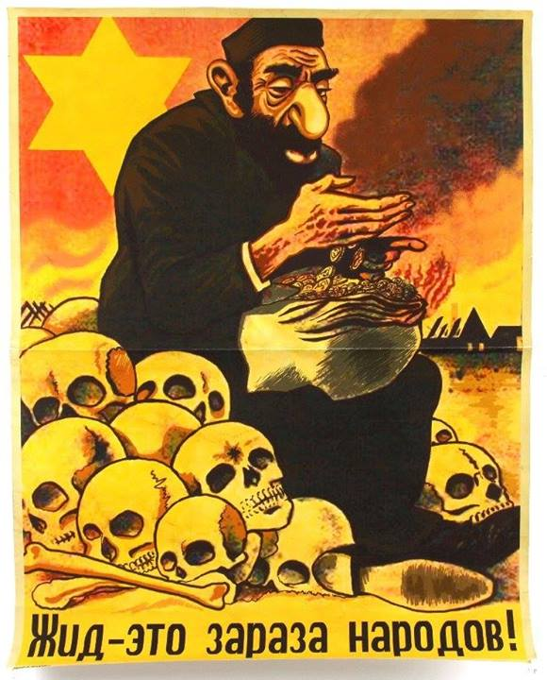
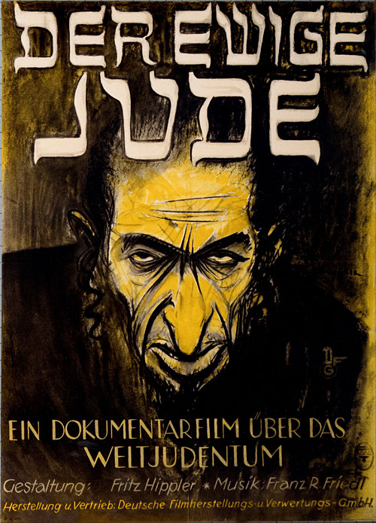
P R O P A G A N D A

Slide 16
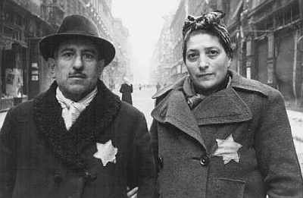
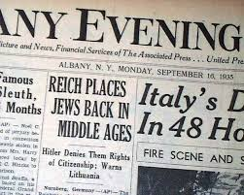
The Nuremberg Laws 1935 After becoming the undisputed leader of Germany in 1934, Hitler and the Nazis immediately began to discriminate and persecute the Jewish population throughout Germany.
The Nuremberg Laws ordered all Jews to be registered and wear a Star of David whenever in public.
Jews were removed from key jobs and political positions and forbidden from marrying ‘pure Germans’.

Slide 17
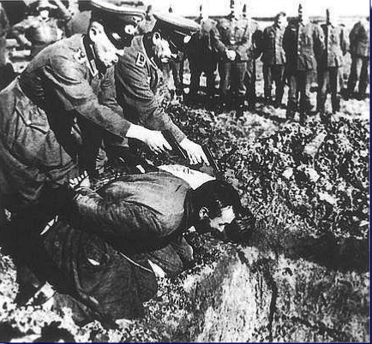
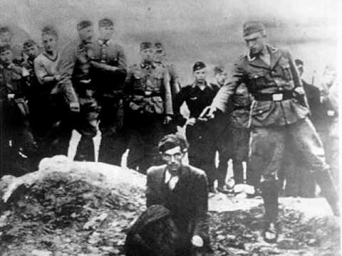
Einsatzgruppen c 1939 Einsatzgruppen were German death squads. They swept up after the German army killing the ‘racially impure’… EG: Jews and Gypsies. The Einsatsgruppen was made up of four battalion sized operational groups. Many believe that this systematic killing of Jews was the first step of the ‘Final Solution’. At first, shooting was the most common form of killing but Heinrich Himmler, noting the stress that the shootings on his own soldiers (and the cost of bullets) decided a more efficient method of killing was needed by 1941. The result was the a mobile gas chamber or truck. This pumped carbon monoxide from the truck's exhaust to kill those in the back.

Slide 18
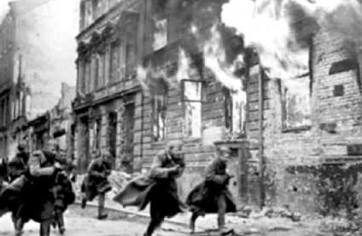
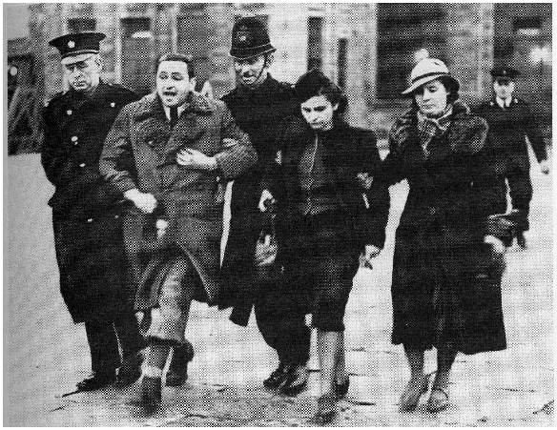
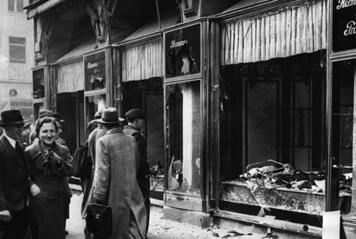
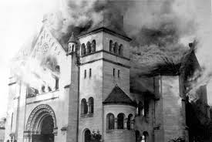
Kristallnacht : Nov 1938 Overview : attacks on Jewish shops, business and synagogues in Germany, November 1938. Why : German Dipomat vom Rath was killed by a Polish Jew in Paris on the 7th November. Joseph Goebbels then encouraged violence. What : SS men started the attacks on the 9th of November. The police were ordered not to stop this. Over two days and nights more than 1,000 synagogues and 7500 business were burned or damaged. 91 Jews killed and Some 30,000 Jewish males aged 16 to 60 sent to the new concentration camps.
This event became known as Kristallnacht or ‘Crystal Night’ or ‘Night Of Broken Glass.’ This name symbolized the final shattering of Jewish existence in Germany.

Slide 19
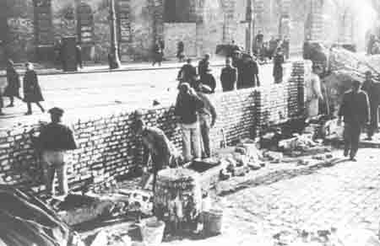
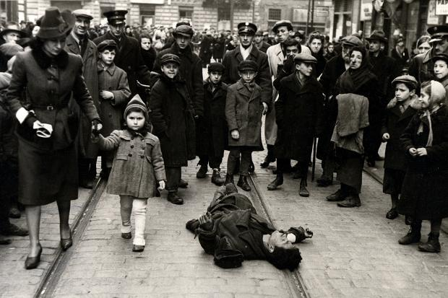
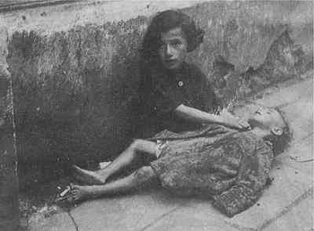
The Warsaw Ghetto After the Second World War began in 1939, the Nazis swept across many countries in Eastern Europe. To deal with this problem the Nazi created ghettos, essentially sealing off entire cities by building walls around them. This was another way to kill off the Jews. The ghettos were crowded and thousands died of disease and starvation. The largest ghetto was the Warsaw Ghetto in Poland.

Slide 20
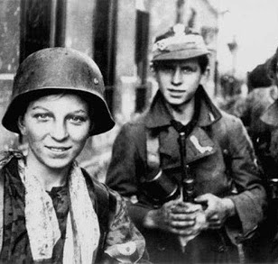
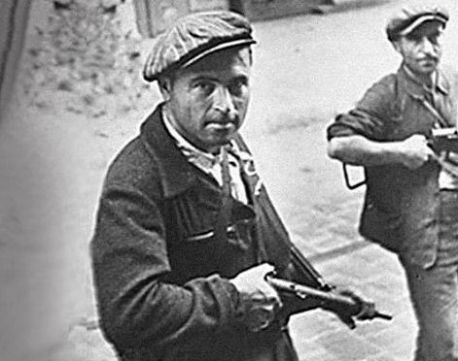
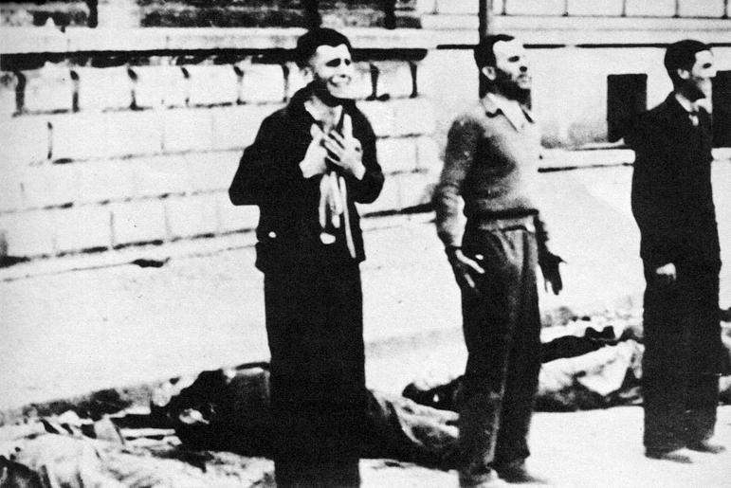
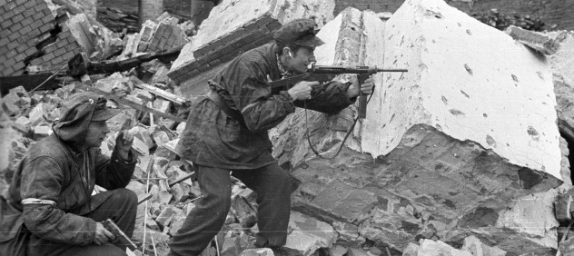
The Warsaw Uprising : 1943 Overview : Jews fight back in the Warsaw Ghetto. Why : the Jews heard they were being taken away to death camps. Why : terrible conditions in the ghetto. What happened : 750 Jewish fighters fought the heavily armed and well-trained Germans. The ghetto fighters were able to hold out for nearly a month. Aftermath : The revolt was eventually crushed. 7,000 Jews were shot, and the rest were deported to camps.

Slide 21
The Final Solution It was not Hitler’s original plan to kill all the Jews in Europe. This idea developed only after the start of the Second World War. On July 17, 1941, Hitler tasked SS chief Heinrich Himmler with responsibility to physically eliminate any perceived threats to German rule.
The ‘Final Solution’ was to build new or develop existing concentration camps into killing centres. Jews and other minorities from all over Europe were to be sent to these death camps by rail. Two of the most infamous killing centres were Auschwitz and Treblinka in Poland.
When they arrived, the old, weak, young and sick would be sent straight to the ‘showers’ for execution. Healthier, stronger people would be set to work. Approximately six million Jewish men, women, and children were killed during the Holocaust. Usually this was done by poisoning hundreds of people at a time in gas chambers with Zyklon B poison pellets.

Slide 22
‘I could see that the lips and tips of the noses were a bluish color. Some of them had their closed, other's eyes rolled. The bodies were dragged out of the gas chambers and inspected by a dentist, who removed finger rings and gold teeth...’
‘I did not look through the opening because it had to be closed as soon as the Zyklon B had been poured in. After a few minutes there was silence. After some time had passed, it may have been ten to fifteen minutes, the gas chamber was opened. The dead lay higgledy-piggedly all over the place. It was a dreadful sight.’
Over 6 million Jews were murdered during the Holocaust
‘Following this, a gassing experiment was carried out. If my memory serves me right, about thirty to forty women were gassed in one gas chamber. The Jewish women were forced to undress in an open place close to the gas chamber.’
‘I can still hear the Jews even today, knocking and shouting 'Dear Germans, let us out'.
‘I concluded from the behavior of these women that they had no doubt what fate awaited them, as they begged and sobbed to the SS men to spare them their lives.’
‘Before the Jews undressed, Michel made a speech
to them. On these occasions, he used to wear a white coat to
give the impression that he was a physician (Doctor). Michel announced to the Jews that they would be sent to work, but before this they would have to take baths….’
‘Some Jews did know what fate awaited them. Inside the camps. I heard accounts of the local Polish farmers signing to them as them as they passed their fields in the crowded trains. The signal was a chilling one, a finger across their throat’.
‘Grabner ordered me to pour Zyklon B into the opening because only one medical orderly had shown up. During a gassing Zyklon B had to be poured through both openings in the ceiling. Zykon B was in granular form, it trickled down over the people as it was being poured in. They then started to cry out terribly for they now knew what was happening to them.’

Slide 23
Afterwards The American and Soviet armies liberated the death camps in 1945. There are accounts of Jewish inmates killing their German prison guards with their bare hands and shovels. Local Polish villagers were forced to bury the dead. In 1948 the state of Israel was created. Many Jews returned their homeland after almost 2000 years of exile. The creation of Israel has caused great tension in the region as Arabs who lived in this area were forced out.

Slide 24
www.icHistory.com
Free PDF worksheets to support this activity also available here ….

