Slide 1
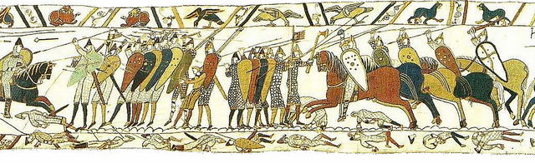
The Norman Conquest 1066

Slide 2
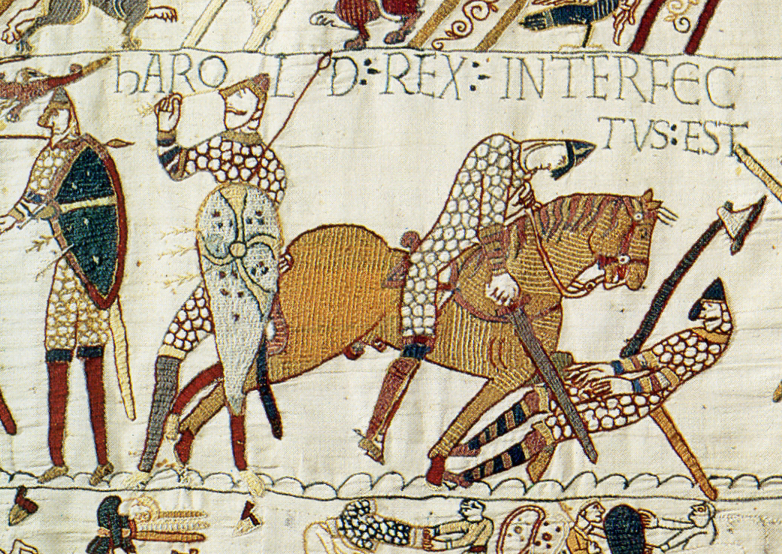
Unit Review Quiz

Slide 3
Suggestions
General - Answers can be recorded on the worksheet provided. - Break into teams of 3-6 players. - Each team nominates a captain. - Take stock after 10 questions … the team with the lowest score allowed to ’steal’ a player. - Captains cannot be transferred!
- Use mini whiteboards / flashboards for bonus answers. Bonus questions - Bonus questions are provided for each slide to extend depth of understanding. - Answer on mini whiteboards Note - Some questions have more than one answer this is referenced on each slide of the presentation. Award one mark for each.

Slide 4
Team Name Bonus Create a name for your team Select a team Captain

Slide 7
Round 1 Complete the labels for each part of the picture

Slide 8
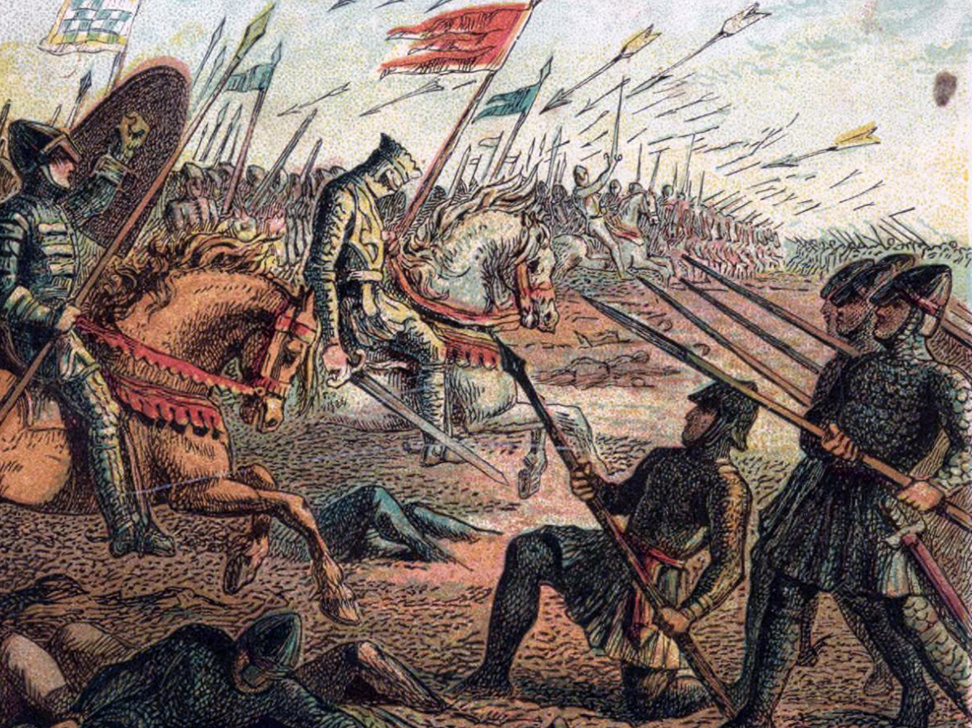
2.S
3.V
1.S
4.L
5.C
8.M
6.K
7.C
9.H
10.I

Slide 9
2.Standard
3.Volley
1.Shield
4.Lance
5.Cavalry
8.Mail
6.Knight
7.Corpse
9.Hauberk
10.Infantry

Slide 10
Round 2 Teams to answer bonus questions using flashboards?

Slide 11
1. The king before Edward The Confessor?
King Arthur
A
Harthurcanute
Bonus
What relation was he to Edward?
B
Hairycanute
C
Hardicanute
D

Slide 12
Hardicanute was his Viking half brother

Slide 13
2. Where did Edward spend his childhood?
Breton
Bonus What was Edward’s relationship with William Of Normandy?
A
Britain
B
Normandy
C
Norway
D

Slide 14
A ‘distant’ or second cousin

Slide 15
3. Which claimants came from 1 2 3 ?
1:Hardrada 2: Tostig 3: Atheling
A
1
1: Harold 2: Hardrada 3 : Normandy
2
B
3
1: Hardrada 2: Harold 3: Normandy
C
Bonus What is the capital of Norway?
1 : Tostig 2: Harold 3 : Normandy
D

Slide 16
Oslo

Slide 17
4. Who fought in the Battle of Fulford Gate?
Harold Morcar and Edgar
A
Tostig, Hardrada Morcar and Edwin
Bonus Who were Edwin and Morcar?
B
Tostig, Hardrada Morcar and Edgar
C
Tostig, Harold William
D

Slide 18
Powerful northern nobles

Slide 19
5. Who fought in the Battle of Stamford Bridge?
Harold William
A
Bonus What delayed the Anglo-Saxons crossing the bridge? Correct spelling
Hardrada Morcar and Edwin
B
Harold, Edwin Tostig
C
Tostig, Hardrada Harold
D

Slide 20
A berserker

Slide 21
6 . How far did Harold have to march from Stamford Bridge to Hastings ?
200 miles
A
250 miles
Bonus What is that distance in kilometers?
B
300 miles
C
350 miles
D

Slide 22
402 kilometers

Slide 23
7 . Where did William land ?
Pevensey Bay
A
Hastings
Bonus What was the name of William’s ship?
B
Dover
C
Dublin
D

Slide 24
The Mora

Slide 25
8 . William brought these with him on his ship (3)
His Wife
A
Horses
1
B
Archers
Bonus Name this city?
C
A Castle
D

Slide 26
York

Slide 27
9 . The first thing William did when he landed?
Went to the toilet
A
Built a castle
B
Bonus How did William turn this embarrassing incident into a positive one?
Fought a battle
C
Fell over
D

Slide 28
He said he now had England in his hands

Slide 29
10. Where did William build his first English castle ?
1
A
2
3
B
2
1
4
3
Bonus
William never learned to speak English True or false?
C
4
D

Slide 30
True

Slide 31
End of Round 1 The team with the lowest score can steal a player from another team!

Slide 32
Round 2 Teams to answer bonus questions on a round robin basis?

Slide 33
11 . Who chose Harold as the King of England ?
Edward The Confessor
A
The Witan
Bonus Who was Harold’s Brother?
B
William Of Normandy
C
Earl Godwin
D

Slide 34
Tostig

Slide 35
12 . What was the key strength of Harold’s army?
Cavalry
A
Archers
Bonus What was the housecarls preferred weapon?
B
Fyrd
C
Housecarls
D

Slide 36
Battle Axe

Slide 37
13. Meaning English
Norse
A
Saxons
Bonus Give 3 weaknesses of a fyrd soldier
B
Anglo-Saxons
C
Professionals
D

Slide 38
1: Part-time soldiers 2: Poorly equipped 3: Lower morale

Slide 39
14. Norman advantages over the English (2)
More cavalry
A
More infantry
Bonus What does professional mean?
B
More archers
C
More professional soldiers
D

Slide 40
They were full-time, year round soldiers

Slide 41
15. Where the Anglo-Saxons set up at Hastings
In a valley
A
Possibly Senlac Hill
Bonus Name the place where the Battle of Hastings was fought
B
A beach
C
Flat ground
D

Slide 42
Hastings

Slide 43
16. What the Anglo-Saxon set up behind
Harold
A
A long wall
Bonus Draw an
Anglo-Saxon shield
B
A shield wall
C
A stone wall
D

Slide 44
Tear drop shape!

Slide 45
17 . First attack at Hastings?
Anglo-Saxons killed William’s jester
A
Housecarls attacked the Normans
Bonus What is a jester?
B
William attacked Harold
C
Norman infantry attacked the shield wall
D

Slide 46
A joker or entertainer The jester had been making fun of King Harold

Slide 47
18 . The main battle started when
English fyrd charged down the hill
A
Normans charged up the hill
Bonus Apart from the hill why was a Norman cavalry charge difficulty?
B
Housecarls attacked Norman cavalry
C
Harold attacked William
D

Slide 48
The ground was marshy (wet)

Slide 49
19 . First mistake made by the Anglo-Saxons
They chose a bad place for a battle
A
The shield wall was weak
Bonus Why did the fyrd leave the wall?
B
The fyrd soldiers broke out of the wall
C
The housecarls did not protect the wall
D

Slide 50
The Normans ran and the fyrd were excited (and poorly trained)

Slide 51
20 . What happened when the fyrd chased the Normans?
The fyrd were killed by Norman cavalry
A
The fyrd killed the Normans
Bonus What did the Normans do next?
B
Archers killed the fyrd
C
Housecarls told the fyrd to come back
D

Slide 52
They played a trick on the English pretending to run away again

Slide 53
End of Round 2 The team with the lowest score can steal a player from another team!

Slide 54
Round 3 Selected students to answer bonus questions?

Slide 55
21 . Harold was hit by an arrow in the eye
Fact
A
Possible
Bonus What type of soldiers use bow and arrows?
B
Improbable
C
Myth
D

Slide 56
Archers

Slide 57
22 . The odd one out?
Sword
Bonus What is the French word for thank you?
A
Helmet
B
Shield
C
Chain Mail
D

Slide 58
Merci

Slide 59
23 . Said to have happened after Harold was hit in the eye?
The fyrd ran down the hill again
A
Bonus Name the tapestry that tells the story of the Norman invasion. Extra bonus point for perfect spelling!
The housecarls protected him
B
He was cut to pieces a Norman knight
C
Harold went to the optician
D

Slide 60
Bayeux Tapestry

Slide 61
24 . The Bayeux Tapestry is a …. (2)
Contemporary source
A
Primary source
Bonus Who made the tapestry?
B
Secondary source
C
Tertiary source
D

Slide 62
The wives of the Norman soldiers

Slide 63
25 . NOT a name given to William
William
The Bastard
A
William Duke Of Normandy
B
Bonus What did William do to people who made fun of his mother?
William The Conqueror
C
Bill The Sod
D

Slide 64
He cut their hands and feet off

Slide 65
26 . After Harold was killed at Hastings … (2)
William took the throne
A
Peace was restored
B
The Anglo-Saxons gave up
Bonus What does rebel mean?
C
The nobles rebelled
D

Slide 66
To fight against

Slide 67
27 . Where did the strongest rebellions take place?
Southern Scotland
A
Northern England
Bonus Who invaded northern England after William became king?
B
Southern England
C
Eastern Ireland
D

Slide 68
Vikings

Slide 69
28 . Which city did they take ?
Liverpool
Bonus What happened to the Norman soldiers guarding York castle?
A
York
B
London
C
Newcastle
D

Slide 70
They were killed by northern nobles who had allied with the Vikings

Slide 71
29 . How did William respond to this act ?
He asked for a truce
A
He invaded Norway
B
He went back to Normandy
Bonus What was the attack on the North called?
C
He attacked the North
D

Slide 72
The Harrying Of The North

Slide 73
30 . Which previous claimant helped the Vikings in the North?
Edgar Atheling
A
Bonus What do Harold Godwinson and Edward The Confessor have in common in 1067?
Earl Godwin
B
Harald Hardrada
C
Edward The Confessor
D

Slide 74
They are both dead

Slide 75
End of Round 3 The team with the lowest score can steal a player from another team!

Slide 76
Round 4 Back to teams to answering bonus questions using mini whiteboards?

Slide 77
31 . Approximately how long did the harrying last?
3-4 days
A
3-4 weeks
Bonus Did the Harrying Of The North stop the rebellions?
B
3- 4 months
C
3-4 years
D

Slide 78
Yes

Slide 79
32 . ‘I am _______ with the rivers of ______ I have shed. Complete William's quote.
Happy / babylon
Bonus What does this quote tell us about how William felt about the Harrying of The North?
A
Saddened / tears
B
Stained / blood
C
Smiling / death
D

Slide 80
He felt bad, guilt, regret, remorse.

Slide 81
33 . Not part of a motte and bailey castle
Palisade
A
Moat
B
Bonus What was placed on top of the motte?
Curtain wall
C
Flying bridge
D

Slide 82
Keep

Slide 83
34 . Which statement is true?
William did not have enough solders to control the country
A
William was a popular king
Bonus Give 3 reasons why William was an unpopular ruler
B
William had enough soldiers to control the country
C
William could rely on
Support from the English
D

Slide 84
He killed Harold Foreign Ruler Cruel Other?

Slide 85
35 . Most powerful / least powerful
Knight / noble / peasant
A
King / noble / knight
B
Noble / peasant / knight
Bonus Name the system! Correct spelling bonus
C
King / knight / peasant
D

Slide 86
Feudal System

Slide 87
36 . Not given by nobles in the feudal system
Vegetables
A
Land
B
Bonus Name one more thing given to the king by the nobles
Protection
C
Presents
D

Slide 88
Knights Loyalty

Slide 89
37 . Odd one out
Serf
A
Bonus What is the difference between a peasant and a slave?
Tanner
B
Peasant
C
Villein
D

Slide 90
Slaves receive no payment

Slide 91
38 . How did William die?
He fell down the stairs in his castle
A
He fell on his horse’s saddle and put a hole in his stomach
Bonus How old was William when he died?
B
He was killed in battle
C
Old age
D

Slide 92
59

Slide 93
39 . What happened after William died (2) ?
The Normans went back to Normandy
Bonus What is the French word for goodbye?
A
The Normans stayed in England
B
The English nobles took control
C
His body exploded in his coffin
D

Slide 94
Au revoir

Slide 95
40 . Who became King after William’s death?
Edgar Atheling
A
His wife, Matilda
Bonus Create a bonus question of your own
B
His son, William II
C
His brother, Henry VIII
D

Slide 96
Award max 3 marks for creative bonus questions

Slide 97
End of Round 4 The team with the lowest score can steal a player from another team!

Slide 98
Bonus Round 5 Chronology : complete the table on the timeline provided

Slide 99
Round 5 : match the event with the date
1042
The Battle OF Hastings
1051
Harold Crowned King Of England
1064
William died
5th January 1066
Edward The Confessor Dies
7th January 1066
Harold Swore An Oath To William?
20th September 1066
The Battle Of Fulford Gate
25th September 1066
The Harrying Of The North
14th October 1066
Edward promised William the crown?
1069 -1072
The Battle Of Stamford Bridge
September 1087
Edward crowned King Of England

Slide 100
Round 5 : answers. (1 mark for each )
1042
Edward crowned King Of England
1051
Edward promised William the crown?
1064
Harold Swore An Oath To William?
5th January 1066
Edward The Confessor Dies
7th January 1066
Harold Crowned King Of England
20th September 1066
The Battle Of Fulford Gate
25th September 1066
The Battle Of Stamford Bridge
14th October 1066
The Battle OF Hastings
1069 -1072
The Harrying Of The North
September 1087
William died

Slide 101
End of Round 5 The team with the lowest score can steal a player from another team!

Slide 102
More PowerPoints can be found @ www.ichistory.com

