Slide 1
Questioning Primary Evidence.

Slide 2
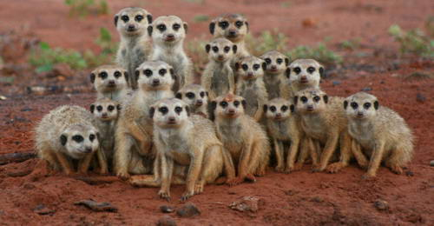
Recap : a primary ( or contemporary ) source is information that originates from the time of the event. A secondary source is information that is made later – the person who recorded it was not there in person. Which are better, primary or secondary sources?
A person who saw an event can be called an eyewitness.

Slide 3
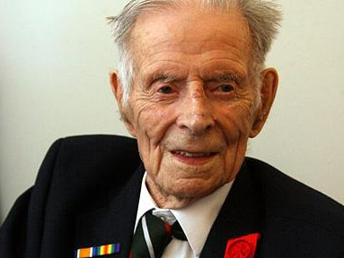
Primary sources - eyewitness
Consider the possible weaknesses in this eyewitness / primary source.
‘The Last Tommy ‘ gives his account of his experiences during World War 2 shortly before he died.

Slide 4
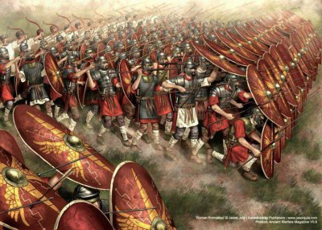
Primary sources - eyewitness
Consider the possible weaknesses in this eyewitness / primary source.
This Roman soldier explains how his legion helped win an important battle.

Slide 5
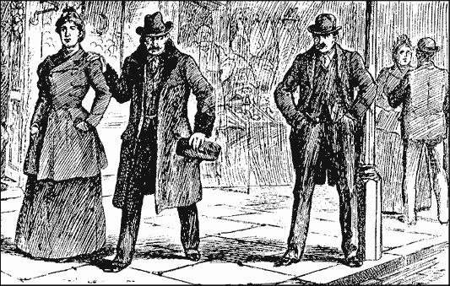
Primary sources - eyewitness
Consider the possible weaknesses in this eyewitness / primary source.
A man gives a description of a person he thinks could be Jack the Ripper.

Slide 6
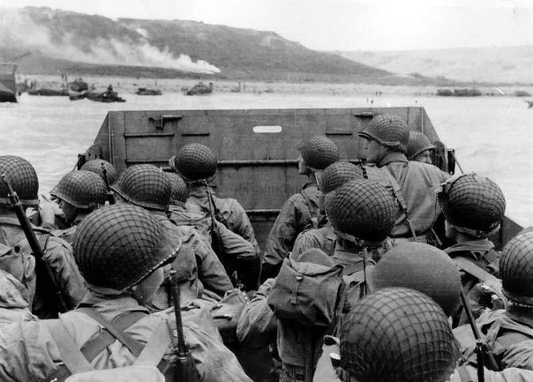
Primary sources - eyewitness
Consider the possible weaknesses in this eyewitness / primary source.
This soldier describes what happened during the D-Day landings in 1944.

Slide 7
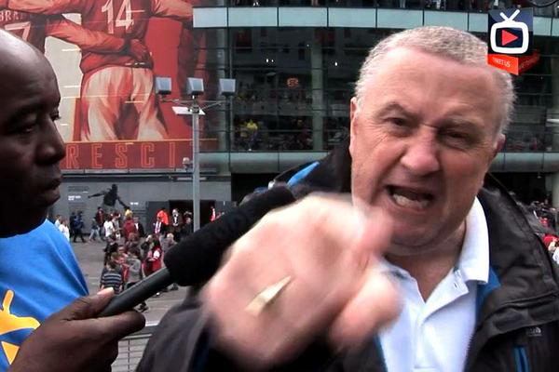
Primary sources - eyewitness
Consider the possible weaknesses in this eyewitness / primary source.
This Arsenal supporter gives his account of a football match at the end of the game.

Slide 8
Test yourself – WHODUNNIT?.
Watch the clip attached by clicking on the image – you should pause the clip at 35 seconds and decide who you think the murderer was. Play the rest of the clip to find out the truth.

Slide 9
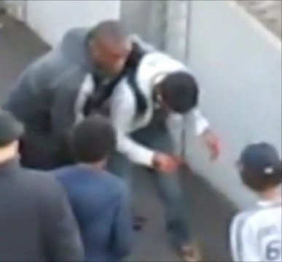
Test yourself – you are an eyewitness.
Watch the clip attached by clicking on the image and make note of the following – 1.Was the person ( circled in blue ) trying to help the boy or not? 2.How many people tried to take something from the boy's bag? 3.How many people actually took something from the bag? Compare your answers before watching the clip again. Did you get clear agreement about what happened during this incident? What does his tell us about eyewitness accounts?

Slide 10
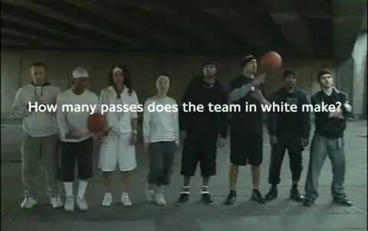
Test yourself – count the passes.
Watch the clip attached by clicking on the image..

Slide 11
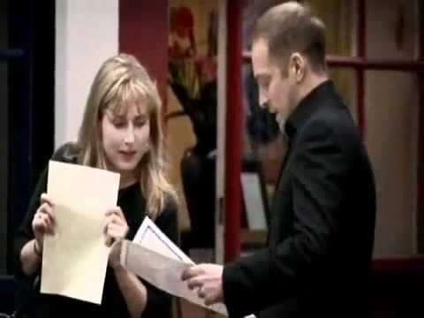
Do you still think eyewitnesses are reliable . ?
Watch the clip attached by clicking on the image..

Slide 12
Wrap it up! Alone, in pairs or as a small groups, make a list of the possible problems with eyewitness or primary accounts. icHistory.com

