Slide 1
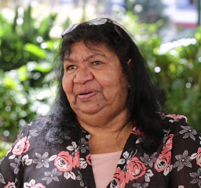
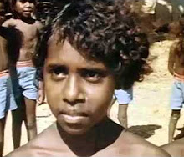
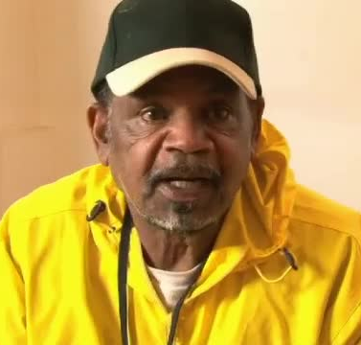
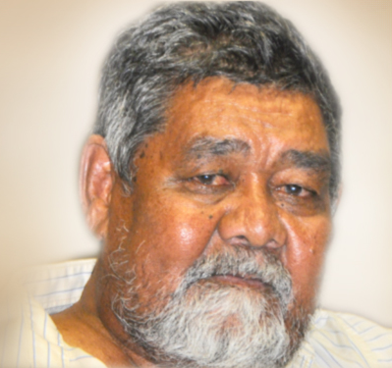
The Stolen Generations: Testimonies
Below are six people who were taken away from their families as a result of the assimilation policy. Click on each image to view the starter documentary or personal accounts web links.
A supporting student worksheet can be downloaded via the ‘click here’ button.
Lorraine Peters
Faye Clayton
Jack Charles
Starter
Bill Simon
Nita Marshall
Keith Kitchener

