Slide 1
The Rhineland - 1936
A What to do ... icHistory.com

Slide 2
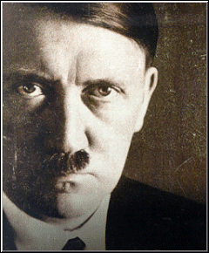
this activity can be done as an individual / pair choice or class vote . Click the answer boxes or the blue button icons to select answers on relevant slides … Another option is to split into two or more teams. Decide which team will start. If an incorrect choice is made by ‘team A’ control is handed over to ‘team B.’ the team that is in control at the end is the winner and gets the Rhineland and the glory!

Slide 3
You are going have to put yourself into this man’s shoes.

Slide 4
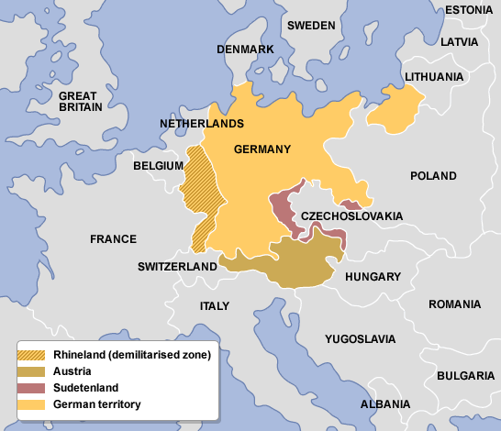
Spot your Rhineland
No Here!
Here!
Definitely here!

Slide 5
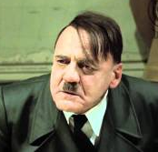
That’s The Sudetenland!

Slide 6
No…That’s Austria!

Slide 7
YEEESSSSS!
A lucky guess?

Slide 8
How had Germany strengthened between 1933-35?
Invaded the Saarland
Invaded the Ruhr
Rebuilt the army in secret
Anglo-German Naval Treaty
Introduced conscription
Remiltarised the Saarland
Saarland had been legally returned
Anschluss with Austria

Slide 9
Whoop !
Well done – Britain did this allowing Germany to break Versailles and also signed it behind the league’s back

Slide 10
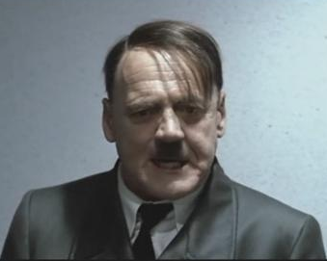
Nope !
That is incorrect

Slide 11
Kind of right!
Hmmmm, conscription is a tricky one! This is announced in MArch1935 but may not have been active until 1936. Pick again!

Slide 12
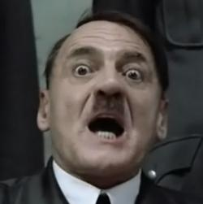
Nope !
Unification with Austria takes place in 1938

Slide 13
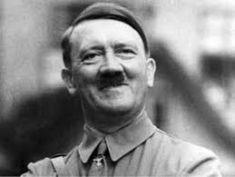
YES … pick another

Slide 14
What happened to the Rhineland under the term of the treaty of Versailles?
It was taken from Germany and given to France
It was taken from France and given to Germany
Give me a tip!
It was put under the control (mandated) to the League of Nations
It was demilitarised –Germany could not put soldiers in its own territory

Slide 15
Why did Hitler want to put troops into the Rhineland at this time?
He was born there
He hated Versailles
To protect factories
I’m not sure
It had lots of oil
It had lots of farmland
It had lots of coal
The French were distracted
Army generals told him to
France wouldn’t give it back
Germans living there treated badly
To annoy the French
Strengthen his reputation
To ‘lock his backdoor’
He no longer feared the League

Slide 16
Correct … pick another

Slide 17
Correct …

Slide 18
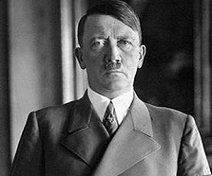
Not the right pick …

Slide 19
You are right !
Demiltarised = no german soldiers allowed there

Slide 20
The year is 1936. you have to consider the wisdom of sending German soldiers into the Rhineland.
The German army is now strong enough to challenge the French army
Yes
No

Slide 21
super !
Although getting stronger the army was still small

Slide 22
Careful!
Although getting stronger the army was still small

Slide 23
The year is 1936. you have to consider the wisdom of sending German soldiers into the Rhineland.
Britain is not too worried about many of the terms of the Versailles now. They think it was actually a bit mean.
True
False

Slide 24
Correct!
Britain felt sympathy for Germany

Slide 25
Checkpoint 1
only truly terrible decisions will send you back to the start

Slide 26
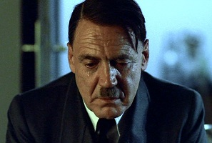
The French army is stronger than mine. My army is weak a failure in the Rhineland will really damage my reputation in Germany – many of the army generals advise me not to enter the Rhineland
Now is not the time for this move … it is too risky.
This is a big gamble and I have a lot to lose.. Lets do it.

Slide 27
Brave Choice
Lets get them moving !

Slide 28
Bad Choice
Hitler’s position was not so secure in 1936 – he still had much to do to consolidate his position.

Slide 29
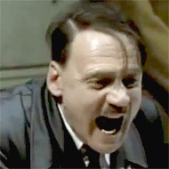
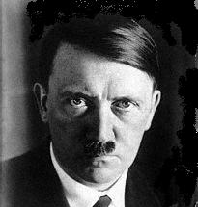
The German people seem disappointed that you have not even tried to move troops … it is not as if you are invading another country, The Rhineland is your land.
I don’t care what the German people think … I am Hitler!
Ok, I will send troops to the border and see how the French respond.

Slide 30
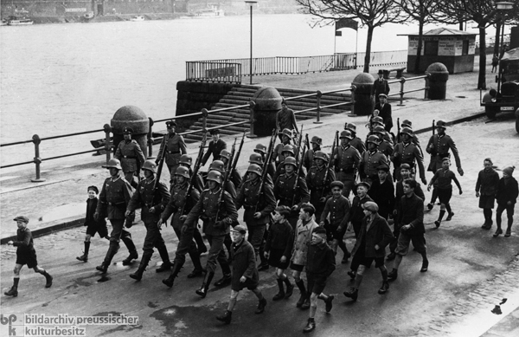
Your men are paused ready to march into the Rhineland. You send a final telegram with strict orders for your generals
If the French send their army against you – leave the Rhineland
If the French send their army against you – attack them first
If the French send their army against you – tell your men to hide
If the French send their army against you – pretend you are lost

Slide 31
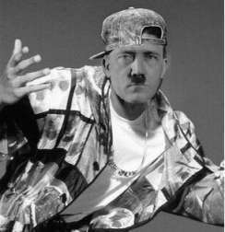
Good plan your army would be destroyed.

Slide 32
The answer is in your school textbook

Slide 33
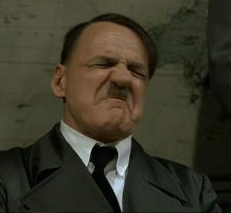
Your army is Destroyed by the french

Slide 34
You almost got away with it. When questioned by the French generals one of your soldiers started laughing

Slide 35
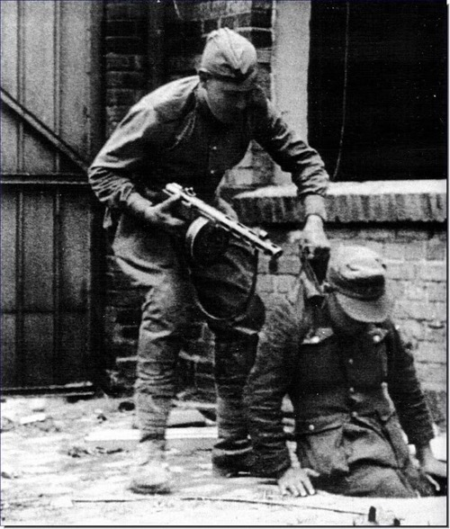
The French are well trained in the art if hide and seek

Slide 36
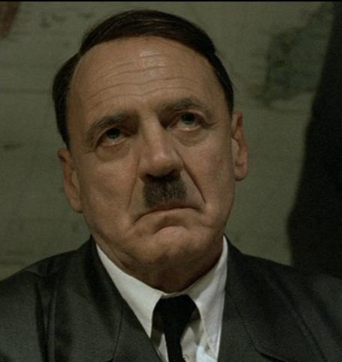
A humiliated dictator

Slide 37
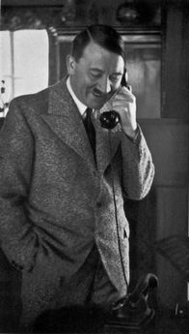
You send soldiers in. The French hit you up on the telephone. They tell you to withdraw or they will invade germany
Get out of there!
Don’t answer
Tell them you have more troops waiting to go in

Slide 38
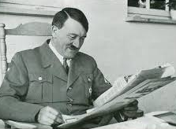
You wait …

Slide 39
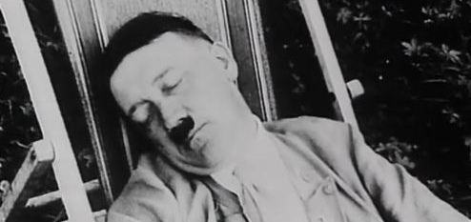
and wait …

Slide 40
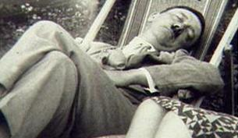
And wait …

Slide 41
The French are on the verge of a General election to decide on a new leader No news is good news?
This is a good thing for us
This is a bad thing for is

Slide 42
correct
The pending election meant that there was a political vacuum and its leadership froze

Slide 43
Incorrect
The pending election meant that there was a political vacuum and its leadership froze

Slide 44
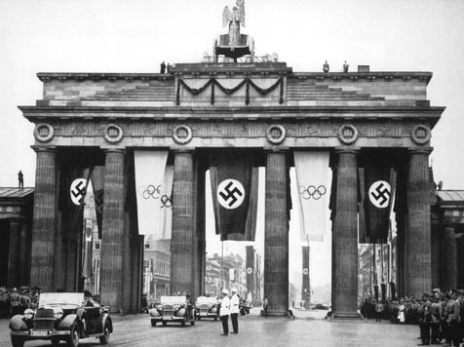
Where is this ?
German Capital Berlin
Rhineland Border Gate
German Capital Weimar

Slide 45
Well done
That’s the Brandenburg gate in berlin

Slide 46
Not Right
Go back

Slide 47
You meet the people in the Rhineland.
They are French and will be angry with you.
Yes
No

Slide 48
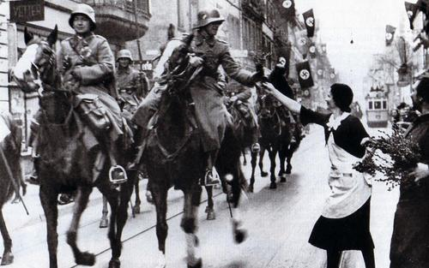
Yee Ha!
The Rhineland is German land and the people in it are German.

Slide 49
The French ask Britain for help
The people of Britain say ….
“Yes”
“No”

Slide 50
good
Britain was not prepared to get involved in conflict. Versailles was outdated and a stronger Germany was a good buffer against communism

Slide 51
Memory Loss?
Britain was not prepared to get involved in conflict. Versailles was outdated and a stronger Germany was a good buffer against communism

Slide 52
The league of nations was a large collection of countries. One of its aims was to stop you breaking the treaty of Versailles using collective security.
The League no longer exists
The League is distracted by the Japanese invasion of Manchuria
The League has proven itself to be weak many times already
You are a League member so you can do what you like
The League is distracted by the Italian invasion of Abyssinia

Slide 53
Checkpoint 2
only truly terrible decisions will send you back further

Slide 54
Yes ! Pick again
Vilna = Fail Corfu Incident = fail Ruhr Occupation = Fail Manchuria = Fail

Slide 55
Super!
The league was distracted with Abyssinia. It had already failed to deal with aggression many times. It takes no action !

Slide 56
Sad face
The league was still in existence . . . Not that it did very much anymore

Slide 57
Oh dear
Sorry, the Manchuria incident was in 1931

Slide 58
Uh Oh!
Don’t you remember leaving the League in 1933?

Slide 59
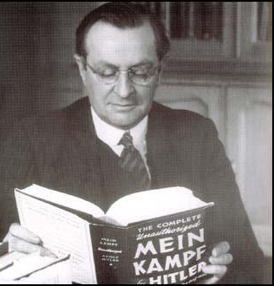
The British mp Lord Lothian described one of the reasons Britain did not want to get involved in the rhineland
‘Germany was only walking into her own place ‘
‘Germany was marching, walking, running stumbling, toward France.’
‘Germany was only marching into its own backyard’
‘Germany was trampling on France’s front garden’
‘Germany was only marching into its own front garden’

Slide 60
Noooo

Slide 61
Shocker!

Slide 62
Impressive!
If you got it the first time around!

Slide 63
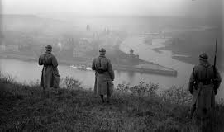
Well done …. The Rhineland was a gamble but it worked. your troops are in without opposition. This is a great opportunity for propaganda and to strengthen your reputation.
I like gambling .. I want more!
That was scary and this is enough for me for now!

Slide 64
Good decision
What now?

Slide 65
Oh come on!

Slide 66
What did I do next?
Leave the League
Invade France
Invade Poland
Nothing
Invade the USSR
Ally with Stalin
Join in Spain’s Civil War
Invade the Sudetenland
Invade Italy
Anschluss with Austria
Do NOT
Choose me
Ally with Italy
Ally with Spain
Ally with Britain
Celebrate good times

Slide 67
Pick again
Close but not quite!

Slide 68
Bad Luck!
You need to work om a timeline of events!

Slide 69
Not the best idea

Slide 70
That’s right
Hitler started his plan to create a club of dictators. Mussolini and Hitler signed the R0me-Berlin Axis in October 1936. After that he would try to recruit to general Franco of spain .

Slide 71
Later Hitler admitted ….
“If the French had marched we would have had to withdraw with our heads in our hands..”
“If the French had marched we would have had to withdraw with out tails between our legs”
“ The twenty four hours after the march into the Rhineland were the most exciting of my life..”
“ The forty eight hours after the march into the Rhineland were the most nerve-wracking of my life..”

Slide 72
Sorry, wrong.
Remember to read questions very carefully. One word can change the entire nature of what is being asked of you.

Slide 73
Nice!
Remembering and using relevant quotes helps provide evidence to support your answers

Slide 74
Why was sending German troops into the Rhineland a risk for Hitler? – NOT a factor!
Failure would be humiliating
Hitler’s Generals said it was a bad idea.
The League of Nations could get involved
The German Army was still weak
The French were holding elections

Slide 75
Good spot!
Remember to read exam questions really carefully. It is very easy to miss a word or the general point of the question.

Slide 76
A factor that did not help Hitler get the Rhineland
Britain was sympathetic
Hitler lied saying he had more army units than he really had
The League was dead in all but name
France had a stronger army
The French were holding elections

Slide 77
Too Easy ?

Slide 78
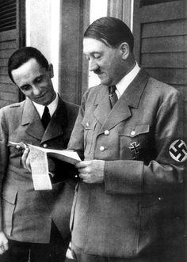
Read The Question More carefully

Slide 79
Fail!
This helped !

Slide 80
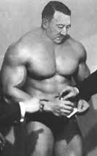
Which was not a consequence of Germany’s Remilitarisation of the Rhineland?
Germany left the League
Hitler kept his troops in the Rhineland
Hitler’s reputation in Germany grew
Appeasing Hitler encouraged him to push for more

Slide 81
Happy face
Hitler had already taken Germany out of the league when he became Chancellor in 1933

Slide 82
Head in hands
This was a result

Slide 83
Which of the following does not help describe what happened in the Rhineland
Why : Hitler swore to destroy Versailles and success in the Rhineland would strengthen him.
Why : Hitler had been watching the League fail time and time again. 1936 was a good time to act.
What : German troops entered the Rhineland unopposed.
What : The French were holding elections so decided to remove their troops from the area .
What : The German troops were successful and greeted warmly by the people of the Rhineland.
Effects : Hitler got stronger, he thought that the French and British were cowards. He wants more.

Slide 84
Clever !
French troops had left after the Locarno Treaties in 1926

Slide 85
Oh no - and you are almost finished
This is an accurate description – look for a false statement
Try again!

Slide 86
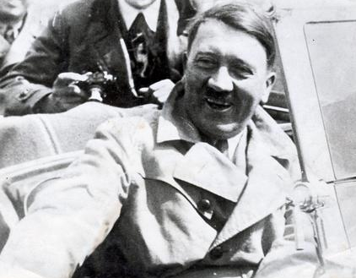
Congratulations …you made it to the end. Play Regularly until you can get through without any errors!
I am ready to try again
I need a break

Slide 87
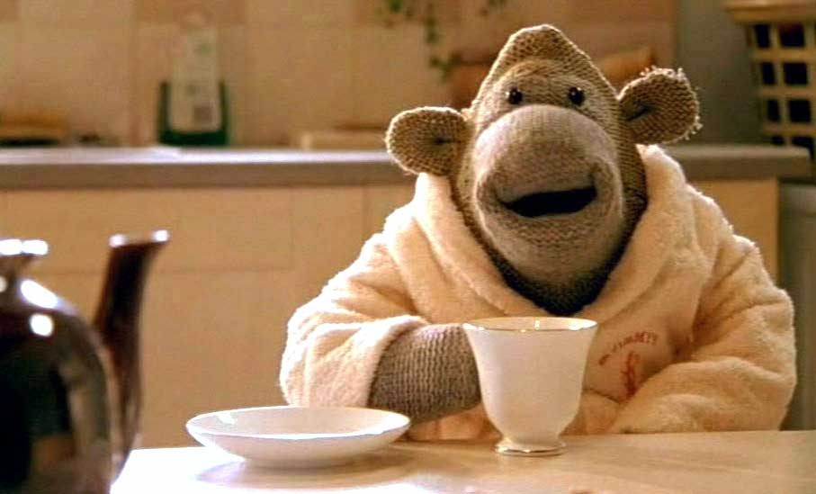
Relax and watch video clip to consolidate your knowledge – click the Youtube icon

