Slide 1
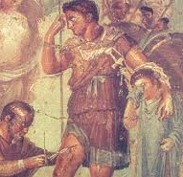
Why was there so little change in medicine During the middles ages?

Slide 2
Navigation
Click icon left to download supporting worksheets and activities
Click to take you to the main factors menu.
Click the YouTube symbols on pages to connect to external videos.

Slide 3
Click on the icon for a brief recap of Middle Age medicine

Slide 4
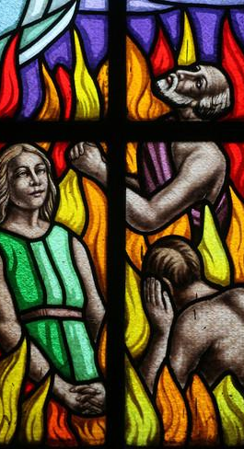
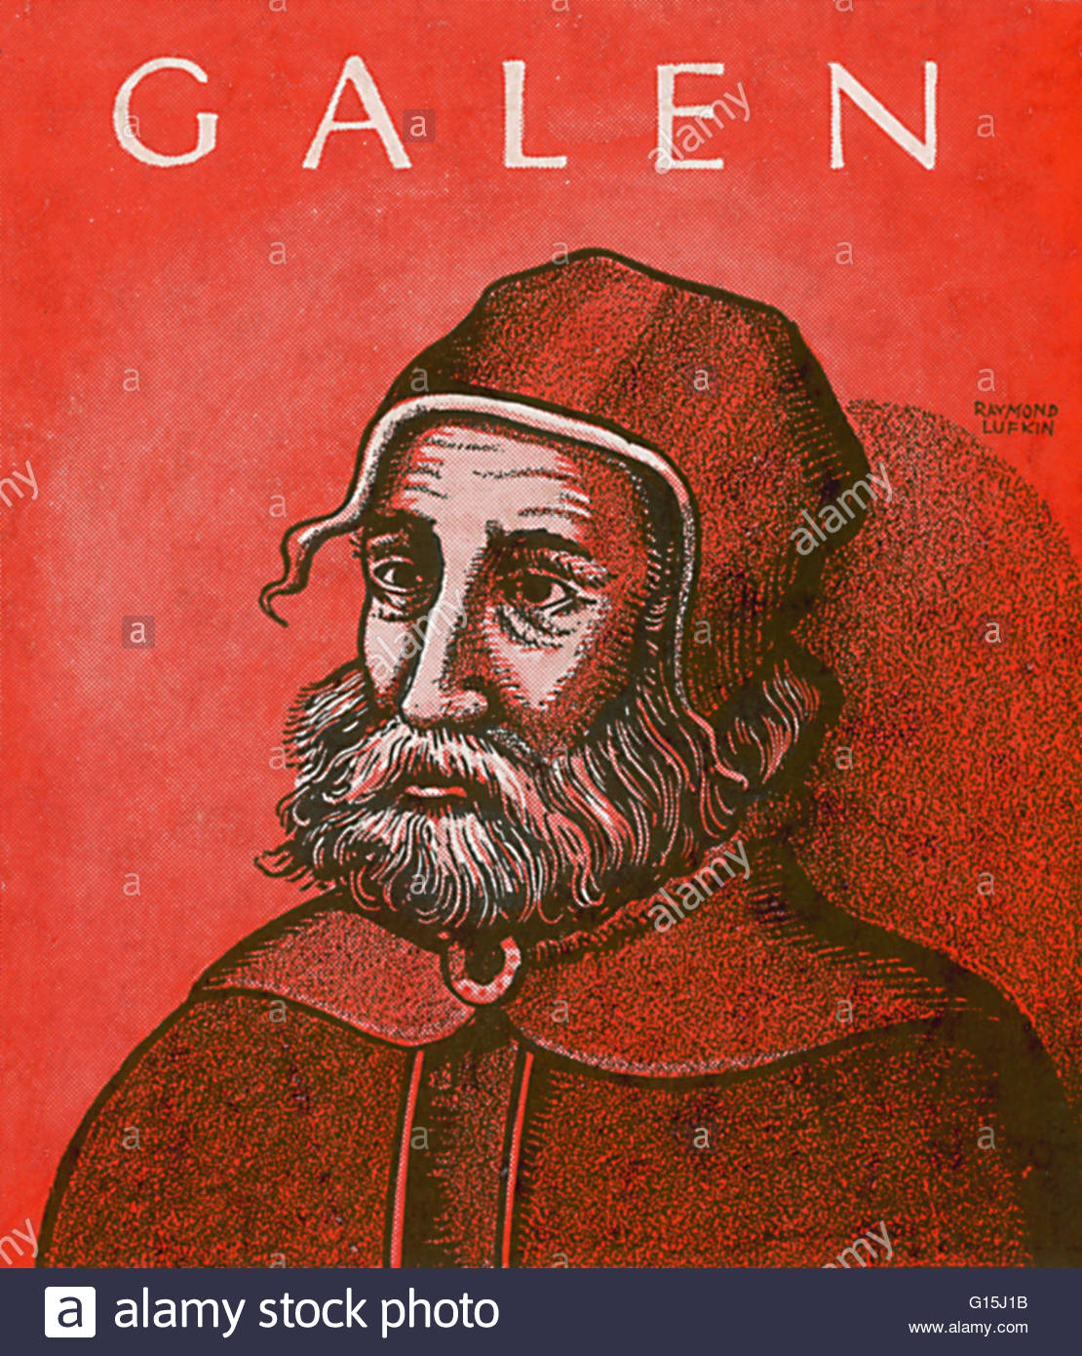
Why Such Little Change During the Middle Ages ? Starter… guess the causes.
Click on each image to find out more.

Slide 5
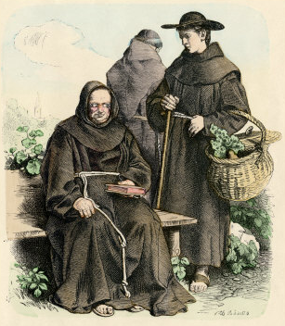
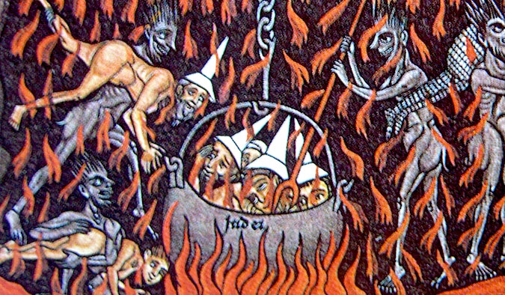
The Church
The Catholic Church was the bedrock of people’s lives in the Middle Ages. It was rich, powerful and influential. Every village had a priest or larger area a bishop who was able to communicate the teachings of the Church to almost everyone. These teachings discouraged people from challenging existing ideas. The bible stated that disease or illnesses were caused by God and were a punishment for sins – there was no need to look beyond God for other for the causes of illness and disease. The Church also supported Galen’s work on the 4 humours and that God made humans in perfect balance. Anyone who challenged these beliefs risked being called a heretic.
Dare to be different?
Great Influence

Slide 6
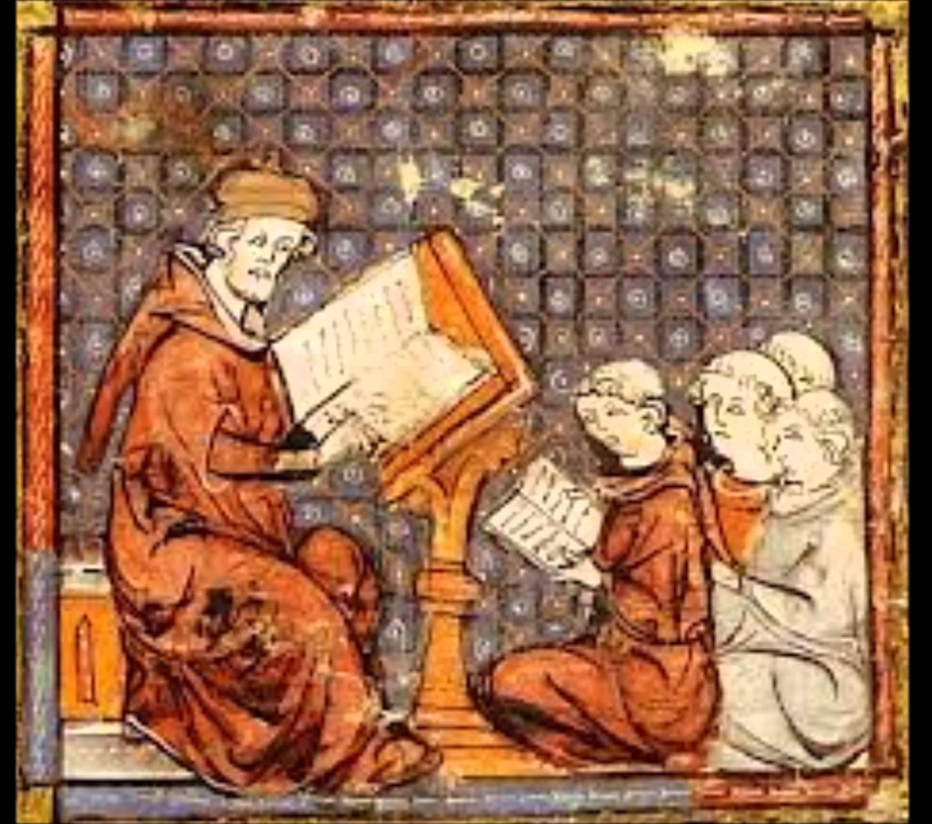
EDUCATION
View from 30 to 33 mins
When thinking about the role of education and why there was little medical progress made during the Middle Ages, you must note that education was controlled by the Church. There were very few people rich enough to undergo the 7 years of training it took to become a physician ( there were less than in England 100 by 1300 ). Just as Important, the study and training for physicians essentially meant COPYING the previous work of Hippocrates and Galen. Physicians were not expected to research and come up with new ideas of their own. In addition to studying the works of Galen they also used the teaching of Arab doctors such as Ibn Sina and Rhazes. Notably, these doctors had also been influenced by Hippocrates and Galen. In sum, physicians were taught to copy the work of others … for example, when it came to dissecting human or animal corpses students were expected to observe to see how the dissection confirmed the teaching and not to explore or experiment for themselves.

Slide 7
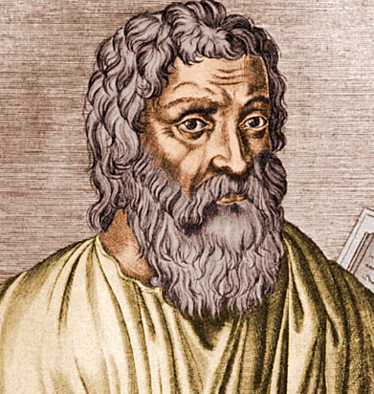
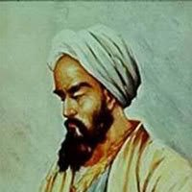
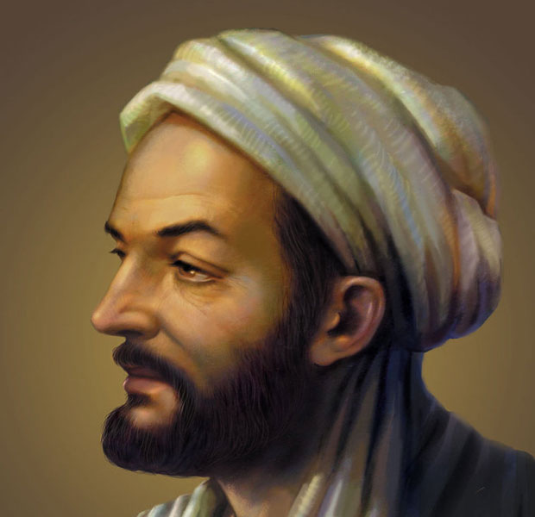
GALEN AND COMPANY
During the Middle Ages there was no major advance in the treatment of illness or disease. This was because physicians at that time were influenced by the work of those before them. Hippocrates is credited with the development of the theory of the four humours - Galen would later use this theory and help spread the idea by teaching it and writing over 250 books based on it. Galen’s books were very detailed and convincing. At the time they offered a very rational solution that doctors felt comfortable following so there was little motive to challenge the ideas of the physicians who came before them. Also, sick people often showed signs of problems with one of the four humours such as vomiting, sneezing or bleeding. This made the four humours theory very convincing and hard to challenge. Later, Arab physicians such as Rhazes and Sina compounded the four humours theory. Physicians in the Middle Ages therefore used the work of others as the key to their own knowledge and understanding. Note: some of the remedies offered by Galen also seemed to work such as treating cold or shivering with hot foods or soups.
c 400 BCE
Hippocrates( Greece)
Galen ( Greece) c 150 CE
Rhazes ( Persia) c 900CE
Ibn SIna ( Persia) c 1000CE

Slide 8
Conservative Mindset
At this stage of the lesson it is good to ask yourself if yourself the question posed to the right. Can you come up with ways in which your thinking is fixed? Can you come up with ways your thinking is more open to growth? Now consider Middle Age attitudes and be sure you understand the meaning of conservative. Can you define this word? What factors promoted a conservative mindset at during the Middle Ages?

Slide 9
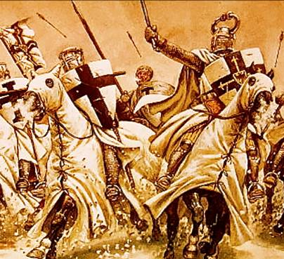
Government
The Crusades
Today our government is expected to take a lead in providing healthcare to help care for and treat the sick. However, in the Middle Ages it was very unusual for monarchs and governments to get involved with medical advancement and issues of health. ( A rare exception of this was during the Black Death when King Edward III ordered the cleaning of towns in 1349.) The role of government at this time was largely to keep the peace and defend the country NOT give money towards universities or advances in medical knowledge.
Fighting wars of religion more important than fighting disease

