Slide 1
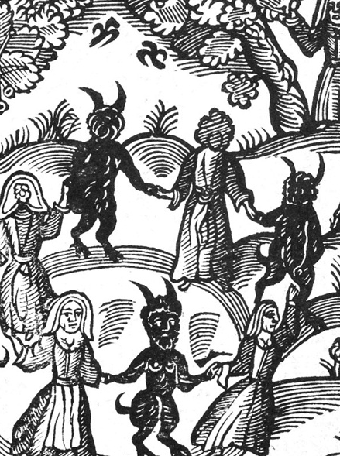
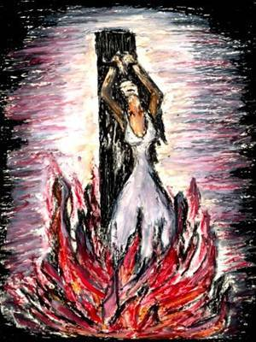
The Witch Craze

Slide 2
Navigation and action buttons
Click to return to the main menu.
Click this symbol on pages to ensure you follow the correct navigation path of the PowerPoint.
Click this symbol on pages to connect to external YouTube videos.
Click this PDF symbol ( now ) to access the supporting student resources, PowerPoint and worksheets.

Slide 3
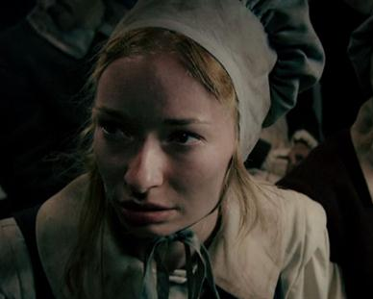
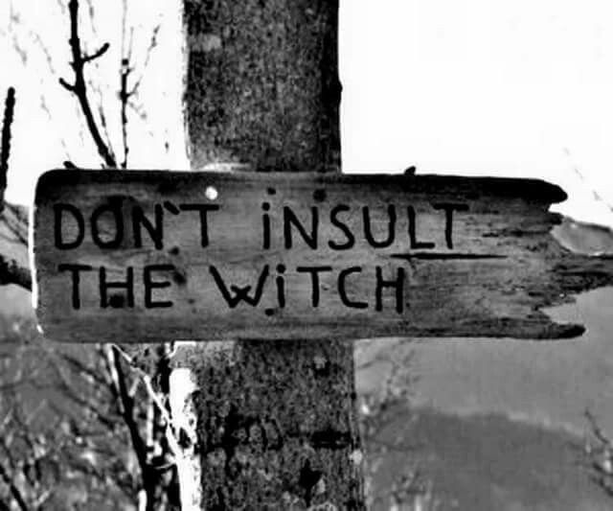
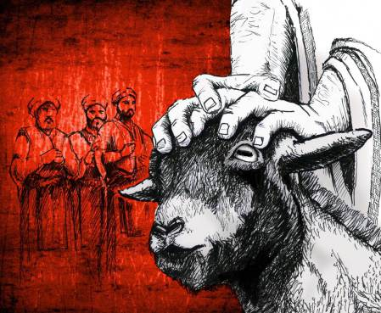
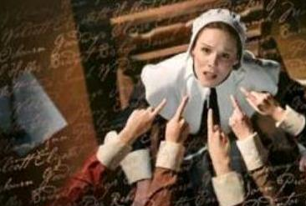
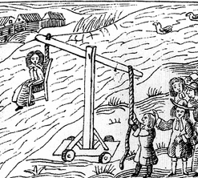
Click on each image to find out more.
WHY WOMEN ACCUSED
HOW TO SPOT A WITCH
WITCHFINDERS
PENDLE WITCHES
SALEM WITCH TRIALS
PUNISHMENTS
SCAPEGOATS
LINKS

Slide 4
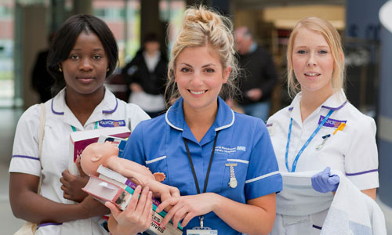
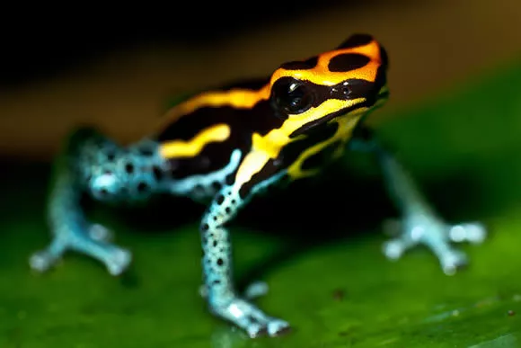
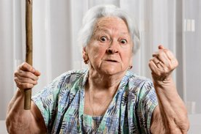
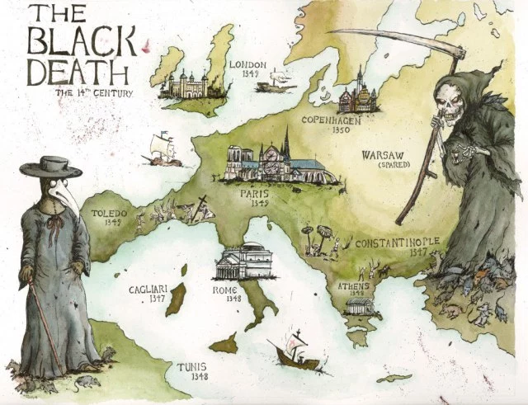
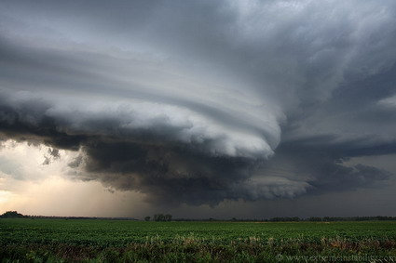
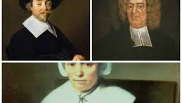
Why Were Women Accused ?
1
2
8
3
7
CANNOT
6
10
4
5
9

Slide 5
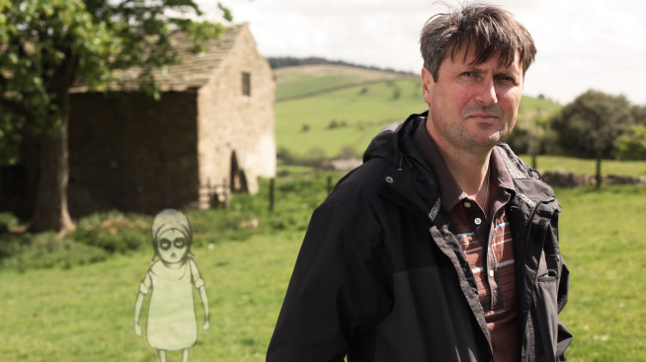
The Pendle WITCHES
Go back to menu …
DOC 1 … Timelines TV
DOC 2 … Pendle Witch Child ( Part 1 )

Slide 6
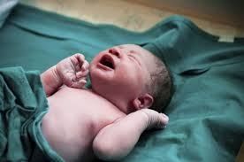
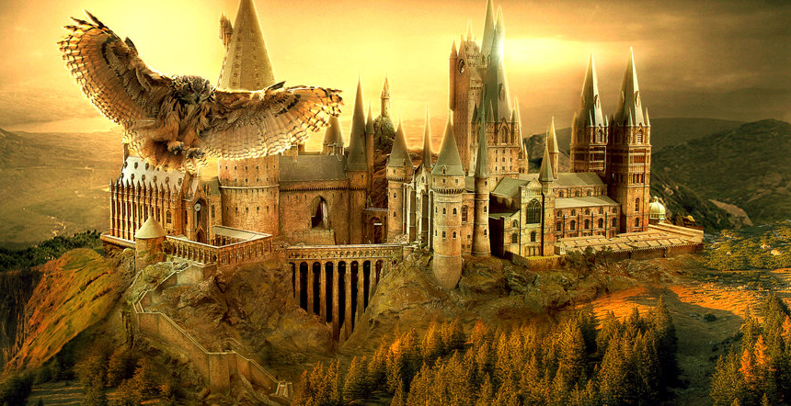
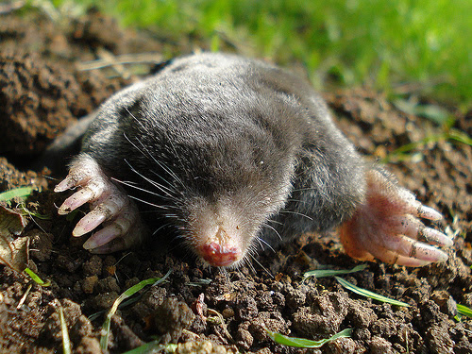
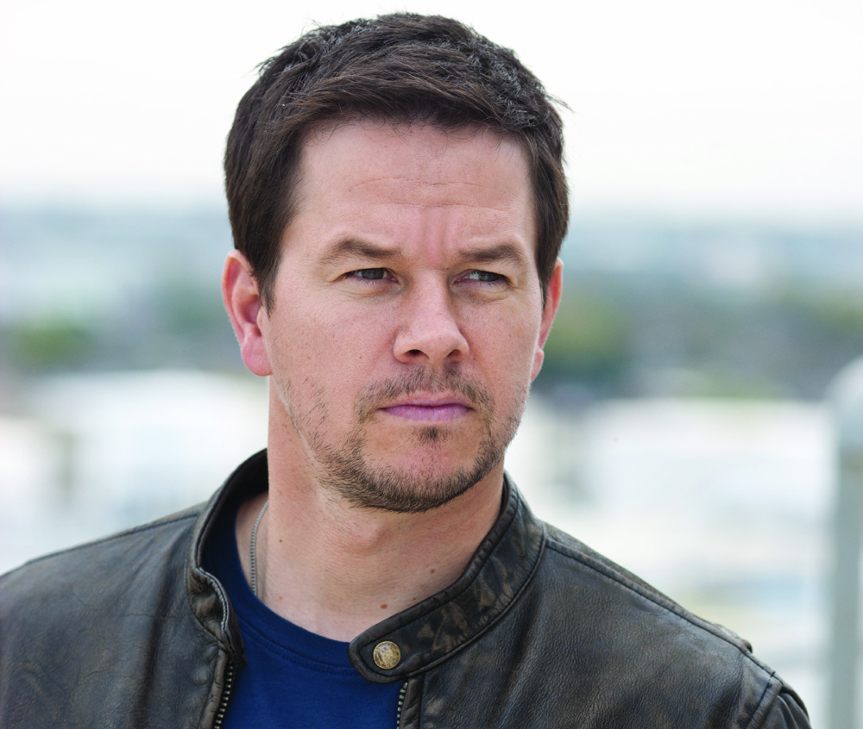
HOW TO SPOT A WITCH 1
According to Witchfinder General Matthew Hopkins there were a number of ways to spot of a person ( almost always a woman) was a witch.
1
1
And / Or
1
Without the ‘Hog’
1

Slide 7
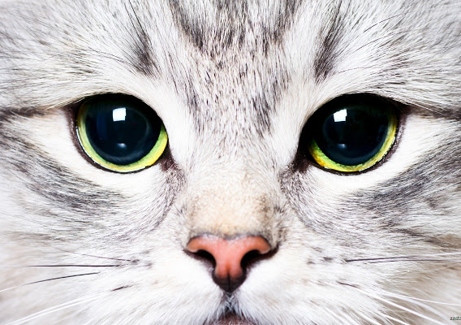
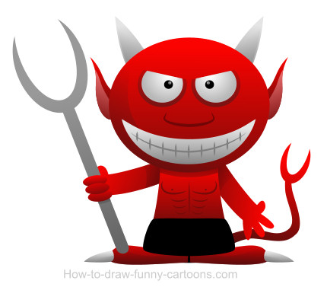
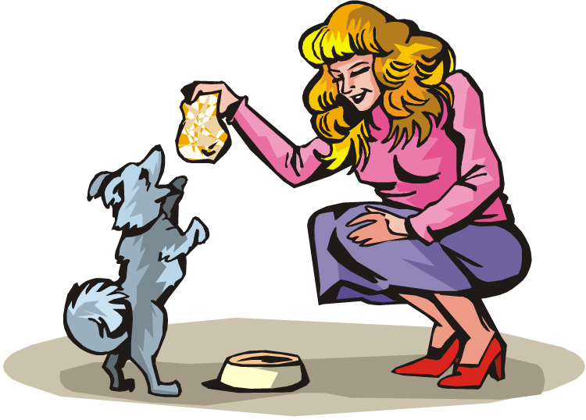
HOW TO SPOT A WITCH 2
=
that
off

Slide 8
HOW TO SPOT A WITCH 3

Slide 9
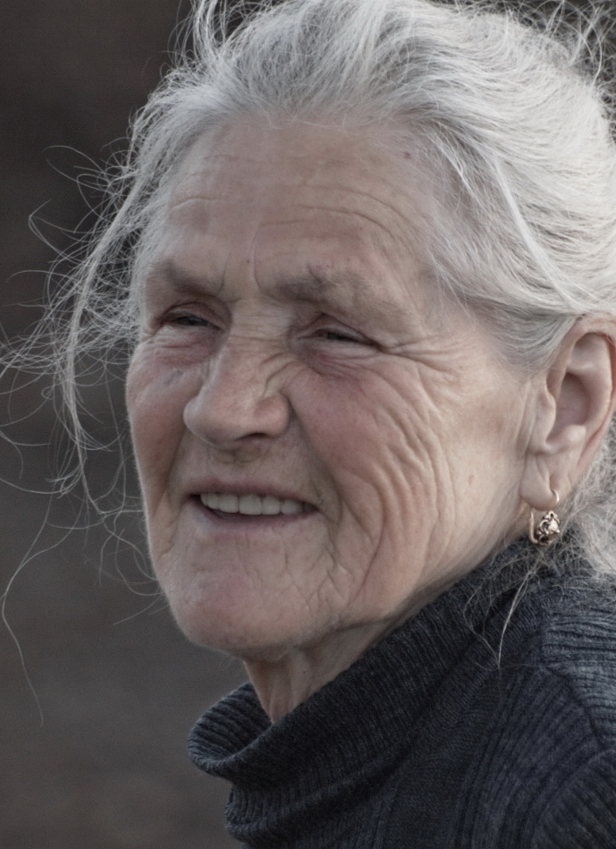
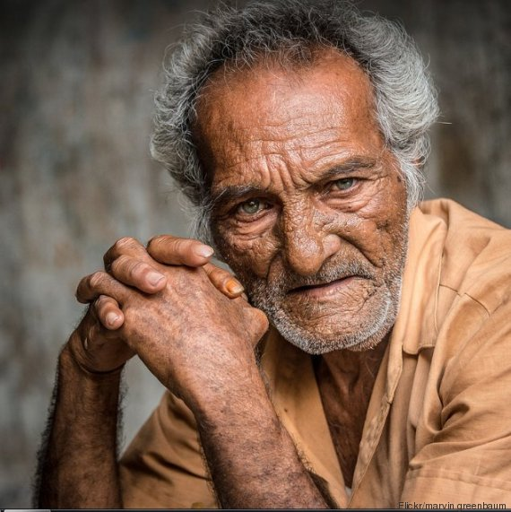
HOW TO SPOT A WITCH 4
A
C
D
A | NN
B | Y
C | N
D | YY
B

Slide 10
HOW TO SPOT A WITCH 5

Slide 11
HOW TO SPOT A WITCH ANSWERS
1: Visible Mark
Such as a birthmark, wart or mole
2: They will have a pet, animal or ‘familiar’
They are demons that feed from the witches mark
3: Absent from church
They did not follow normal rules of society
4: They were usually old women
Men were not usually targeted, but younger women were
5: Acted in strange ways, muttered or talked gibberish
This could be a sign the witch was casting spells

Slide 12
Matthew HOPKINS
Click The PDF symbols for a series of lessons about Matthew Hopkins
Crime and Punishment Revision guide provided by the Southlands High School
Warm Up !
icHistory Resources

