Slide 1
The first World war
by icHistory

Slide 2
Navigation and action buttons
(If there is no clear navigation path click relevant image to progress)
Click to return to the main menu.
Click to return to sub menus.
Next slide.
Click the YouTube symbol to connect to external videos. If a link has been removed you can insert a new one independently.
Click the PDF symbol on pages to access free supporting student resources, PowerPoint and worksheets.

Slide 3
Beginnings
Process
End
More

Slide 4
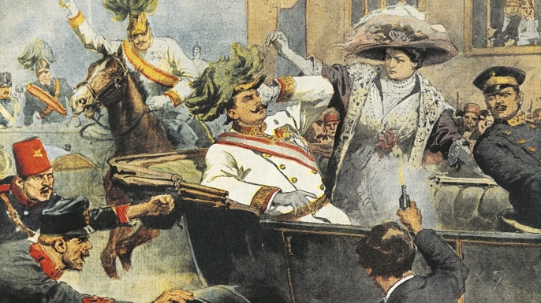
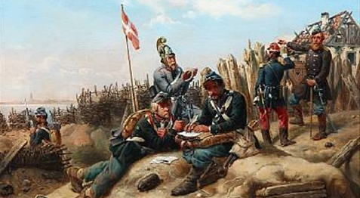
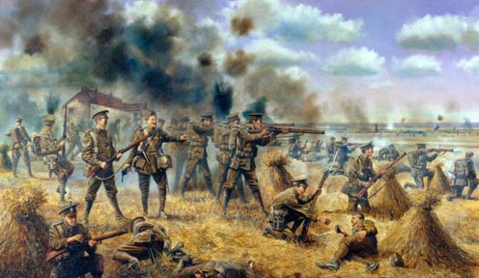
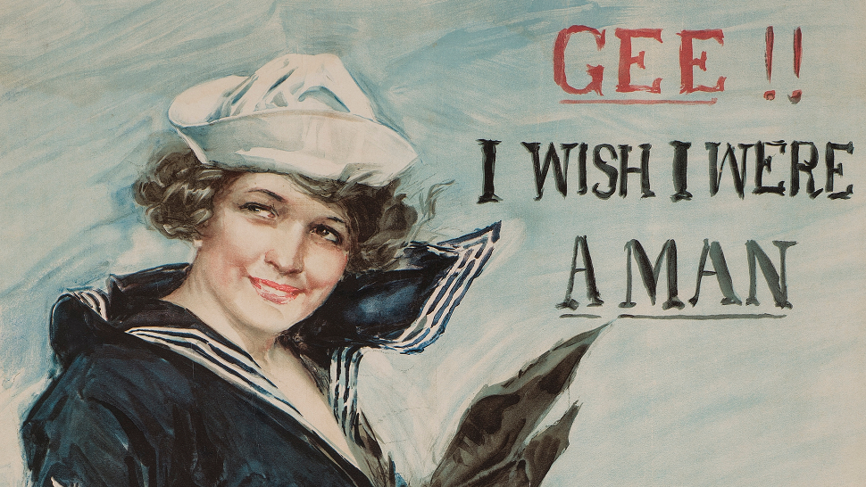
CAUSES OF WW1
LONG, SHORT, TRIGGER EVENTS
OUTBREAK
JOINING THE FIGHT

Slide 5
What could this be …. ?is

Slide 6
What could this represent ? s
E
vents

Slide 7
Long or short term factor ?is
The event = The First World War

Slide 9
Assassination

Slide 10
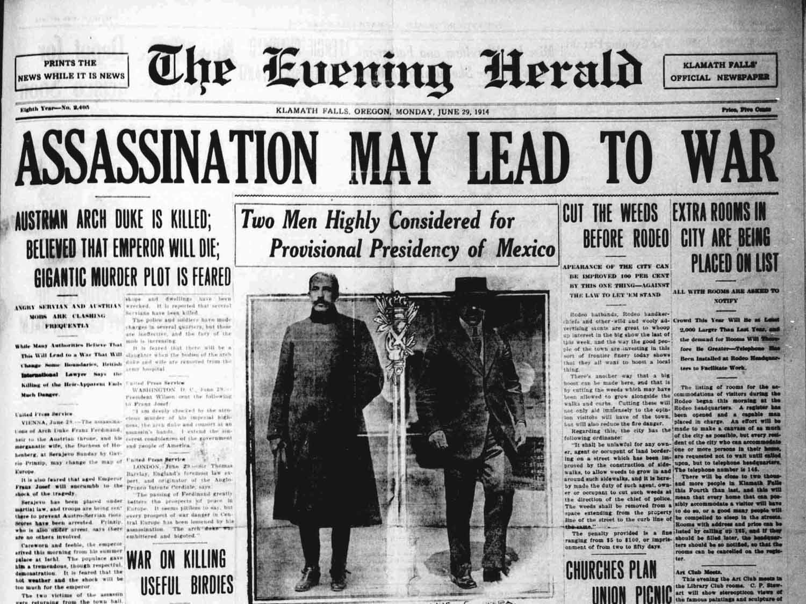
CAUSES
Like almost all major events the First World War had several causes. Causation can be roughly sorted into long term, short term and trigger events. Click right to find out more about the causes of World War 1.
OUTBREAK
When the war began European countries scrambled to mobilise their armies ready for the fight. The initial start of the war saw a mobile war with armies moving across Europe. However, new technology meant that old methods of warfare were over.
Germany initiates the Schlieffen Plan. Britain declares war on Germany.
JOINING UP
At the start of the war many men were excited to volunteer join the fight. They were filled with a sense of patriotism and perhaps saw war in a rather ‘romantic’ way. Many would go to fight, help win the war and return a hero. The reality was usually very different.

Slide 11
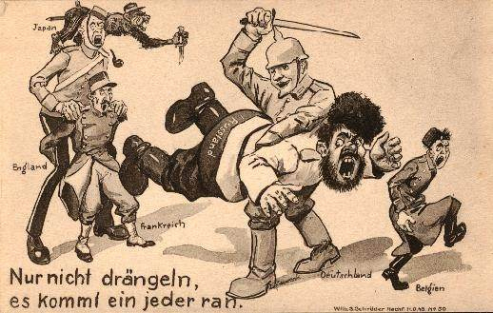
Click on images to navigate to relevant activities …
THE JULY CRISIS ACTIVITY
Outbreak summary / plenary
WHO WAS TO BLAME FOR WW1

Slide 12
The July Crisis: 1914. The following activity will help you understand the process of events that led to the outbreak of World War One. Simply click the events in the correct order. Note - a wrong choice will reset the activity and you will have to start again. Note, note - Follow the navigation buttons carefully to ensure the activity works correctly. This can be done indivdually or run as a class activity as suggested below. 1. Split the class into two teams and decide which team begins. ‘Team A’ should vote to choose which event comes first. ’Team A’ is in control until an error is made. Once an error is made ‘Team B’ takes over. The team that gets to the end is the ‘winner’.

Slide 13
Germany initiates the Schlieffen Plan. Britain declares war on Germany.
Austria declares war on Serbia. Russia starts to mobilise its army.
Austria sends an unrealistic ultimatum to Serbia.
July Crisis Begins Austria is given a ‘blank cheque’ from Germany.
Serbia accepts all but one of the terms of the ultimatum. Seeks Russian support.
Germany declares war on France.
Germany declares war on Russia.
Gavrilo Princip shoots and kills Austrian Archduke Franz Ferdinand in Sarejvo, Bosnia.
Austria-Hungary declares war on Russia. Serbia declares war on Germany.

Slide 14
Incorrect… Click Left To Restart The Activity

Slide 15
Well done …you must click the green arrow to ensure the PowerPoint navigates correctly.

Slide 16
Germany initiates the Schlieffen Plan. Britain declares war on Germany.
Austria declares war on Serbia. Russia starts to mobilise its army.
Austria sends an unrealistic ultimatum to Serbia.
July Crisis Begins Austria is given a ‘blank cheque’ from Germany.
Germany declares war on France.
Germany declares war on Russia.
Serbia accepts all but one of the terms of the ultimatum. Seeks Russian support.
Austria-Hungary declares war on Russia. Serbia declares war on Germany.

Slide 18
Austria declares war on Serbia. Russia starts to mobilise its army.
Germany initiates the Schlieffen Plan. Britain declares war on Germany.
Austria sends an unrealistic ultimatum to Serbia.
Germany declares war on France.
Germany declares war on Russia.
Serbia accepts all but one of the terms of the ultimatum. Seeks Russian support.
Austria-Hungary declares war on Russia. Serbia declares war on Germany.

Slide 20
Germany initiates the Schlieffen Plan. Britain declares war on Germany.
Austria declares war on Serbia. Russia starts to mobilise its army.
Germany declares war on France.
Germany declares war on Russia.
Serbia accepts all but one of the terms of the ultimatum. Seeks Russian support.
Austria-Hungary declares war on Russia. Serbia declares war on Germany.

Slide 22
Germany initiates the Schlieffen Plan. Britain declares war on Germany.
Germany declares war on France.
Austria declares war on Serbia. Russia starts to mobilise its army.
Germany declares war on Russia.
Austria-Hungary declares war on Russia. Serbia declares war on Germany.

Slide 24
Germany initiates the Schlieffen Plan. Britain declares war on Germany.
Germany declares war on France.
Germany declares war on Russia.
Austria-Hungary declares war on Russia. Serbia declares war on Germany.

Slide 26
Germany initiates the Schlieffen Plan. Britain declares war on Germany.
Austria-Hungary declares war on Russia. Serbia declares war on Germany.
Germany declares war on France.

Slide 28
Austria-Hungary declares war on Russia. Serbia declares war on Germany.
Germany initiates the Schlieffen Plan. Britain declares war on Germany.

Slide 30
Austria-Hungary declares war on Russia. Serbia declares war on Germany.

Slide 31
Well Done ! The First World War Has Begun … Now consider … who was most to blame?

Slide 32
Which country was to blame for the First World War?
 | Blame 100% | Key Reason | Rank
Austria
Belgium
Britain
France
Germany
Italy
Russia
Serbia

Slide 33
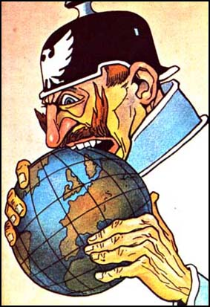
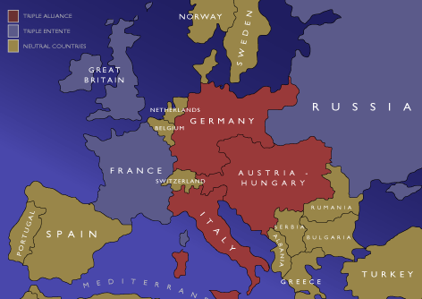
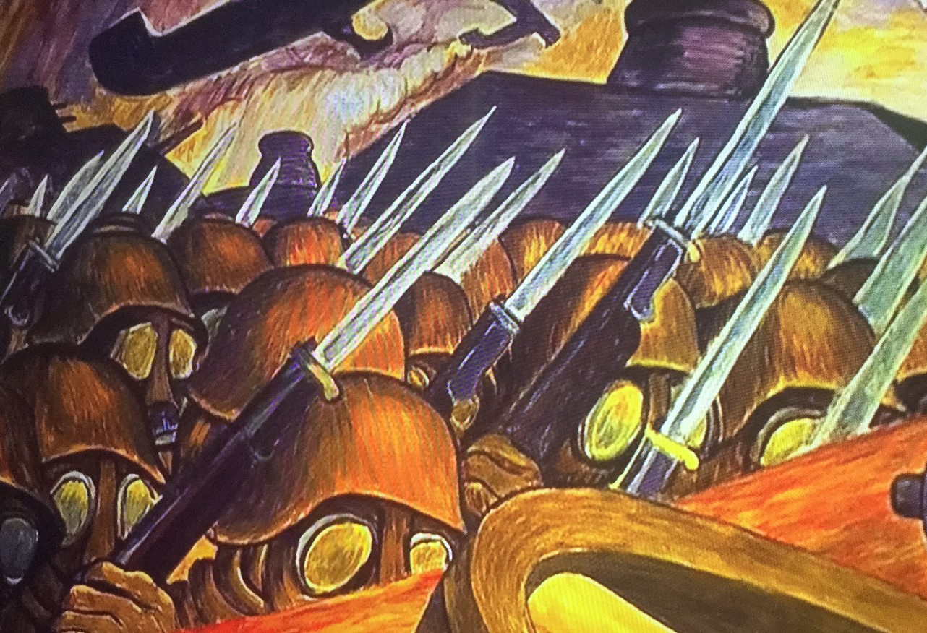
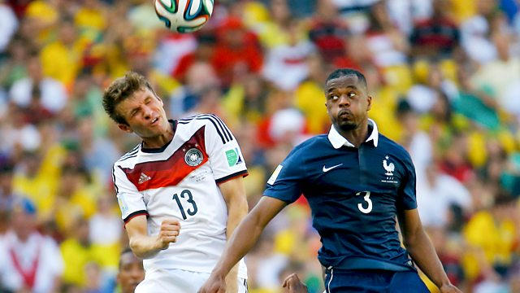
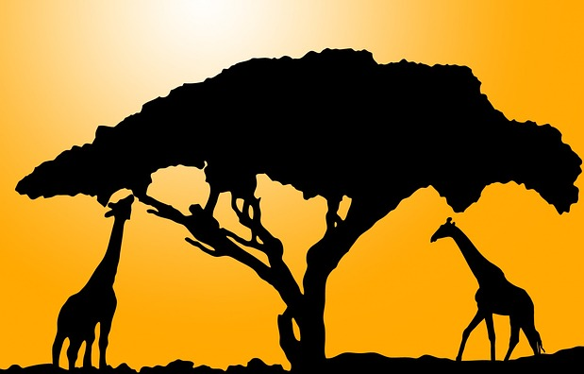
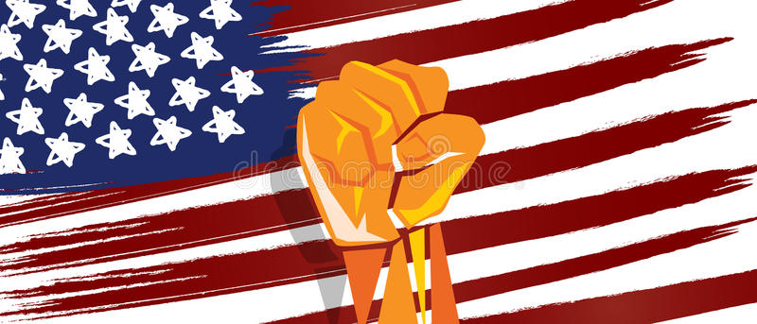
Starter… use the images to guess the causes of WW1.
Click on each image to find out more.

Slide 34
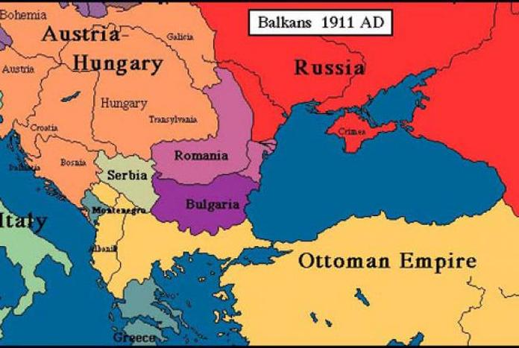
The Bosnian crisis:1908
Austria had once been a European superpower. However, during the 19th century her power began to fade. A large but outdated army ruled over the vast Austro-Hungarian Empire. In 1908, Austria annexed ( took over ) Bosnia. This was partly due to unrest in the Balkans, an area to the south of Austria-Hungary. This would be a major cause of trouble as many Bosnians wanted to join with Serbia to the east. Serbia was furious and threatened to declare war with Austria.

Slide 35
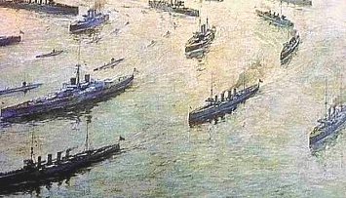
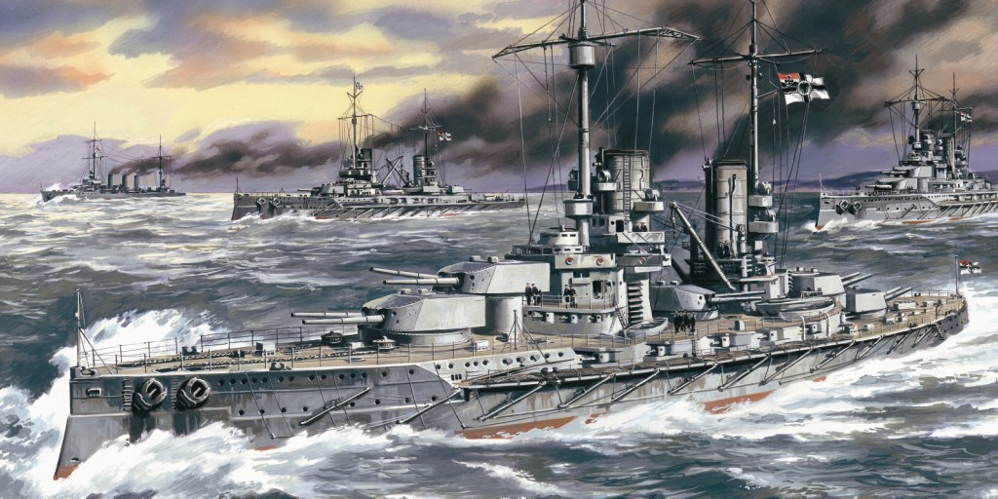
Militarism + The Naval Race
With the growth in nationalism European countries wanted to show they were powerful they began to build up their military forces. Pride turned to fear as nations felt threatened by enemies that grew more powerful so they raced to ensure they were able to defend if attacked. A good example of the was the Anglo-German naval race. Traditionally Britain had ‘ruled the waves’ and prided itself on having the biggest and most powerful navy in the world. However, as a young boy Wilhelm ( the future German Kaiser) had visited England and marvelled at Britain's navy. He vowed to build a navy to match that of Britain. As Wilhelm ordered the building of more ships King George did the same and an arms race began.

Slide 36
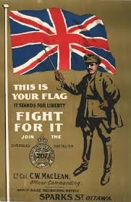
Growing nationalism
During the 1800’s countries in Europe had experienced a growing sense of pride and love for their country. Germany and Italy had only become unified countries after 1860. This created an environment in which nations wanted to prove that their country was superior (better) than others. The results of this were …
Increased
rivalry, anger and hostility.
Greater will to go to war to protect national interest.

Slide 37
The Alliance System
European countries had a long history of warfare and also of shifting alliances. With growing tensions in Europe two major alliances took shape.
In 1882, Germany, Austria-Hungary and Italy joined together in the Triple Alliance. In 1907 Britain, France and Russia joined the Triple Entente.
The alliance system meant that small conflict would most likely lead to a war between all major European countries.

Slide 38
The assassination
The assassination of the Archduke Franz Ferdinand and his wife in Sarajevo was critical in setting off a chain of events that led to the First World War. Not only was it a bad day for the Archduke and his family, but also a bad day for Europe and the wider world.

Slide 39
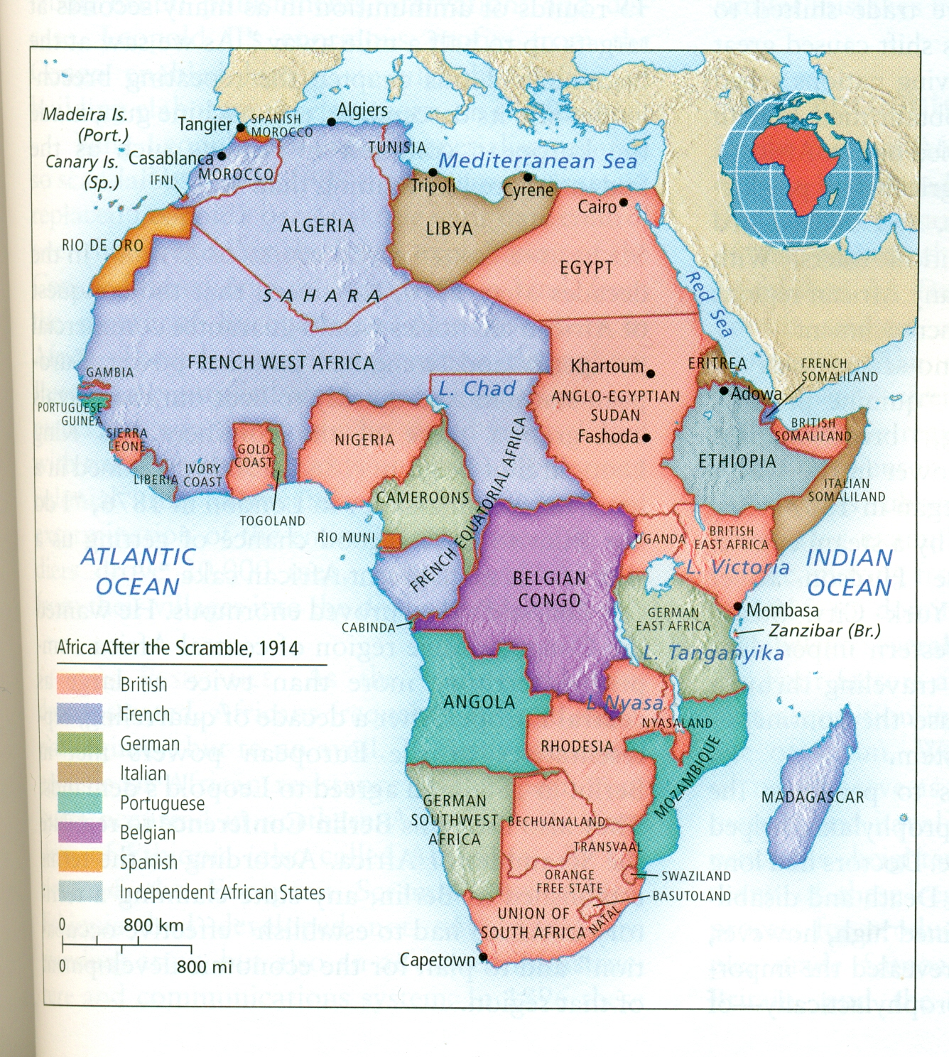
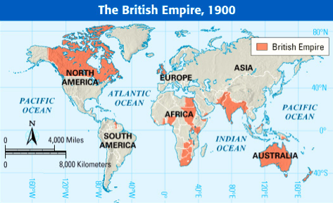
Imperialism and empires
The "Scramble for Africa" or partition of Africa was the invasion and colonization of African territory by European powers during a period of Imperialism in the later 1800’s. The backdrop in Africa created further tensions between the major European countries and was just one area where European powers jostled for more territory.

Slide 40
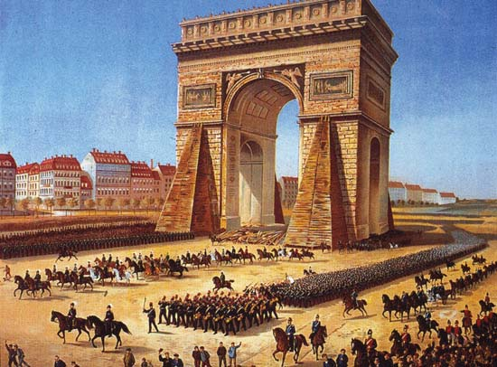
German and FRENCH Hatred
Germany and France had long been neighbours at war. The Franco-Prussian War was fought between France and Prussia (Germany) between 1870 -1871. Prussia would first fight and destroy the armies of the emperor Napoleon, then the newly raised armies of the Third Republic. The victory of the German states created a unified German Empire and brought the fall of the empire of Napoleon III. As part of the settlement, the French territory of Alsace-Lorraine was taken by Germany.
Prussian troops enter Paris, France.

Slide 41
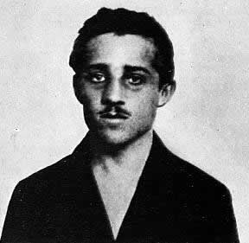
Quick Quiz The Causes Of WW1 Use a team flashboard for bonus answers?

Slide 42
1: Which of the following were NOT causes of the First World War? ( 2 answers )
A
The Anglo – German Naval Race
Bonus Countdown ! Longest Word? M S E I A L I R I M P Click Clock
B
The Alliance Systems
C
Austria – Hungary was getting stronger
D
Adolf Hitler takes over Germany

Slide 43
Longest word Imperialism

Slide 44
2: Which of the following were causes of the First World War? (2 answers)
A
Militarism
B
Sensationalism
Bonus 1 Many European counties ‘scrambled’ to grab parts of which continent in the 1800’s?
C
Nationalism
D
Pessimism

Slide 45
Africa

Slide 46
3: Which countries signed the Triple Alliance?
A
Germany , Russia, Italy
Bonus 1 In what year was the Triple Alliance signed?
B
Austria –Hungary, Italy, France
C
Russia, Britain, France
D
Austria-Hungary, Germany, Italy

Slide 47
1882

Slide 48
4 : Which statement best describes the Bosnian Crisis?
A
A war between Serbia and Bosnia
Bonus 1 Which country controlled Bosnia in 1908?
B
A disagreement over the control of Bosnia
C
Russia invaded the Balkans
Bonus 2 To what Balkan country did many Bosnians want to join with?
D
Serbia taking over Bosnia

Slide 49
1. Austria-Hungary 2. Serbia

Slide 50
5 : Which statement is the odd one out?
A
Prime Minister
Bonus 1 Who was the British King when WW1 began?
B
Kaiser
C
Tsar
D
King

Slide 51
King George V

Slide 52
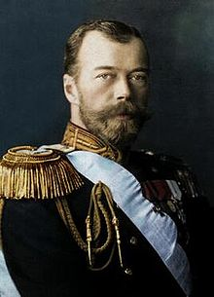
6 : Who is this?
A
Kaiser Wilhelm of Germany
B
Tsar Nicholas II Of Russia
C
King George V Britain
Bonus 1 Which of A, B and C were cousins?
D
Captain Birdseye

Slide 53
All 3 were cousins yet they would eventually go to war with each other!

Slide 54
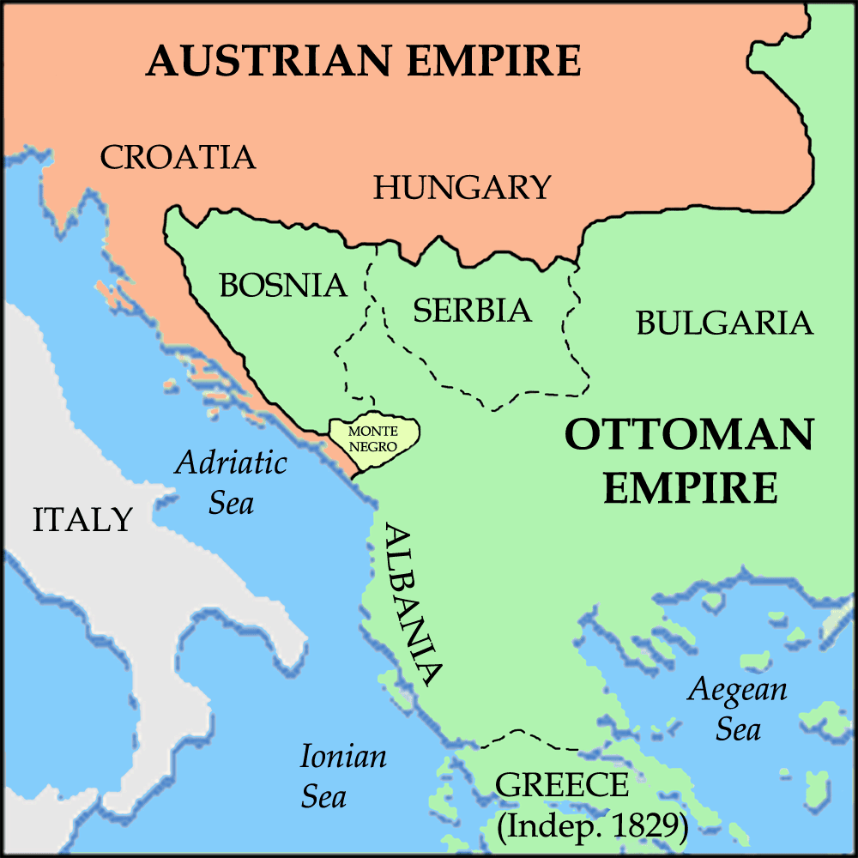
7: Identify the countries covered by X,Y and Z
A
X Russia, Y Austria, Z Serbia
X
Y
Z
B
X Austria, Y Bosnia, Z Serbia
C
X Austria, Y Serbia, Z Bosnia
Bonus 1 Which country acted as a ‘big brother’ to Serbia?
D
X Germany, Y Bosnia Z Serbia

Slide 55
Russia

Slide 56
8 : Best describes Gavrilo Princip?
A
An Austrian Terrorist
Bonus 1
How many people did he assassinate in 1914?
B
A Serbian Nationalist
C
A Bosnian Nationalist
D
An Australian Tourist

Slide 57
Three 1. Archduke Ferdinand 2. Duchess Sophie 3. Their unborn child

Slide 58
9 : The terrorist / nationalist group that Princip was part of?
A
The Red Nose Gang
Bonus 1 What did Princip do after his first failed attempted assassination?
B
The Blue Man Group
C
The Red Hand Gang
D
The Black Hand

Slide 59
The Story? Bought and ate a
sandwich

Slide 60
10 : Best describes the assassination of Archduke Franz Ferdinand?
A
A Long Term Cause
Bonus 1 ‘Who’ did Austria blame for the killing of Archduke Ferdinand?
B
The Trigger
C
A Short Term Cause
D
The Tipping Point

Slide 61
Serbia

