Slide 1
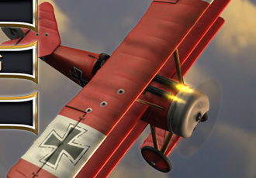
The First World War
The Great Big Review Quiz

Slide 2
The complete quiz comprises of 6 rounds.
Suggestions …
1. Break into teams of 3 to 6 or people. 2. Each team should choose a captain. 3. Each team should choose a team name. Nb: maximum of 3 points for team names. 4. After each round the team with the lowest score can steal a player from any other team. Nb. captains cannot be transferred. 5. Teacher to decide how bonus questions are answered. You can access a PDF answer template below

Slide 3
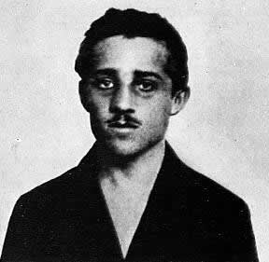
Round 1 The Causes Of WW1 Use a team flashboard for bonus answers?

Slide 4
1: Which of the following were NOT causes of the First World War? (2)
A
The Anglo – German Naval Race
Bonus Countdown ! Longest Word? M E I A L I R I S M P Click Clock
B
The Alliance Systems
C
Austria – Hungary was getting stronger
D
Adolf Hitler takes over Germany

Slide 5
Imperialism

Slide 6
2: Which of the following were causes of the First World War? (2)
A
Militarism
Bonus 1 Many European counties ‘scrambled’ to grab parts of which continent in the 1800’s?
B
Sensationalism
C
Nationalism
D
Pessimism

Slide 7
Africa

Slide 8
3: Which countries signed the Triple Alliance?
A
Germany , Russia, Italy
Bonus 1 In what year was the Triple Alliance Signed?
B
Austria –Hungary, Italy, France
C
Russia, Britain, France
D
Austria-Hungary, Germany, Italy

Slide 9
1882

Slide 10
4 : Which statement best describes the Bosnian Crisis?
A
A war between Serbia and Bosnia
Bonus 1 Which country controlled Bosnia in 1908?
B
A disagreement over the control of Bosnia
C
Russia invaded the Balkans
Bonus 2 To what Balkan country did many Bosnians want to join with?
D
Serbia taking over Bosnia

Slide 11
1. Austria-Hungary 2. Serbia

Slide 12
5 : Which statement is the odd one out?
A
Prime Minister
Bonus 1 Who was the British King when WW1 began?
B
Kaiser
C
Tsar
D
King

Slide 13
King George V

Slide 14
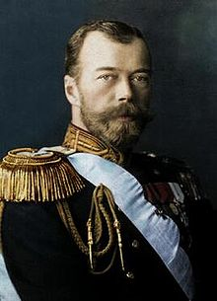
6 : Who is this?
A
Kaiser Wilhelm of Germany
B
Tsar Nicholas II Of Russia
C
King George V Britain
Bonus 1 Which of A, B and C were cousins?
D
Sherlock Holmes

Slide 15
All 3 were cousins yet they would eventually go to war with each other!

Slide 16
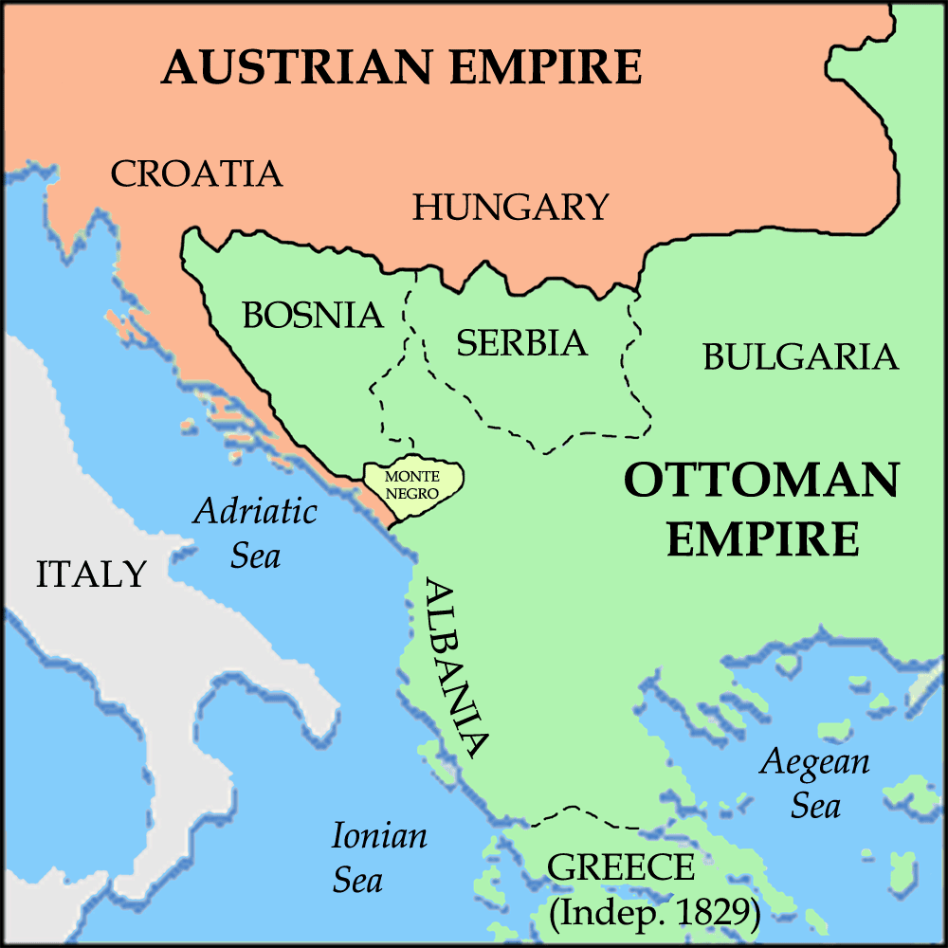
7: Identify the countries covered by X,Y and Z
A
X Russia, Y Austria, Z Serbia
X
Y
Z
B
X Austria, Y Bosnia, Z Serbia
C
X Austria, Y Serbia, Z Bosnia
Bonus 1 This country acted as ‘big brother’ to Serbia?
D
X Germany, Y Bosnia Z Serbia

Slide 17
Russia

Slide 18
8 : Best describes Gavrilo Princip?
A
An Austrian Terrorist
Bonus 1 How many people did he assassinate in 1914?
B
A Serbian Nationalist
C
A Bosnian Nationalist
D
A Russian Imperialist

Slide 19
Three 1. Archduke Ferdinand 2. Duchess Sophie 3. Their unborn child

Slide 20
9 : The terrorist / nationalist group that Princip was part of?
A
The Red Nose Gang
Bonus 1 What did Princip do after his first failed attempted assassination?
B
The Blue Man Group
C
The Red Hand Gang
D
The Black Hand

Slide 21
Bought and ate a
sandwich

Slide 22
10 : Best describes the assassination of Archduke Franz Ferdinand?
A
A Long Term Cause
Bonus 1 ‘Who’ did Austria blame for the killing of Archduke Ferdinand?
B
The Trigger
C
A Short Term Cause
D
The Tipping Point

Slide 23
Serbia

Slide 24
End Of Round 1 The team with the lowest score can steal a player from any other team.

Slide 25
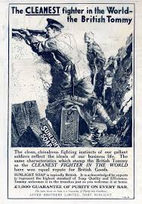
Round 2
Beginnings / Trenches.

Slide 26
11 : Which of the following happened first?
A
Russia moblised against Austria and Germany
Bonus 1 Complete the order of events after B
B
Austria-Hungary attacked Serbia
C
Germany invaded Belgium
Bonus 2 Name the plan that would stop Germany fighting a war on 2 fronts. Correct spelling bonus!
D
Britain declares war on Germany

Slide 27
B, A, C, D Schlieffen Plan

Slide 28
12 : Why did the Schlieffen Plan fail? (3)
A
Belgium fought and held back the Germans
Bonus 1 Give one other reason the plan failed
B
The French defended their border well
C
German commanders did not communicate well
D
Russia mobilised much quicker than expected

Slide 29
The French fought fiercely to stop the circling of Paris

Slide 30
13 : Consequences of the failed Schlieffen Plan? (2)
A
Trench warfare
Bonus 1 What did Kurt von Schlieffen say about the failed plan?
B
Germany lost the war the following year
C
The French were knocked out of the war
D
Germany has to fight a war on two fronts

Slide 31
Nothing, he died long before the war started.

Slide 32
14 : Not part of a trench system? (2)
A
Toilet Duck
Bonus 1 Where did soldiers sleep?
B
Duck Board
C
Fire Trap
D
Fire Step

Slide 33
Dugout

Slide 34
15 : Part of a soldier’s morning routine.
A
Stand Up
Bonus 1 Image?
B
Stand To
C
Stand Out
D
Stand Off

Slide 35
Dugout

Slide 36
16 : Soldiers ate.. (2)
A
Intimidating Lamb
Bonus 1 Why were trenches shaped like this?
B
Bully Beef
C
Dried Biscuits
D
Dried Beef

Slide 37
To stop one explosion killing too many men

Slide 38
17 : What was getting a ‘cushy’?
A
A good night’s sleep
Bonus 1 Give two possible causes of.. C H E L L O S H S K
B
Extra pillows for the Dug Out
C
Too friendly with the officers
D
Sent home due to an injury

Slide 39
Shellshock Fear / stress of being in the trenches The result of air pressure caused by explosion Effects of the terrible sights of death and injury

Slide 40
18: Rats were described as being as big as….
A
Mice
Bonus 1 Why were the rats so big?
B
Small Dogs
C
Cats
D
Children

Slide 41
There was so much for them to eat (dead soldiers)

Slide 42
19: This country had the most success when attacking trenches….
A
Britain
Bonus 1 Explain the Canadian strategy?
B
Germany
C
France
D
Canada

Slide 43
Night time attacks against a concentrated area

Slide 44
20 : Best for for defending a trench (2)
A
Artillery
Bonus 1 Which country was barbed wire invented in and what was its original use?
B
Sandbags
C
Barbed Wire
D
Machine guns

Slide 45
USA It was a farming invention used to fence off the Great Plains.

Slide 46
End Of Round 2 The team with the lowest score can steal a player from any other team.

Slide 47
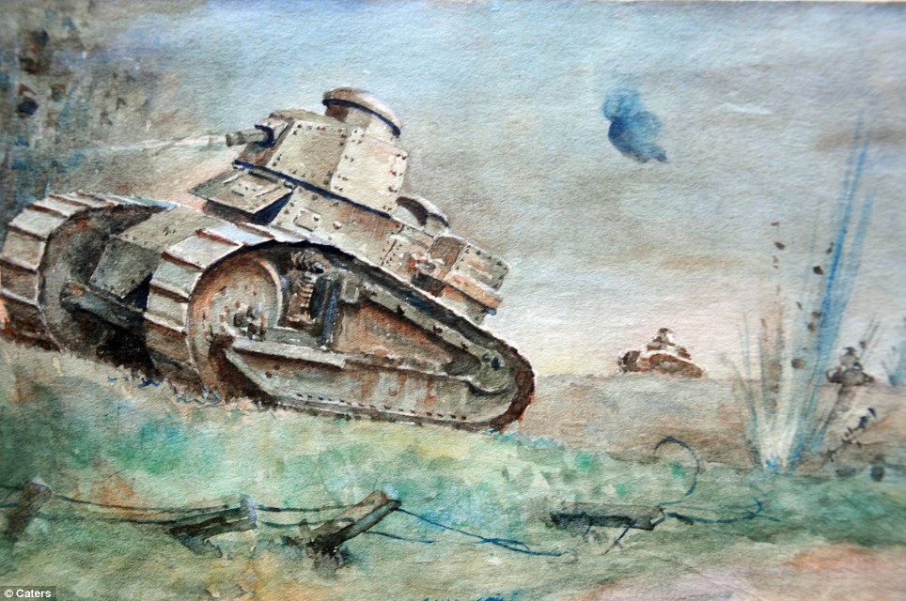
Round 3
Major Events

Slide 48
21 Took place in the first year of the war
A
Battle of the Somme
Bonus 1 Why did the Christmas Day truce NOT happen in December 1915?
B
Russia leaves the war
C
USA enters the war
D
The Christmas Day truce

Slide 49
The High Command issued orders that any further fraternising with the enemy was a court marshal offence (Death penalty)

Slide 50
22. Why was the Battle of the Somme needed?
A
Germany was threatening to break French lines
Bonus 1 Where were the German threatening to break? Clue = V
B
To win the war outright
C
Germany about to break the British trenches
D
To improve Haig’s reputation

Slide 51
Verdun

Slide 52
23. Outcomes of the Battle of the Somme? (2)
A
British win
Bonus 1 The battle was described as ‘futile’. What does this mean?
B
Thousands of dead
C
Over a million dead
D
Only a small amount of ground taken

Slide 53
Pointless

Slide 54
24. Why did the USA enter the war (2)
A
German U-boats sank American merchant ships
Bonus 1 Name the telegram Germany sent to Mexico
B
A telegram
C
The US president was hungry for glory
Bonus 2 What did this secret telegram say?
D
Germany declared war on the USA

Slide 55
The Zimmermann Telegram Germany asked Mexico to attack the USA

Slide 56
25. Why had America stayed out of the war until 1917?
A
It was weak
Bonus 1 Name the most famous (British) passenger ship sunk by German U-boats
B
It had no army
C
It was isolationist
Bonus 2 How many Americans were killed when the ship was sunk?
D
It was allied with Germany

Slide 57
Lusitania 1153 killed
128 were Americans

Slide 58
26. Who won the Battle of Tannenberg?
A
Russia
Bonus 1 Name another large battle of the Eastern Front Clue= M L
B
Germany
C
Britain
D
Austria-Hungary

Slide 59
Masurian Lakes

Slide 60
27. Why did Russia leave the war in 1917? (2)
A
It became friends with Germany
Bonus 1 Name the treaty Germany forced on the Russians
B
It was exhausted from fighting
C
It hated America
D
It had been taken over by a communist revolution

Slide 61
Brest Litovsk

Slide 62
28. Who took control of the Soviet Union in 1917?
A
Stalin
Bonus 1 Name the communist party that led the Russian revolution
B
Lenin
C
Tsar Nicholas
Bonus 2 What did Russia became known was after 1917?
D
No one

Slide 63
The Bolsheviks The Soviet Union Or USSR

Slide 64
29. Where did Germany have colonies?
A
Asia
Bonus 1 Germany controlled parts of East Africa also known was ? Clue=Ta?
B
South America
C
Africa
D
North America

Slide 65
Tanzania

Slide 66
30. Which country sent over 1 million soldiers to fight for the British army?
A
Israel
Bonus 1 Why did Indians fight for the British?
B
India
C
Thailand
D
Argentina

Slide 67
India was part of the British Empire (The Jewel In The Crown)

Slide 68
End Of Round 3 The team with the lowest score can steal a player from any other team.

Slide 69
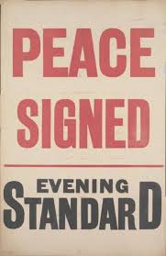
Round 4
The End Game

Slide 70
31. The war was not fought here…
A
Africa
Bonus 1 Why did a European was become a world war?
B
Australia
C
Asia
D
Argentina

Slide 71
Manu European countries had Empires and they got involved EG : India, Canada and Australia were part of the British Empire

Slide 72
32. How did the entry of the USA help Britain and France? (2)
A
More resources
Bonus 1 How many soldiers did India sent to help Britain fight the war?
B
New weapons
C
Fresh, motivated soldiers
D
Millions more soldiers

Slide 73
1 Million

Slide 74
33. How did Britain stop resources, weapons and equipment getting to Germany ?
A
Army Blockage
Bonus 1 What was this?
B
Military Blockers
C
Army Blockade
Bonus 2 Name the major naval battle of WW1 Clue = J
D
Naval Blockade

Slide 75
1.Britain blocked all German ports
2. Jutland

Slide 76
34. What was the Ludendorff Offensive?
A
A final, successful British attack
Bonus 1 S R A I K E
B
A final, failed Germany attack
C
A successful German attack
D
A final battle that left no clear winner

Slide 77
Kaiser

Slide 78
35. Why did Germany and her allies lose the war? (3)
A
Austria-Hungary was a weak ally
Bonus 1 Give one example how the war affected the German people
B
The Triple Entente had more resources
C
Had to fight a war on two fronts
D
Russia was a weak ally

Slide 79
Starvation Social Unrest Growth in support for communism Other?

Slide 80
36. What happened to the German Kaiser at the end of the war?
A
He was killed by his own people
Bonus 1 Who took over the rule of Germany?
B
He was killed by the British
C
He fled to Holland
D
He stayed in Germany and signed the surrender

Slide 81
The Social Democrat Party

Slide 82
37. Which country changed alliances during the war?
A
Austria-Hungary
Bonus 1 Why did Italy change sides?
B
France
C
Italy
D
Belgium

Slide 83
Italy did not commit to fighting for the triple Alliance at the start if the war. It changed sides when it sat they were doing badly.

Slide 84
38. How many people died during the war?
A
Austria-Hungary
Bonus 1 Which country suffered the most deaths?
B
France
C
Italy
D
Belgium

Slide 85
Russia?

Slide 86
39. Peace was offered to Germany based on this man’s idea. What were his ideas called?
A
10 Commandments
B
12 Statements
C
13 Requirements
Bonus 1 Who is this?
D
14 Points

Slide 87
Woodrow Wilson

Slide 88
40. Which countries decided what would happen to Germany after the war?
A
Britain, France, USA and Italy
B
Britain, Germany, France
Bonus 1 What was the name of the treaty that punished Germany after the war?
C
Russia, Britain and France
D
USA, Britain, Russia
And France

Slide 89
The Treaty of Versailles

Slide 90
End Of Round 4 The team with the lowest score can steal a player from any other team.

Slide 91
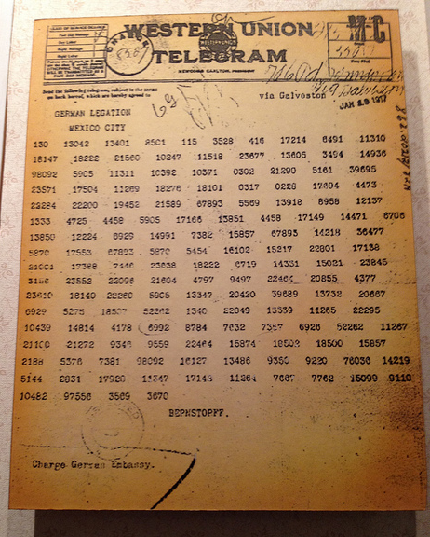
Round 5
Pictures

Slide 92
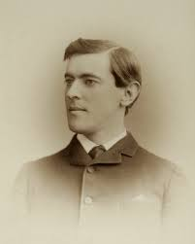
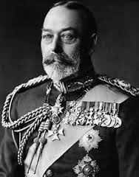
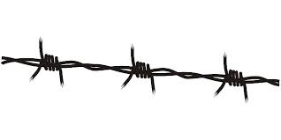
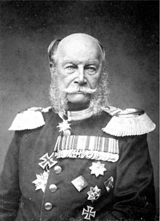
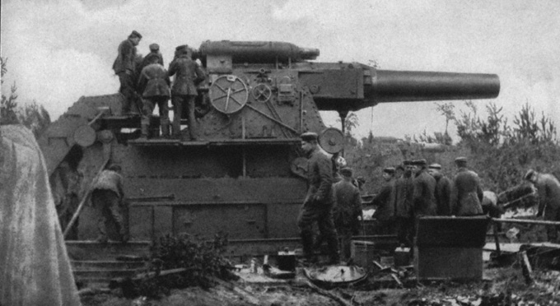
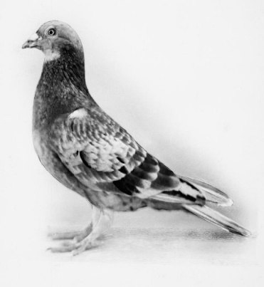
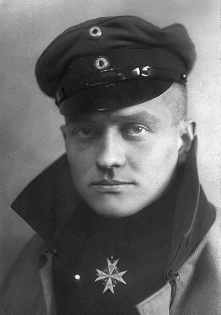
4
2
1
3
8
5
7
6
9
10

Slide 93
4
Barbed Wire
2
1
King George V
3
Tsar Nicholas II
Woodrow Wilson
8
5
7
Kaiser Wilhelm II
Zimmermann Telegram
Big Bertha
6
9
The Red Baron
10
Cher Ami
No Man’s Land

Slide 94
End Of Round 5 The team with the lowest score can steal a player from any other team.

Slide 95
Round 6 Chronology

Slide 96
Date | Jumbled Events
1882 | Assassination Of Franz Ferdinand
1907 | The Triple Alliance Signed
1908 | The Ludendorff Offensive Begins
June, 1914 | The Treaty Of Brest-Litovsk Signed
December, 1914 | The Christmas Day Truce
!916 | The Bosnian Crisis
1917 | The USA enters the war
February, 1918 | The Battle Of The Somme
March, 1918 | The Triple Entente Signed
November 11th 1918 | Germany signs the armistice to end the war

Slide 97
Answers

Slide 98
Date | Ordered Events
1882 | The Triple Alliance Signed
1907 | The Triple Entente Signed
1908 | The Bosnian Crisis
June, 1914 | Assassination Of Franz Ferdinand
December, 1914 | The Christmas Day Truce
!916 | The Battle Of The Somme
1917 | The USA enters the war
February, 1918 | The Treaty Of Brest-Litovsk Signed
March, 1918 | The Ludendorff Offensive Begins
November 11th 1918 | Germany signs the armistice to end the war

Slide 99
End Of Round 6 The team with the lowest score can steal a player from any other team.

