Slide 1
The Second World war
by icHistory

Slide 2
Navigation and action buttons
Click to return to the main menu.
Click to return to sub menus.
Click the YouTube symbols on pages to connect to external videos.
Click the PDF symbol on pages to access free supporting student resources, PowerPoint and worksheets

Slide 3
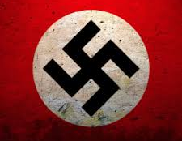
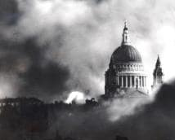
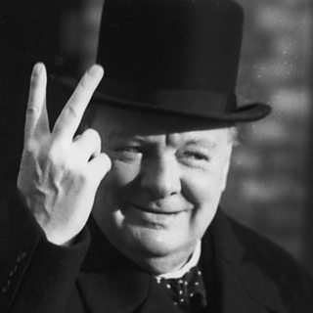
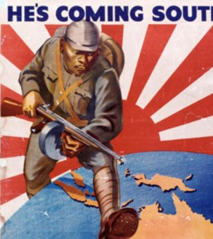
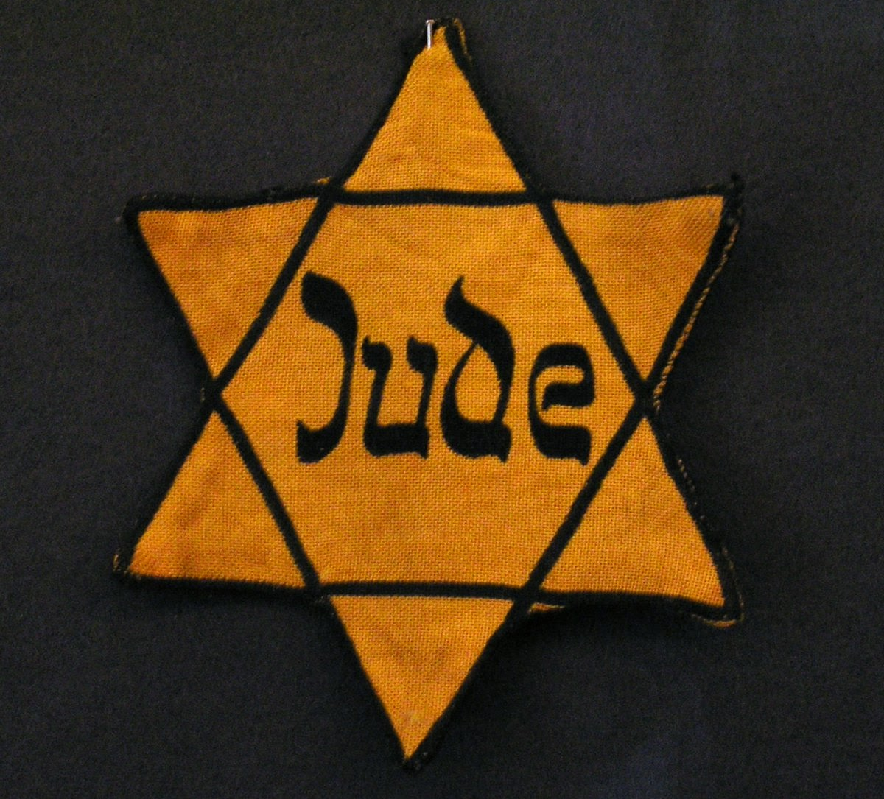
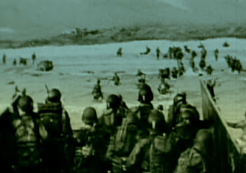
Click on each image to find out more.
TEATRES OF WAR
HOMEFRONT
CAUSES
MORE
TYPES OF WARFARE
HOLOCAUST
REVIEW + LEGACY
MAJOR EVENTS

Slide 4
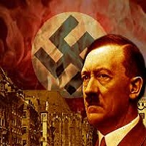
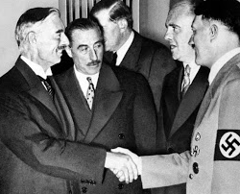
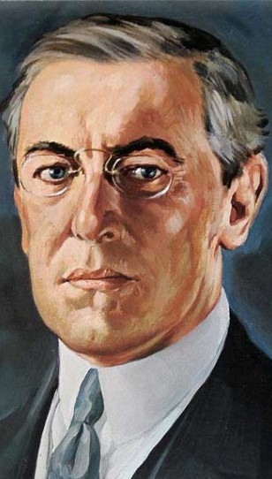
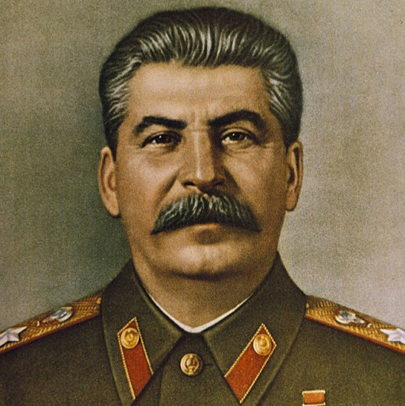
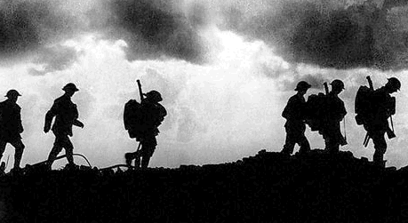
Starter … guess the causes of WW2
Click icon right to download free supporting resources Click on each image to find out more

Slide 5
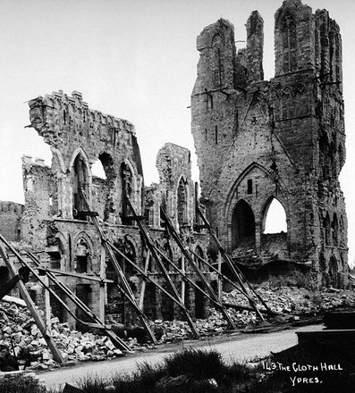
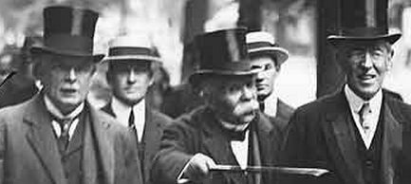
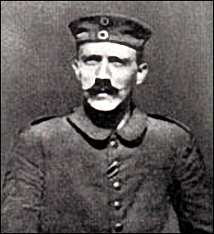
THE LEGACY OF WW1
FRANCE IN RUINS - 1918
The first World War was supposed to be the war to end all wars. Sadly, this was not true and the war did not solve many of the problems that caused it. Germany and France already had a great hatred for each other and the damage and destruction caused in France after Germany’s invasion only increased this hatred. Once the war was over, most Germans felt they were treated very unfairly under the terms set out in the Treaty of Versailles. Germany had to accept all the blame for the war, had large amounts of its territory taken away and the reparation terms crippled the German economy. This created enormous anger within Germany and led to distrust of the ‘peacemakers’ from other nations too. Adolf Hitler, an Austrian who fought in WW1 felt especially bitter about the loss and treaty.
THE PEACEMAKERS ?

Slide 6
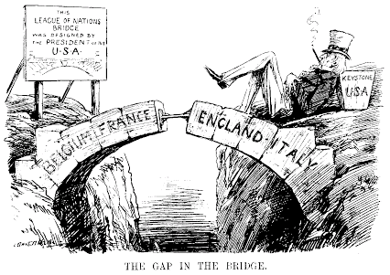
The Failure of the League
The League was the ‘brainchild’ of Woodrow Wilson. He believed that a League of Nations, guided by the principle of Collective Security, would stop another terrible war from happening again. Despite Wilson's dream, the U.S. Congress adopted a policy of isolationism and chose keep America out of the League. Without the leadership of Wilson and the power of the USA the League lacked direction. It did have some successes in the 1920’s but failed terribly after 1929. In 1935, the League stood by and allowed Italian leader, Mussolini, to get away with an attack on Abyssinia. The League was not taken seriously after this event and stopped being a deterrent to others.
MESSAGE ?

Slide 7
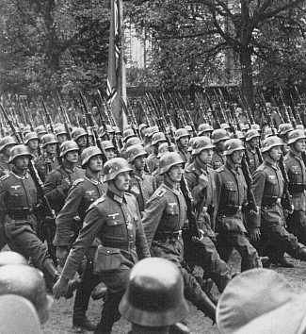
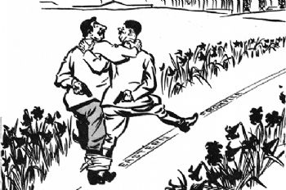
THE NAZI-SOVIET PACT
The NSNAP was a surprising agreement between sworn enemies Hitler of Germany and Stalin of the U.S.S.R. from This non-aggression pact opened the way for Hitler to invade Poland without fear of immediate Soviet attack. The Nazi invasion of Poland was the trigger for WW2.
.
MESSAGE ?
THE NAZIS ENTER POLAND –SEPTEMBER 1939

Slide 8
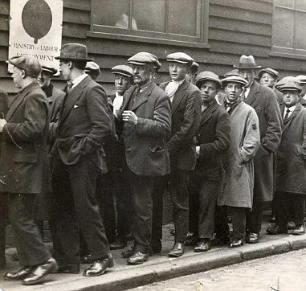
THE GLOBAL DEPRESSION
The Wall Street Crash marked the start of a Global Depression. This helped dictators such as Hitler come to power. Other countries including those in the League were too weak or too distracted with their own problems to stand against them.
ECONOMIES SUFFERED AND UNEMPLOYMENT ROSE
PEOPLE LISTENED TO RADICAL SOLUTIONS

Slide 9
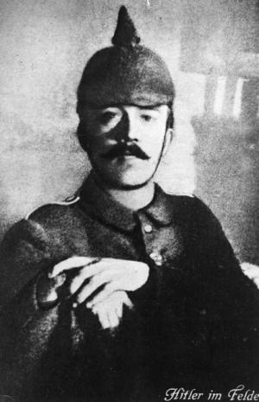
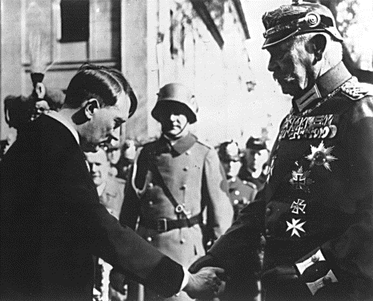
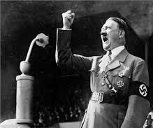
HITLER’S FOREIGN POLICY
Opening 20mins recommended
Fuelled by his anger at the loss of WW1 and the treaty of Versailles, Hitler sought revenge and to restore Germany to its former glory. Hitler had largely been ignored in Germany in the years after the war and seen as a hot-headed radical. However, once the depression hit Germany after 1929, Hitler’s ideas become more popular with the German people. Once he became Chancellor in 1933, Hitler repeatedly broke the Treaty of Versailles and pushed Europe to the edge of war.
FIERY ORATORY
HITLER DURING WW1
CHANCELLOR IN 1933

Slide 10
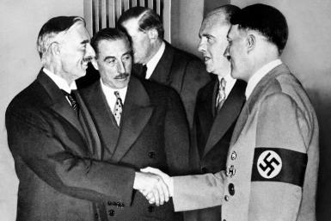
APPEASEMENT
Following the failure of the League to deal the Manchuria and Abyssinia invasions, Hitler gambled and marched German troops into the Rhineland in 1936. This was another break of the Treaty of Versailles. Germany was still relatively weak at this point compared to Britain and France but no action was taken. As Germany grew stronger and sensing a lack of will to stand against him , Hitler demanded the return of the Sudetenland in 1938. Britain did not want to go to war over the Sudetenland and after talks in Munich, Hitler was allowed to march troops into the Czech Sudetenland. Despite promising the Sudetenland was his ‘last territorial demand’ Hitler soon turned his attention towards Poland.
BRITISH PM NEVILLE CHAMBERLAIN FOLLOW A POLICY OF APPEASEMENT AND REARMAMENT

Slide 11
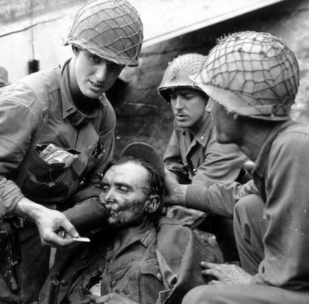
The HOLOCAUST

